Slide 1
PQS Surgery
Why complete PQS?
Where we were and where we are
The Gateway Criteria and the Domains
Roles included
Training
Helpful resources
Over to you

Slide 2
Where we were

Slide 3
Where we are

Slide 4
Overview of PQS Year 4 Gateway Criteria & Quality Criteria
Gateway Criteria
Quality Criteria
1
Risk Review
2
Access to palliative and end of life care
3
Safeguarding level 3
4
5
6
7
Domestic abuse prevention
Respiratory
Weight management
Antimicrobial stewardship
8
Cancer awareness training
1
2
Updated patient safety report, learning & actions
20 NMS between 1 April 2022 and 31 March 2023, which must be claimed for by 5 April 2023

Slide 5
Roles included

Slide 6
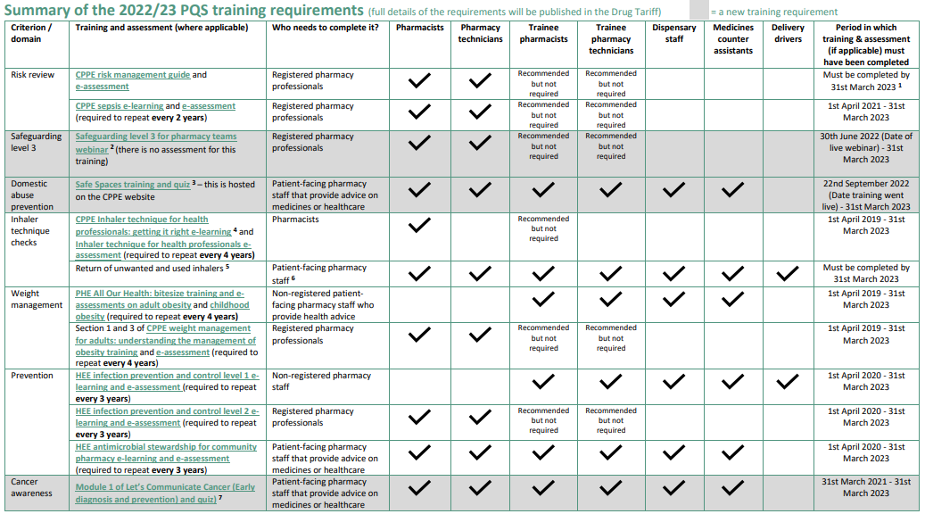

Slide 7
Helpful resources
PSNC website
PCN Leads
Contractor Clinic
CPPE & eLFH
NHSBSA PQS hub
PQS Surgery
Deadline Tracker
LPC website
PQS workbook

Slide 8
Over to you

