Slide 1
What’s new at CPPE?
Meera Joshi
CPPE East Midlands Regional Tutor & Education Supervisor
Notes:
Welcome
Introduce yourself

Slide 2
Supporting Community Pharmacists with PQS
CPPE offer learning and assessments to support you in achieving criteria relating to the following three domains in the 2022/2023 version of the scheme:
Risk management and safeguarding
Respiratory
Healthy living support
https://www.cppe.ac.uk/services/pharmacy-quality-scheme#navTop
Notes:
The Pharmacy Quality Scheme (PQS) forms part of the Community Pharmacy Contractual Framework (CPCF). It supports delivery of the NHS Long Term Plan and rewards community pharmacy contractors that deliver quality criteria in three quality dimensions: clinical effectiveness, patient safety and patient experience. You will find information about this year’s scheme on this page.
CPPE offer learning and assessments to support you in achieving criteria relating to the following three domains in the 2022/2023 version of the scheme:
Risk management and safeguarding
Respiratory
Healthy living support
For some of these domains, you may be required to complete learning from other providers. When this is the case, we provide a link to this learning.
We also provide links to the learning available from elearning for healthcare required to support you in achieving criteria in the Prevention domain.
There is a new requirement in the 2022/23 PQS that may mean that staff are required to repeat training and e-assessments that they have completed previously, depending on the stated validity period and when staff completed the training and e-assessments. We have developed this tracker to support you to quickly determine which CPPE learning programmes and assessments you have completed within the specified timeframe (if applicable).

Slide 3
Gateway criteria
Advanced services – New Medicine Service (NMS) https://www.cppe.ac.uk/services/nms#navTop
Antidepressants New Medicine Service pilot - https://www.cppe.ac.uk/services/anms-pilot#navTop
Patient safety report – access the patient safety learning gateway for resources to support with understanding of patient safety https://www.cppe.ac.uk/gateway/patientsaf

Slide 4
Domain 1 - Risk management and safeguarding
Risk review update
CPPE sepsis online training and passed the e-assessment.
CPPE risk management guide and passed the e-assessment.
Update of the previous risk review undertaken as part of the PQS 2021/22
Safeguarding level 3 webinar – via e-lfh
Domestic abuse prevention – via CPPE website
https://www.cppe.ac.uk/services/pqs/22-10/risk-management#psqMenu
Notes:
I will talk you through some of our new resources- listed above

Slide 5
Domain 2 - Respiratory
Inhaler technique checks
CPPE inhaler technique for health professionals: getting it right training e-learning and passed the current version of the Inhaler technique for health professionals e-assessment (updated 15th April 2020)
Inhaler waste management
Use of a spacer in patients aged 5-15 years
Personalised Asthma Action Plans (PAAP)
Referrals for patients using three or more short-acting bronchodilator inhalers without any corticosteroid inhaler in six months
Fundamentals of respiratory therapeutics e-course
Notes:
I will talk you through some of our new resources- listed above

Slide 6
Domain 3 - Healthy living support
Weight management
Sections one and three of the CPPE Weight management for adults: understanding the management of obesity e-learning and e-assessment.
Notes:
I will talk you through some of our new resources- listed above

Slide 7
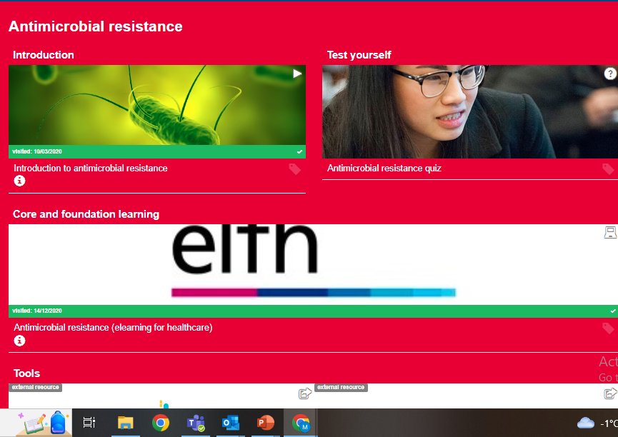
Domain 4 - Prevention
Antimicrobial stewardship
Infection prevention and control Level 1 and Level 2 e-learning and assessment on the elfh website
Antimicrobial Stewardship for Community Pharmacy e-learning and e-assessment (patient-facing staff).
https://www.cppe.ac.uk/gateway/amr
Cancer awareness
Let’s Communicate Cancer e-learning Module 1 can be accessed via elfh
https://www.cppe.ac.uk/gateway/cancer
Notes:
I will talk you through some of our new resources- listed above

Slide 8
Domain 5 - Addressing unwarranted variation in care
Palliative and end of life care action plan
Palliative care learning gateway: https://www.cppe.ac.uk/gateway/palliative
Fundamentals of palliative care e-course
https://www.cppe.ac.uk/programmes/l/palliative-ec-01
Notes:
I will talk you through some of our new resources- listed above

Slide 9
Clinical Audit
Focus on valproate, with the aim of reducing the potential harm caused by taking valproate during pregnancy.
Resources to support learning:
https://www.cppe.ac.uk/gateway/epilepsy
Pharmacy chosen audit
Quality improvement (QI): an introduction for pharmacy professionals e-learning and e-assessment
Notes:
I will talk you through some of our new resources- listed above

Slide 10
NHS Pharmacy Contraception Service (PCS)
The tiered approach will be as follows:
Tier 1 - Ongoing monitoring and supply of repeat oral contraception (OC) prescriptions
Core learning includes:
Safeguarding Level 2
CPPE emergency hormonal contraception e-learning and e-assessment
CPPE contraception including contraception and e-assessment
CPPE consultation skills in community pharmacy
CPPE Sexual health in pharmacies and e-assessment
Notes:
I will talk you through some of our new resources- listed above

Slide 11
Newly qualified pharmacist programme
The overall aim of the Newly qualified pharmacist programme is to support newly qualified pharmacists to develop, and demonstrate, confidence and competence in core areas of pharmacy practice.
Notes:
The overall aim of the Newly qualified pharmacist programme is to support newly registered pharmacists to develop, and demonstrate, confidence and competence in core areas of pharmacy practice. The programme is designed to support them to become better equipped to adapt and deliver safe and effective patient care at this pivotal stage in their career as they transition from a pre-registration trainee to a fully qualified pharmacist.
The 12-month programme, fully funded by Health Education England (HEE) as part of their Newly Qualified Pharmacist pathway takes a blended learning approach, offering a mix of online learning, workshops, assessment and work-based support through a designated CPPE education supervisor. The Newly qualified pharmacist programme will be a pharmacist’s first step in their post-registration professional development journey, and provides comprehensive learning to support pharmacists’ to demonstrate readiness to enrol on an Independent Prescribing (IP) training course.
The 2022-23 programme is for pharmacists employed or locuming in community pharmacy, primary care (except for those employed under the Additional Roles Reimbursement Scheme who will enrol onto PCPEP) or for pharmacists working in health in justice roles, who registered with the GPhC since 2020. Pharmacists who registered before 2020 and are returning from a career break or changing sector are also eligible to apply.
Cohort 4 – please check latest cohort information on the CPPE website
Applications open on: 02 January 2023
Applications close: 13 March 2023
Start date: 27 March 2023

Slide 12
Leading for change
Leading for Change is open to pharmacy professionals from all sectors of practice, including community pharmacy.
Aim: To enable you to develop the behaviours to become an inspiring and effective pharmacy leader
Notes:
Who is the course for?
Leading for Change is open to pharmacy professionals from all sectors of practice, including community pharmacy.
This fully funded leadership programme is open to anyone who has responsibility for leading a team or leading services within their organisation and would like to develop their skills further.
Course aims
The aim of the programme is to enable you to develop the behaviours required to become an inspiring and effective pharmacy leader, equipping you with the knowledge and skills to take on challenges effectively and lead in medicines optimisation to deliver better outcomes for your patients and service users.
Course format
The programme comprises four online modules delivered over six months:
Achieving your potential
Developing and managing services
Inspiring and achieving the best from your team
Pharmacy within the wider healthcare system
Each module is supported by a half-day online workshop, online discussion forums and a networking Zoom event to enable you to put your learning into practice and to allow you to network with fellow course participants. At the end of the programme you are required to submit an assignment to demonstrate how you have used your leadership skills over the course of the six months.
Course dates
There will be six cohorts of the programme running in 2023, starting in March, April and May.
There is a choice of workshop dates so that you can choose a cohort that works around your other commitments. You will need to attend all four workshops on the same day of the week to enable you to complete all parts of the programme with your online tutor and fellow cohort participants.
Full details of the all cohorts for 2023 can be found in the Course format and dates tab below.

Slide 13
Programmes for pharmacy technicians
Pharmacy technicians, enhancing your professional practice e-course
Accuracy checking pharmacy technician (ACPT) programme
Notes:
The Pharmacy technician impact groups and Myers Briggs Type Indicator® (MBTI®) online workshop for pharmacy technicians form our exciting new programme of learning for pharmacy technicians, and complement our Pharmacy technicians: enhancing your professional practice e-course.

Slide 14
Pharmacy technicians e-course
Recognising the evolving role, the aim of the Pharmacy technicians: enhancing your professional practice e-course is to support pharmacy technicians to recognise how their skills, knowledge, understanding and professional behaviours allow them to provide safe and effective care to the people they serve.
Notes:
The aim of this self-directed e-course is to support pharmacy technicians to recognise how their skills, knowledge, understanding and professional behaviours allow them to provide safe and effective care to the people they serve, as the pharmacy technician role continues to evolve.
Learners will complete a self-assessment framework to help identify personal learning needs and that will direct them to specific elements of this e-course that will help to meet them.
It is a self-directed e-course which means that you can work through the course at a time and pace that suits.
The programme will help to build evidence showing how their development has enabled them to meet updated learning outcomes from the GPhC 2017 Standards for the initial education and training of pharmacy technicians.

Slide 15
Accuracy checking pharmacy technician (ACPT)
The CPPE Accuracy checking pharmacy technician (ACPT) programme aims to support pharmacy technicians to:
develop the skills required to be a safe final accuracy checking pharmacy technician
improve leadership skills to direct the dispensary team
support the multi-disciplinary team to deliver patient-facing services.
Payment for this course can be made by you or your employer: the total cost for a place on the course is £330 including VAT.
The ACPT programme is open to pharmacy technicians who are registered with the General Pharmaceutical Council (GPhC), work in a premises in England and who meet the entry criteria. You can check the entry criteria here.
So far, over 1000 pharmacy technicians working in community, hospital and secure environment sectors have been supported by the CPPE ACPT programme to become final accuracy checkers.

Slide 16
New resources for community practice
Hypertension focal point workshop and resources to support the case-finding service
Preparing for community practice e-course
Coming soon: Familial hypercholesterolaemia - focal point and Supporting people living with frailty
Notes:
Hypertension case finding service webpage
The CPPE website has a dedicated page to provide support for pharmacy teams preparing to deliver the Hypertension case finding service;
You will find an outline of the training requirements for the service, as described in the service specification, and signposting to a selection of further learning resources that you can use to support your delivery of this service.
Self-assessment framework
Depending on your existing level of knowledge and experience, you may wish to undertake further learning. To help you to direct your learning, we have developed a self-assessment framework – completing this framework is not a requirement, however it can be used as a tool to help you direct your own learning. Once you have completed the self-assessment, you can visit the topic area(s), listed below, which are relevant to your personal learning needs.
Understanding hypertension and measuring blood pressure
Understanding vascular risk
Behaviour change interventions
Further resources include the following;
CPPE Vascular risk and the NHS health check programme e-learning
CPPE Hypertension fact sheet
CPPE Cardiovascular fact sheet
Hypertension focal point workshops
A number of online Hypertension workshops are currently available. This learning programme aims to enable you to interpret and apply clinical guidance to support people with hypertension. You will consider how to optimise their treatment and use a shared decision-making approach to empower people with hypertension to self-manage their condition.
Further information and workshop dates can be accessed via the link below;
https://www.cppe.ac.uk/programmes/l/hyper-ew-01
Preparing for community practice e-course
The aim of this course is to build the confidence and competence of pharmacy professionals who are starting to work in community practice for the first time. This includes pharmacy professionals that have just qualified and those moving to community pharmacy practice for the first time from another sector.
To help you reflect on your confidence and competence, you will work through the Preparing for community pharmacy self-assessment framework. Completing the self-assessment framework at the start of the programme helps you identify the key topics you need to learn more about to develop your knowledge and skills in preparation for starting practice.

Slide 17
Over-the-counter desogestrel progestogen-only pills case study
The desogestrel progestogen-only pill has been available over the counter (OTC) in pharmacies since 2021.
To help you provide person-centred care and shared decision making when selling this medicine, we have developed the short e-learning programme Over-the-counter desogestrel progestogen-only pills case study.

Slide 18
Safeguarding case studies e-learning
The aim of this programme is to support you to apply underpinning safeguarding knowledge and develop the confidence and skills to identify and report safeguarding concerns you encounter in practice.
Notes:
The aim of this programme is to support you to apply underpinning safeguarding knowledge and develop the confidence and skills to identify and report safeguarding concerns you encounter in practice. This programme is not sufficient on its own to meet the nationally set mandatory safeguarding training requirements. It can be used to further your learning and enable you to consider how you can take a person-centred approach to safeguarding and understand how you can meet your safeguarding responsibilities in whichever area(s) of practice you work.
The programme includes six case studies that guide you through challenging scenarios that raise safeguarding concerns and provide practical tips as well as suggested words and phrases you can use to deal with similar scenarios in practice.

Slide 19
Controlled drugs in chronic pain e-learning
The aim of this e-learning programme is to support you to develop the knowledge, skills and behaviours to support patients to use prescribed controlled drugs safely and effectively, with a focus on controlled drugs used in chronic pain.
Notes:
The aim of this e-learning programme is to support you to develop the knowledge, skills and behaviours to support patients to use prescribed controlled drugs safely and effectively, with a focus on controlled drugs used in chronic pain. It will allow you to explore the risks, challenges and consequences associated with a growing use of prescribed controlled drugs, and how to apply a shared decision-making approach to discussions involving controlled drugs.

Slide 20
Menopause learning gateway
The Menopause learning gateway provides core and foundation learning, assessments, and other resources to increase your understanding of the menopause and perimenopause.
www.cppe.ac.uk/gateway/menopause
Notes:
The Menopause learning gateway provides core and foundation learning, assessments, and other resources to increase your understanding of the menopause and perimenopause. The gateway contains information on the symptoms people can experience during menopause and perimenopause, and the possible treatment options and lifestyle changes that can be offered to support people and help them manage their symptoms.
If you have wifi access and time you could play the introductory video on the menopause learning gateway page Menopause (cppe.ac.uk)

Slide 21
www.cppe.ac.uk
info@cppe.ac.uk
0161 778 4000
Follow us on Twitter, Facebook, LinkedIn and YouTube:
www.twitter.com/cppeengland
www.facebook.com/cppeengland
www.linkedin.com/company/centre-for-pharmacy-postgraduate-education
www.cppe.ac.uk/youtube

