Slide 1
Nisha Badwal Healthcare Development Manager

Slide 2
This meeting has been supported by Scope Ophthalmics Ltd.

Slide 3
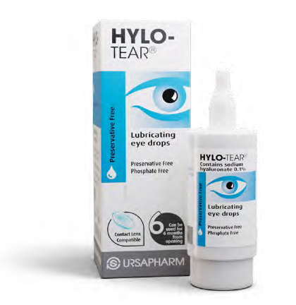
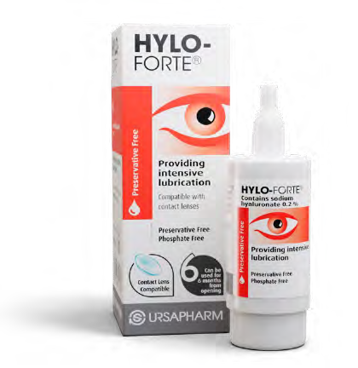
Scope relies on trusted global supply chains to ensure guaranteed access to our products.
For over a decade, Scope has been a trusted supplier of market-leading preservative-free dry eye lubricants to the UK.
Scope’s strong healthcare heritage and innovative products continue
to positively impact
patients’ quality of life.
Scope Eyecare
Scope products are manufactured to the highest standards under strict EU and UK regulations.
Scope provides education and support to HCPs and patients. Keep an eye out for our events and webinars.
EU: European Union; HCP: healthcare professional; UK: United Kingdom.

Slide 4
Scope Products Non Medicine

Slide 5
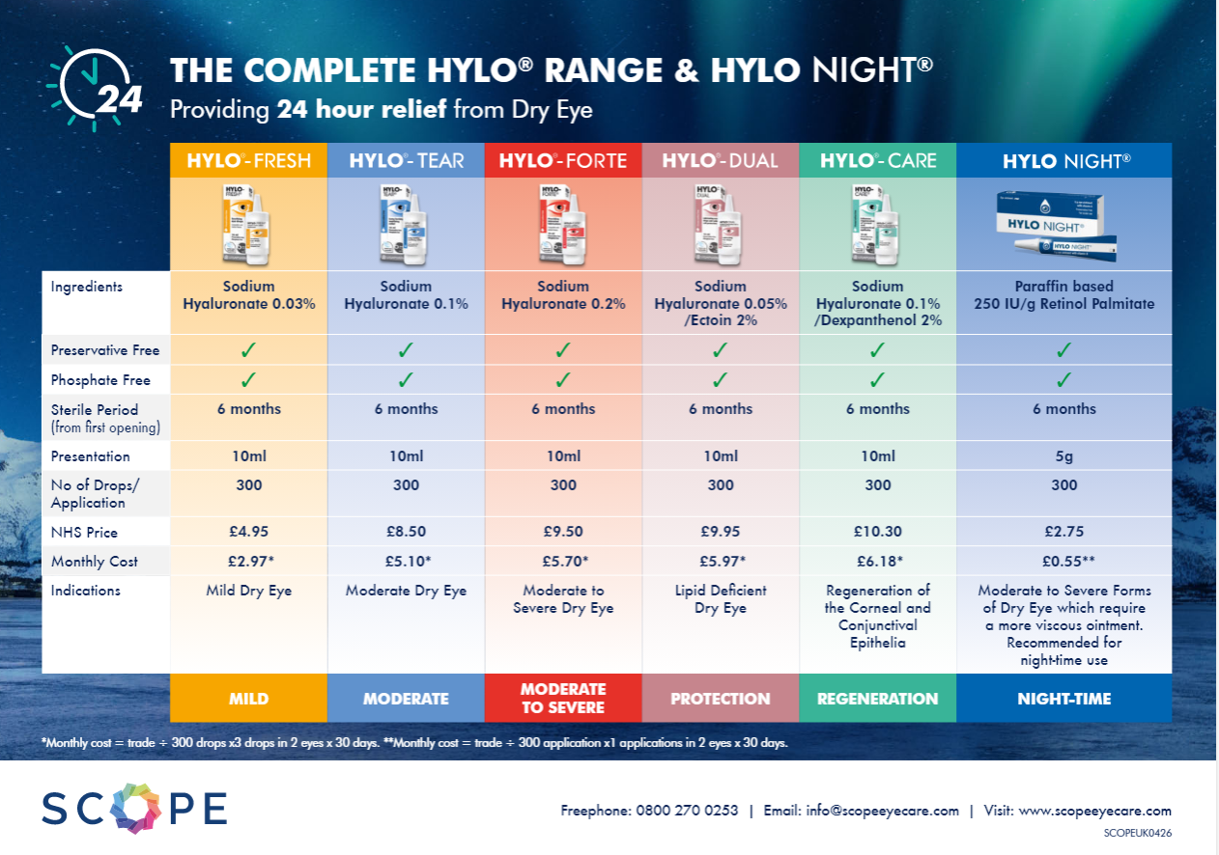

Slide 6
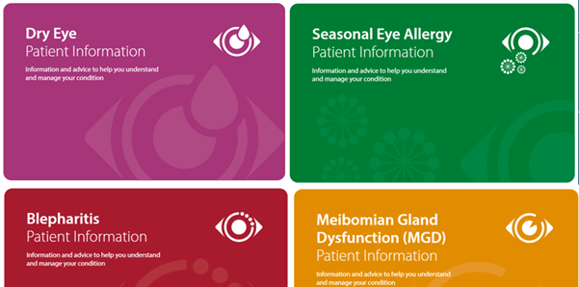
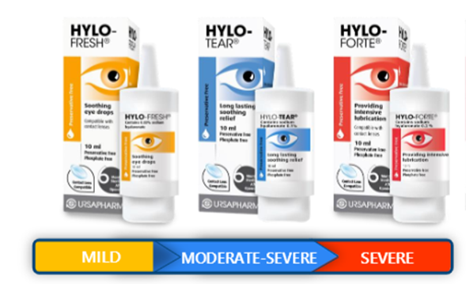
Healthcare Development Manager:
Nisha Badwal
E: nishabadwal@scopeeyecare.com
T: 07930 469981
Thank You

