Slide 1
Community Pharmacy Open House Surgery Rajshri Owen Chief Officer

Slide 2
Welcome Relaunch You said we did Poll via WhatsApp group (*If you are not on the WhatsApp group get in touch)

Slide 3
Agenda Updates from Community Pharmacy Leicestershire and Rutland – regional and national Workstreams – regional and national Hear from you-Tell us what is important to you/ matters arising

Slide 4
Updates

Slide 5
Review Steering Group (RSG)
LPCs have been undergoing changes to respond to the Review Steering Group (RSG) recommendations on pharmacy representation.
The sector voted in favour of the RSG proposals in the summer of 2022, and since then progress has been made on many of the changes at both local and national level as part of the Transforming Pharmacy Representation (TAPR) Programme.
Over the last year-18 months, LPCs have considered the following and sought approval from pharmacy owners at a local level to:
Consider boundary and size, where possible more closely aligning with the local NHS;
Reduce LPC committee sizes to a range of 10-12 members whilst maintaining local proportional representation;
Meet the future Community Pharmacy England levy through efficiencies;
Adopt a new updated model constitution to strengthen governance and focus levy funded activity; and
Rebrand to be known as ‘Community Pharmacy <Local>’, where ‘local’ represents a description of an area or location

Slide 6
Review Steering Group (RSG)
We met all
RSG recommendations
before they were announced
LPCs have been undergoing changes to respond to the Review Steering Group (RSG) recommendations on pharmacy representation.
The sector voted in favour of the RSG proposals in the summer of 2022, and since then progress has been made on many of the changes at both local and national level as part of the Transforming Pharmacy Representation (TAPR) Programme.
Over the last year-18 months, LPCs have considered the following and sought approval from pharmacy owners at a local level to:
Consider boundary and size, where possible more closely aligning with the local NHS;
Reduce LPC committee sizes to a range of 10-12 members whilst maintaining local proportional representation;
Meet the future Community Pharmacy England levy through efficiencies;
Adopt a new updated model constitution to strengthen governance and focus levy funded activity; and
Rebrand to be known as ‘Community Pharmacy <Local>’, where ‘local’ represents a description of an area or location

Slide 7
Model Timeline for change
Transformation explainer events for LPCs 13th September
Transformation Toolkit part 1 published 14th September
Employment matters portal launched 16th September
Engagement with neighbouring LPCs to discuss boundaries - ongoing
Representatives of LPC Conference 22nd September – levy and constitution discussions
Indicative levy amounts for 2023/24 and beyond published
LPCs meet to begin discussing the main questions
Development of a proposal for the committee
LPC meeting to discuss and agree boundaries, name, size
Prepare materials for contractors and engagement plan to explain rationale for the new LPC model constitution, any boundary changes, proposed mergers and extension to the term of office to 30 June 2023
Give notice of special meeting of contractors
Hold special meeting of contractors with resolutions on model constitution and 3-month delay of current LPC term and then declare the results, inform NHS England and CPE of existing LPC, new LPC, merged LPC or small changes to boundaries
Develop implementation plan and prepare for LPC elections, nominations
Move to implementation phase to include consulting with employees, financial convergence
Existing terms of office end
New LPC term of office begins, other operational changes – rebranding and websites
September 2022
October 2022
November/December
2022
January 2023
February 2023
April – June 2023
July 2023
CPCF year 5 begins
ICBs live with delegated commissioning

Slide 8
New Committee
Name | Organisation | Elected or appointed by
Shoaib Haji | Countesthorpe Chemist | Independent
Altaf Vaiya | Alpharm Chemist | Independent
Nayan Chauhan | Medicine Chest | Independent
Kishan Kotecha | Medicare Pharmacy | Independent
Nadya Jethwa | Bosworth Pharmacy | Independent
Satyan Kotecha | Saraj Chemist | Independent
Rahul Patel | BMP Healthcare | Association of Independent Multiples (AIM)
Viral Patel | Boots | Company Chemists Association (CCA)
Ron Gregson | Boots | Company Chemists Association (CCA)
Shezad Alimahomed | Boots | Company Chemists Association (CCA)
Constitution
1st July 2023
10 members
6 Independent
1 Aimp
3 CCA
LPC Committee – Community Pharmacy Leicestershire and Rutland
Notes:
SGM last year – you voted in following Wright review
Triggered the election process
Committee a few weeks ago completed an induction afternoon with me and the Exec to help them settle and adapt in to their new role

Slide 9
Updates NEW BRANDING
New name
Vibrancy
Collaboration
Aligned to NHS and CPE

Slide 10
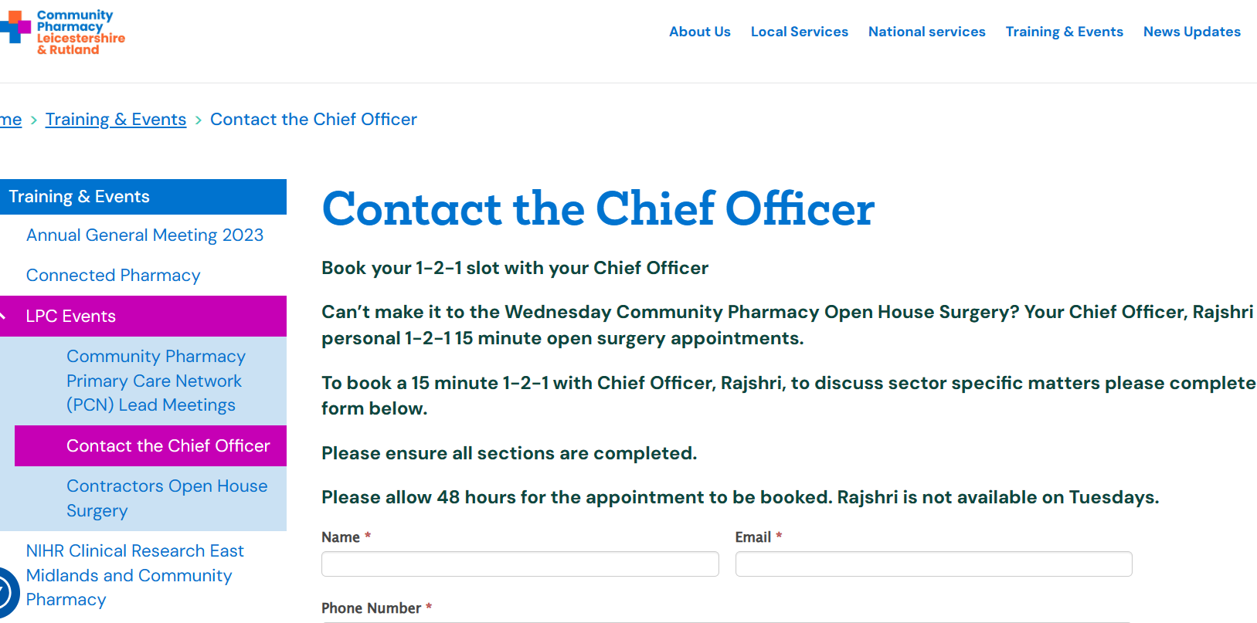
Updates: NEW WEBISTE: Community Pharmacy Leicestershire and Rutland – Community Pharmacy Leicestershire and Rutland
Fresh new layout & content
NEW feature – Contact the Chief Officer for a 15 min
1-2-1
To discuss
sector issues
e.g., Contracts/ Workforce / Complaint / Query.
It will be a 15 min conversation with myself

Slide 11
Social Media- FOLLOW US !
Facebook
Leicestershire & Rutland Community Pharmacy | Leicester | Facebook
Instagram
Community Pharmacy Leicestershire & Rutland (@communitypharmaciyllr) | Instagram
LinkedIn
https://www.linkedin.com/in/community-pharmacy-leicestershire-and-rutland-577723276

Slide 12
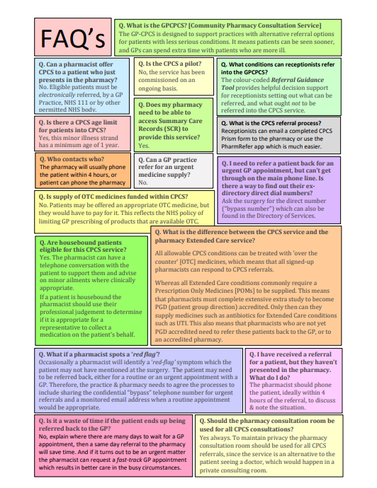
Updates
Community Pharmacist Consultation Service (CPCS) – Community Pharmacy Leicestershire and Rutland
CPCS Toolkit

Slide 13
Delivery plan for recovering access to primary care (PCARP)
On 9th May 2023, the Government and NHS promised a £645m investment in community pharmacies over the next two years to support a pharmacy common conditions service, along with expansion of the NHS Pharmacy Contraception and NHS Hypertension Case-Finding services.
Expand pharmacy oral contraception (OC) and blood pressure (BP) services this year, to increase access and convenience for millions of patients, subject to consultation. (31st Dec 2023)
Launch Common Conditions Service (CCS) formerly known as Pharmacy First so that by end of 2023 community pharmacies can supply prescription-only medicines for seven common conditions. (31st Dec 2023)
Uncomplicated UTI / Shingles / Impetigo / Sinusitis / Infected insect bites / Acute otitis media/ Sore throat
This, together with OC and BP expansion, could save 10 million appointments in general practice a year once scaled, subject to consultation.

Slide 14
Delivery plan for recovering access to primary care (PCARP)
Pharmacy
• Launch Common Conditions Service (formerly Pharmacy First) by end of 2023 By 31 Dec 2023
• Expand Blood Pressure and Oral Contraception services this year By 31 October 2023
• Increase pharmacy flexibility (on supervision, PGDs, POM to P, and hub and spoke)*
(subject to parliamentary timetables)
Digital
• Develop and deliver interoperable digital solutions between pharmacy and general practice
By 31 October 2023

Slide 15
Workstreams

Slide 16
AGM planning
Hybrid event (F2F and online)
Also looking at incorporating training in to the AGM for the first time

Slide 17
Workstreams
PQS Drug Tariff Part VIIA PQS 27042023_0.pdf (nhsbsa.nhs.uk)
BP Check Service
Reduced Year 5 Community Pharmacy Contractual Framework (CPCF) PQS scheme launched on 1 June 2023.
1 gateway criterion NMS
3 domains Medicines Optimisation, Respiratory and Prevention
Webinar planned in Sept
Tailored training
ABPM poll on whatsapp
PRN00173-Advanced-service-specification-NHS-community-pharmacy-hypertension-case-finding-advanced-service-vers-1.pdf (england.nhs.uk)
Pharmacist, or pharmacy technician

Slide 18
Meeting with Novo nordisk TODAY - Ozempic supply issues
Subject: Urgent Issue with Ozempic Stock and Request for Support
Chair, Altaf Email sent to MHRA and CPE
Chief Officer –ICB and ICS
Raised issues around unfair distribution, communication for CP, GPs , Patients and ICB
Pulling together financial impact of inflated procurement pricing on average pharmacy to support DoH and Govt consultation
Ozempic 1mg solution for injection supply issue updated SPS guidance- further update later today
Glucagon-like peptide-1 (GLP-1) analogues act as GLP-1 receptor agonists.
Prescribing available GLP-1 receptor agonists – SPS - Specialist Pharmacy Service – The first stop for professional medicines advice

Slide 19
Local workstreams
Locally commissioned services
MP engagement
NRT voucher scheme
EHC County PGD updating
Shared Care Records
Parliamentary drop in session 10th July with CPE
Sent emails and invitations to
Jon Ashworth
Liz Kendell
Neil o'brien
Claudia Webbe

Slide 20
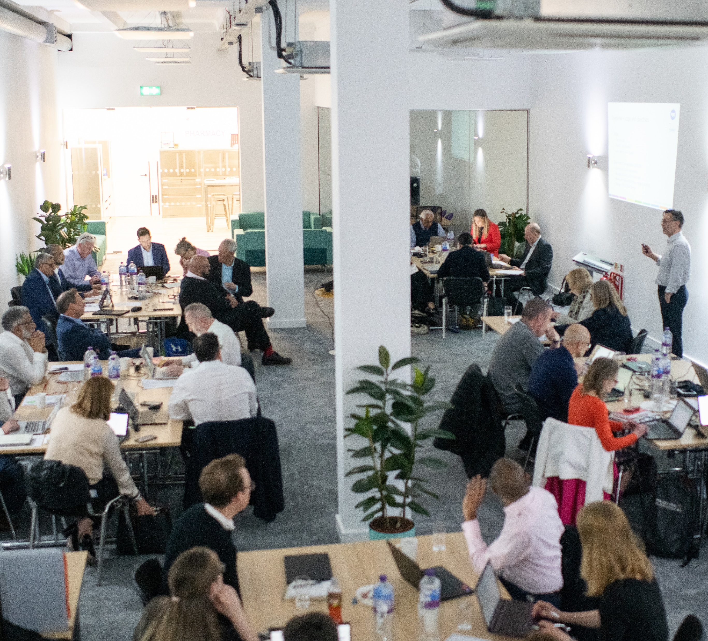
Questions & Discussion

