Slide 1
Controlled Drugs in Community Pharmacy
Presented by: NHSE Central Midlands CDAO Team & Turning Point
Notes:
Standard title slide

Slide 2
Objectives
To introduce the role of an NHS England Controlled Drugs Accountable Officer (NHSE CDAO)​
How to report CD incidents to the NHSE CDAO​
CD destructions
Current Issues​/themes
Common incidents reported by community pharmacies
Update from Turning Point
Q&A

Slide 3
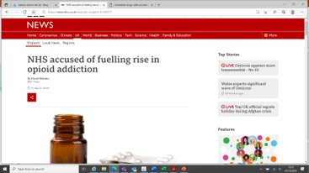
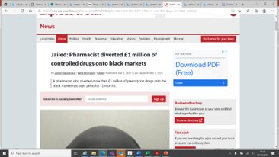
Why do we need to be vigilant?
Shipman Inquiry - GOV.UK (www.gov.uk)
The Government response to the report of the Gosport Independent Panel (publishing.service.gov.uk)
NHS England » Faye’s story: good practice when prescribing opioids for chronic pain
Notes:
Plain slide with subhead and bullets

Slide 4
The Controlled Drugs (Supervision of Management and Use) Regulations
The Regulations came into force in England on 1st April 2013 and have subsequently been updated to The Controlled Drugs (Supervision of Management and Use) (Amendment) Regulations 2020.
NHS England CDAOs have a statutory duty to ensure that safe systems are in place for the management and use of controlled drugs. This is to prevent harm to patients and staff from any misuse of controlled drugs.
Notes:
NHS England has a statutory duty to ensure that safe systems are in place for the management and use of controlled drugs. This is to prevent harm to patients and staff from any misuse of controlled drugs.
Controlled Drugs are drugs that are subject to high levels of regulation as a result of government decisions about those drugs that are especially addictive and harmful.
The Controlled Drugs (Supervision of Management and Use) Regulations were introduced as part of the Government’s response to the Shipman Inquiry’s Fourth report in 2004.
The aim of these regulations was to strengthen the governance arrangements for the use and management of Controlled Drugs. Controlled Drugs (CDs) are essential to modern clinical care. As such, it is essential that NHS England enforces robust arrangements for the management and use of CDs to minimise patient harm, misuse and criminality.
As a consequence of passing the Health and Social Care Act 2012, the 2006 regulations have been revised to reflect the new architecture in the NHS in England. The Controlled Drugs (Supervision of Management and Use) Regulations 2013 came into force in England on 1 April 2013.
These regulations require NHS England and other ‘designated bodies’ such as NHS trusts, Hospices, Private and Independent Hospitals to appoint Accountable Officers for Controlled Drugs and requires those Accountable Officers to ensure safe systems are in place for the management and use of controlled drugs.
Healthcare professionals have a statutory duty to report all complaints, concerns or untoward incidents involving controlled drugs to the CDAO. Non-Designated Bodies such as community pharmacies, GP practices, care homes, drug and alcohol services and others report CD incidents to the regional NHSE CDAOs
The NHSE CDAOs have additional local responsibility for the following:
Establishing and leading the Local Intelligence Networks (LINs) for their local geography. The LIN will be drawn from representatives of designated and responsible bodies.
Convening incident panels. The LIN must have a transparent process for establishing an incident panel if serious concerns are raised. The process should outline the responsibilities of key individuals and how the panel should be called together.
Analysing NHS and private prescribing of CDs using Prescribing Analysis Reports provided by NHS Business Services Authority (NHSBSA).
Ensuring their organisation operates arrangements for periodic inspections of premises used in connection with the management or use of CDs which are not subject to inspection by other regulatory bodies such as the CQC or GPhC.
Ensuring adequate steps are taken to protect patients and the public if there are concerns about inappropriate or unsafe use of CDs by a person who is not providing services for any designated body, but who provides services in the LIN area.
Promoting good prescribing practice in relation to CDs. This will include strategies to improve the safety of prescribing of CDs, to increase the levels of incident reporting from primary care in relation to CDs and to reduce the harms to patients exposed to CDs, working in conjunction with the NHSE patient safety team.

Slide 5
CD Reporting Portal (CDRP)
www.cdreporting.co.uk
Notes:
The NHSE Midlands Controlled Drugs Accountable Officer (CDAO) Team have been using the online CD reporting portal (CDRP) for a number of years. The CDRP is a national platform which is used by all NHSE regional CDAO teams, all modules of the CDRP have been agreed on by the national CDAO network.
The CDRP has undergone a major update and was relaunched in December 2022. Part of this review and update has been to align the CDRP to the new national NHS service for recording and analysis of patient safety events that occur in health care, Learn from Patient Safety Events (LFPSE). The Portal has 5 different modules available:
Incidents repots
Concern reports
Occurrence Reports
Destruction requests
Declarations
The portal is used as the main platform for reporting incidents and concerns by non-Designated Bodies. Designated Bodies are able to submit Quarterly Occurrence Reports. GP surgeries and Pharmacies are able to request a destruction request for obsolete and out of date Sch 2 CD stock. Finally, we have a declaration module which is used for GP’s, Dentist and other private prescribers to provide reassurance around CD governance to the CDAOs.

Slide 6
CD Destructions
Basics
Have SOPs in place and train all your key team members
Make sure you have a T28 for your premises - T28 waste exemption: sort and denature controlled drugs for disposal - GOV.UK (www.gov.uk)
Use CD destruction kits to denature CDs – Schedule 2, 3, 4 (part1)
Read instructions prior to use
Maintain robust records
Destruction should involve a witness (usually a registered professional) and another person destroying CDs
Keep up to date with destructions
Notes:
PB
Keep up to date to prevent diversion, build up of CDs – which can impact patient safety and service provision, protects you staff.

Slide 7
CD Destructions
Patient Returned CDs
Pharmacies cannot accept CD returns from nursing homes
Good practice to keep a record of returned CDs and their destruction– separate to CD Register
You do not require an Authorised Witness (CDAO designated AW/ GPhC inspector/CDLO) to destroy these CDs.
Destruction can be completed by pharmacy team (witness & person destroying)
Safe custody of schedule 2 and 3 CDs must be maintained, unless exempt.
Segregate in CD safe – clearly marked as patient returns
Notes:
PB

Slide 8
CD Destructions
Expired/obsolete CD Stock – Schedule 2 CDs
It is a legal requirement to have an Authorised Witness (CDAO designated AW/ GPhC inspector/CDLO) to destroy CDs
Not a Body Corporate – submit an Authorised Witness (AW) destruction request via online CD portal
Body Corporate – follow organisational SOP
Safe custody should be maintained, CDs should be segregated and clearly marked
Out of Date (OOD) stock should be entered into CD register and included in balance checks
An entry is made into the CD register at the time of destruction
(Schedule 3 and 4 can be destroyed by pharmacy staff with witness and person destroying)
Notes:
PB
Explain BC – pharmacy business with 5 or more branches
If you are BC and would like to have AWs – please contact our team via the generic email

Slide 9
Current Issues/Themes in Community Pharmacy
CPCS
Fraudulent activity
Monitoring (5 days’ supply)
Diversion of CDs
Complete CRB checks
Check your stock levels
Attempts to get hold of codeine linctus and Phenergan liquid
Fraudulent prescriptions
Healthcare professionals
Patients adding CDs, changing quantities to existing prescriptions
Stolen FP10s used to order CDs
Private prescriptions for codeine
Notes:
Amit

Slide 10
Common Themes for Community Pharmacy Incidents
Balance discrepancies
Dispensing errors
Quantity errors
LASA drugs
Modified release vs immediate release
FP10 MDA instalment prescriptions
Home Office Appropriate wording and dates
Lost prescriptions – postal service, at branch
Communication – WhatsApp Groups for non-confidential urgent messages
3-day rule
Titration dose rule
Notes:
PB
Balance discrepancies due to locum staff, no access to e-registers, irregular balance checks
28 day and 30 day pack sizes

Slide 11
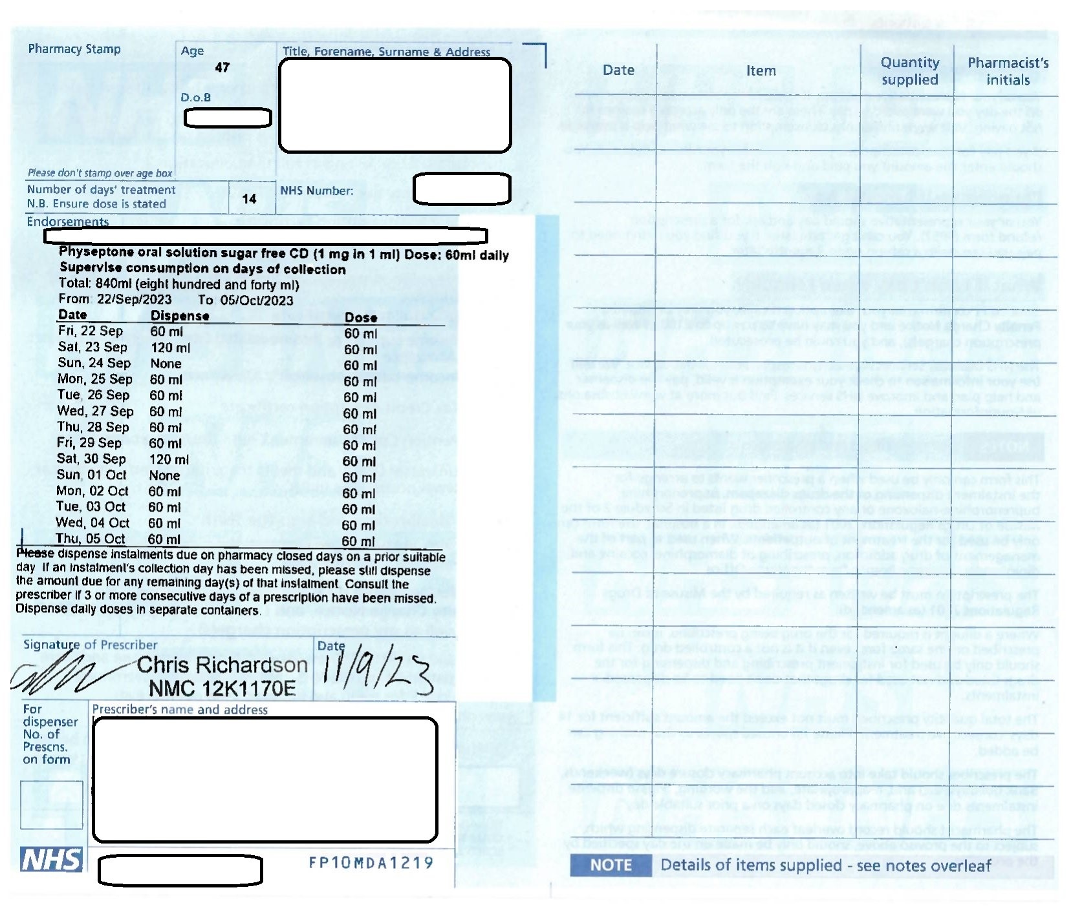
Home Office Approved Wording
Includes Bank Holiday’s, planned and unplanned pharmacy closures

Slide 12
Appropriate Date
What is the Appropriate Date?
“The later of the date on which it was signed by the person issuing it or the date indicated by him as being the date before which it shall not be supplied”

Slide 13
Lost Prescriptions
Prescriptions are posted via tracked Royal Mail
Check the contents of the envelope and notify Turning Point if there are any discrepancies or missing prescriptions
Return the receipt to Turning Point
If a prescription cannot be found information Turning Point who can check the postal tracker
If the prescription is missing in the post Turning Point will notify the CDAO and generate a replacement prescription
If the prescription is showing as being received at the pharmacy the pharmacy will be asked to double check the prescription cannot be found and asked to notify the CDAO before a replacement is issued

Slide 14
Communication
Direct dial contact for Turning Point’s Leicester Hub: 0116 373 2108
WhatsApp with the Turning Point Pharmacist is available for non-confidential urgent messages
“Please can you call ABC Pharmacy, I need to discuss a client who has presented to us”

Slide 15
Missed collections
During Titration
Do not dispense the prescription
Contact Turning Point
The risk of death during methadone induction has been calculated at nearly seven-fold greater than the paient’s risk of death prior to entering methadone maintainence treatment. Deaths usually occur during the first 3-10 days of treatment.
After titration
ONE DAY MISSED: Indicate on the prescription and on NEO360 “not dispensed” next to the relevant date
THREE CONSECTUIVE DAYS MISSED:
Do not dispense the prescription
Contact Turning Point
Note any discussions with Turning Point on the PMR
FOUR NON-CONSECUTIVE DAYS IN A 2 WEEK PERIOD
Dispense the prescription
Inform Turning Point

Slide 16
Case Study – Methadone Collection by Patient’s Rep
Situation
A patient’s relatives collected methadone on behalf of the patient due to health problems, a quantity of over 5000ml involved, no confirmation patient received it. (3.5 months)
The patient did not engage with Drug and Alcohol Service and the key worker did not have any communication with them.
Pharmacy supplied methadone to the patient’s relatives as reps were presenting signed notes every day.
Allegedly the patient was outside the country, the relatives were collecting the medication and they claimed it was being sent abroad to the patient.
On return to the UK the patient was admitted to hospital where, during the medicines reconciliation process, the Pharmacy were contacted to obtain information on the Methadone dosing and the case came to light

Slide 17
Case Study – Methadone Collection by Patient’s Rep
Actions
Pharmacy contacted the Drug and Alcohol Service notifying them the patient was in hospital, patient’s prescriptions were voided, and the methadone supply stopped
Pharmacy and Drug and Alcohol Service reviewed their processes
Drug and Alcohol Service contacted the patient to discuss the incident and contacted the hospital to verify if they had patient’s own methadone
Police made aware of the incident

Slide 18
Case Study – Methadone Collection by Patient’s Rep
Outcomes
Further discussions with patient and the patient’s representative, a total of 910mls of methadone was returned to the pharmacy for disposal.
The Pharmacy team reviewed the Service Level Agreement (SLA) between the Pharmacy and the Drug and Alcohol Service, and re-read the Standards Operating Procedure (SOP) for substance misuse dispensing.
The Drug and Alcohol Service reviewed internal processes to ensure approval by the prescribing team is obtained by the patient’s key worker for a patient’s representative to collect medication.

Slide 19
Case Study – Methadone Collection by Patient’s Rep
Learnings
Appropriate members within a Pharmacy should be aware of the SLA in place with Drug and Alcohol Services and ensure they have all read and understood the process for substance misuse patients.
All conversations between Pharmacies and Drug and Alcohol Services about a patient should be documented in the patient’s records.
Requests for medication to be collected by a patient’s representatives should be time limited.
Pharmacies should double check with Drug and Alcohol Services every time a patient’s medication is requested by a representative. This should include how long the arrangement is in place for and if there are other factors that need to be considered, for example, health problems which need discussing at multi-disciplinary team (MDT) meetings.
If a patient is sending a representative to collect their medication on a regular basis, the patient should be contacted by their healthcare professional (e.g. key worker, prescriber or pharmacist) to ensure that they are receiving and taking their medication as prescribed. This can mitigate concerns regarding reduced tolerance, inappropriate drug use and increased overdose risk.

Slide 20
Thank you
england.centralmidlands-cd@nhs.net
mohammed.shaikh@turning-point.co.uk

