Slide 1
Community Pharmacy Open House Surgery Sept 2023 Rajshri Owen Chief Officer

Slide 2
Welcome Join us on social media Facebook Leicestershire & Rutland Community Pharmacy | Leicester | Facebook Instagram Community Pharmacy Leicestershire & Rutland (@communitypharmaciyllr) | Instagram LinkedIn https://www.linkedin.com/in/community-pharmacy-leicestershire-and-rutland-577723276 (*If you are not on the WhatsApp group, get in touch chiefofficer@leics-lpc.co.uk add mobile in chat)

Slide 3
Agenda 1. Updates from Community Pharmacy Leicestershire and Rutland 2. Workstreams – regional and national 3. Shared care records Laura Godtschalk, LLR Care Record Programme Manager Sandra Taylor, LLR Care Record Benefits and Change Manager Hear from you-Tell us what is important to you/ matters arising

Slide 4
Updates

Slide 5
New Committee
Name | Organisation | Elected or appointed by
Shoaib Haji | Countesthorpe Chemist | Independent
Altaf Vaiya | Alpharm Chemist | Independent
Nayan Chauhan | Medicine Chest | Independent
Kishan Kotecha | Medicare Pharmacy | Independent
Nadya Jethwa | Bosworth Pharmacy | Independent
Satyan Kotecha | Saraj Chemist | Independent
Rahul Patel | BMP Healthcare | Association of Independent Multiples (AIM)
Viral Patel | Boots | Company Chemists Association (CCA)
Ron Gregson | Boots | Company Chemists Association (CCA)
Shezad Alimahomed | Boots | Company Chemists Association (CCA)
Constitution
1st July 2023
10 members
6 Independent
1 Aimp
3 CCA
Notes:
SGM last year – you voted in following Wright review
Triggered the election process
Committee a few weeks ago completed an induction afternoon with me and the Exec to help them settle and adapt in to their new role

Slide 6
New committee- 1st Meeting on 1st Sept 2023
New executive and sub-committees
Executive Committee | Contracts Committee | Governance Committee | HR Committee | Finance Committee
Viral Patel Chair | Rahul Patel | Kish Kotecha | Shoaib Haji | Altaf Vaiya Treasurer
Altaf Vaiya Treasurer | Nadya Jethwa | Ron Gregson | Shezad Alimahomed | Kish Kotecha
Satyan Kotecha Vice Chair | Shoaib Haji |  | Ron Gregson | Nayen Chauhan

Slide 7
Social Media- FOLLOW US !
Facebook
Leicestershire & Rutland Community Pharmacy | Leicester | Facebook
Instagram
Community Pharmacy Leicestershire & Rutland (@communitypharmaciyllr) | Instagram
LinkedIn
https://www.linkedin.com/in/community-pharmacy-leicestershire-and-rutland-577723276

Slide 8
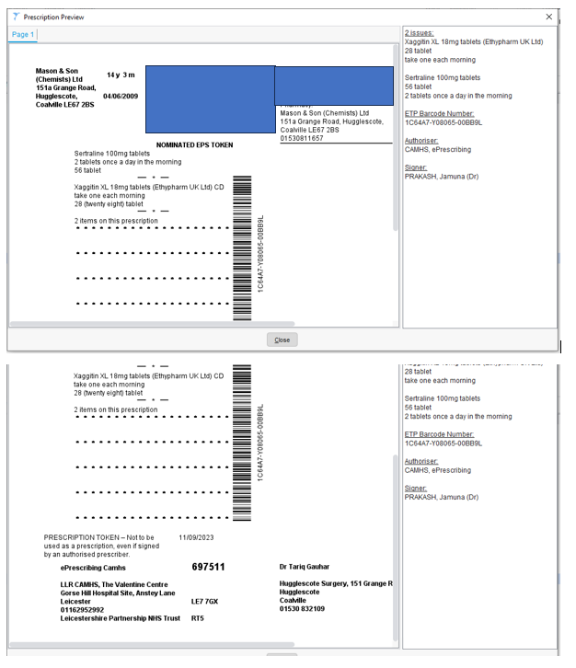
Leicestershire Partnership Trust- CD Rx
We are getting several scripts rejected / queries from community pharmacy because the prescribers name is not included on the EPS script.
We’ve checked regionally and with the NHSBSA and there is no need to include this as long as we have spurious code (team) details on the Rx.

Slide 9
I spoke with our regulations team on this topic previously: They had explained that on the issue of whether the prescriber's name must appear on the CD prescription - interestingly, the answer is no.
The address, and indication of the kind of prescriber is required but not explicitly the name. I expect some might choose to add to CD register prescriber name, but that also may not be required and may be a good practice.
I believe the prescriber type may be within the EPS message even if not printed on the EPS token.
The signature for EPS prescriptions is of course the advanced electronic signature implicit and associated with whichever individual prescriber - the prescriber had required a Smartcard to generate the prescription. Arguably the electronic signature and existence of the EPS script provides more security than any sight of an ink signature on paper.

Slide 10
Delivery plan for recovering access to primary care (PCARP)
On 9th May 2023, the Government and NHS promised a £645m investment in community pharmacies over the next two years to support a pharmacy common conditions service, along with expansion of the NHS Pharmacy Contraception and NHS Hypertension Case-Finding services.
Expand pharmacy oral contraception (OC) and blood pressure (BP) services this year, to increase access and convenience for millions of patients, subject to consultation. (31st Dec 2023)
Launch Common Conditions Service (CCS) formerly known as Pharmacy First so that by end of 2023 community pharmacies can supply prescription-only medicines for seven common conditions. (31st Dec 2023)
Uncomplicated UTI / Shingles / Impetigo / Sinusitis / Infected insect bites / Acute otitis media/ Sore throat
This, together with OC and BP expansion, could save 10 million appointments in general practice a year once scaled, subject to consultation.

Slide 11
Workstreams

Slide 12
Workstreams
PQS Drug Tariff Part VIIA PQS 27042023_0.pdf (nhsbsa.nhs.uk)
Drug Tariff Part VIIA PQS 27042023_0.pdf (nhsbsa.nhs.uk)
To qualify for the Pharmacy Quality Scheme (PQS) 2023/24 payment, pharmacy contractors will have to meet the gateway criterion by the end of 31 December 2023.
Pharmacy contractors must claim payment for the PQS 2023/24 quality criteria during the declaration period, which is between 09:00 on 5 February 2024 and 23:59 on 1 March 2024
Reduced Year 5 Community Pharmacy Contractual Framework (CPCF) PQS scheme launched on 1 June 2023.
1 gateway criterion NMS
3 domains Medicines Optimisation, Respiratory and Prevention
FAQs pertaining to palliative and of end of life drugs can be found here Pharmacy Quality Scheme - PSNC Website
Please see link for updated medication list and provider list that stock the medication for the LLR Commissioned End of Life Service

Slide 13
Services
DMS Training event 11th Oct
New tools on their way
October UHL & CP event 11th Oct
Triangulate Trust, CP and GP Practice
Improve understanding and value of DMS
It is an essential service

Slide 14
Services
BP Check Service- New resources on website
ABPM support
Updated content on website
Training – BP Checks Training Opportunity
About the Pharmacy Blood Pressure Checks Service
BP Service Resources for Pharmacies
BP Service Resources for Surgeries
ABPM-Service-Support
Blood Pressure Check Service IT system Update
Ambulatory Blood Pressure Monitors (ABPM) – device support
A&D: https://medical.andprecision.com/product/tm-2440/
HingMed: https://www.emthealthcare.co.uk/p/79066/wbp02a
Meditech: https://www.pmsinstruments.co.uk/acatalog/Meditech-ABPM-06.html

Slide 15
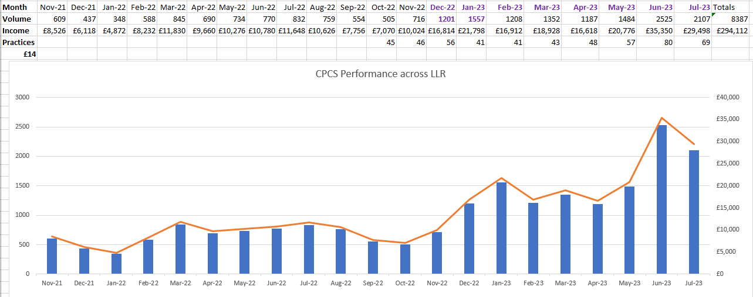
Services CPCS Today the LLR LPC area is the highest CPCS performer in the Midlands region.

Slide 16
CPCS
CPCS IT Provider Pays – chasing and follow ups
Please use the resources available on website including the toolkit.
Toolkit is a conversation starter.
Contact PharmOutcomes if you wish to remain with them and complete the process to put a contractual agreement in place
Contact one of the other assured providers and put a contractual agreement in place with them
Deregister from providing CPCS

Slide 17
Contractor Resources and Support
Monthly updates
Website – Contact us
Newsletter
Deadline tracker
Regional correspondence Regional Correspondence – Community Pharmacy Leicestershire and Rutland
Report an issue - Report an issue – Community Pharmacy Leicestershire and Rutland Allows contractors to report issues easily using the web form
Contact the chief Officer -Contact the Chief Officer – Community Pharmacy Leicestershire and Rutland – Allows contractors to book a 1-2-1 private 15 min meeting with the CO to discuss and highlight sector specific issues

Slide 18
Events planned for Sept & Oct

Slide 19
6:15pm buffet
7pm start
Hotel Brooklyn Leicester LE2 7QS
Register for tickets now
Pharmacists, Techs, PMs, AMs and Superintendents
https://www.eventbrite.co.uk/e/693946060347?aff=oddtdtcreator
ABPM training EMT / A&D bring your device

Slide 20
CD webinar will be AO and Turning Point.

Slide 21
SAVE THE DATE
GPhC Inspector led webinar
Interactive
Opportunity to ask questions
Support Pharmacy teams in preparing for an inspection
Pharmacists, PMs, Technicians, AM, Superintendents

Slide 22
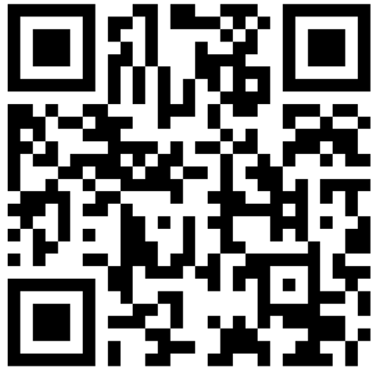
Community Pharmacy Leicestershire and Rutland in partnership with The Leicester, Leicestershire and Rutland ICB are inviting pharmacy professionals from all sectors of practice to join a whole system Discharge Medicines Service (DMS) learning event. Please share with your practice pharmacist
Registration form and QR code for the DMS event
https://forms.office.com/e/xYs3GgTgdN

Slide 23
World Pharmacist Day Monday 25th Sept 2023
World Pharmacists’ Day is a time when we pause to celebrate and be thankful for all that we have achieved as a profession – and the amazing work pharmacy teams do every day to enable people to stay healthy.

Slide 24
We will continue to have our open house surgery monthly 3rd Weds of every month at 8pm

Slide 25
Questions
If you require additional support from the administrative team, please contact any member of the team
Rajshri Owen- Chief Officer | chiefofficer@leics-lpc.co.uk
Kate – Administrator | admin@leics-lpc.co.uk
Gareth McCague – Service Delivery Facilitator | service.support@leics- lpc.co.uk
Vinay Mistry-Service Development Lead | servicedevelopmentlead@leics-lpc.co.uk

Slide 26
Shared Care Records (ShCRs)
ShCRs pull together information on a patient from several sources, such as GP and hospital records, so they contain extra information compared to the NHS Summary Care Record
e.g., important vaccine information including eligibility/ blood test results/ drug allergies/ previous ADRs.
The LLR ShCR programme will for the first time allow all LLR communities pharmacy access to the patient’s ShCR.
Accessed through a web app
Establish Community Pharmacy discovery and benefits group
Are you interested in being a pilot site?
Drop your email address in chat
Email chiefofficer@leics-lpc.co.uk

Slide 27
Questions & Discussion

