Slide 1
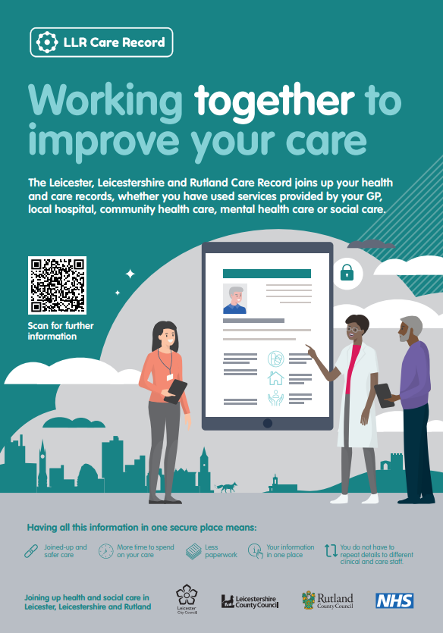
Leicester, Leicestershire and Rutland Care Record: Introduction
Leicestershire Pharmaceutical Committee
Open House Surgery - 20 September 2023
Laura Godtschalk – Programme Manager (laura.godtschalk@nhs.net)
Toby Page – Architecture Lead (toby.page1@nhs.net)
Sandra Taylor – Change and Benefits Manager (Sandra.taylor50@nhs.net)
Contact: lpt.llrcarerecord@nhs.net
Feedback:
Menti.com 1234 5678

Slide 2
Leicester, Leicestershire and Rutland Care Record: Introduction
Leicestershire Pharmaceutical Committee AGM
29 September 2023
Laura Godtschalk – Programme Manager (laura.godtschalk@nhs.net)
Toby Page – Architecture Lead (toby.page1@nhs.net)
Sandra Taylor – Change and Benefits Manager (Sandra.taylor50@nhs.net)
Contact: lpt.llrcarerecord@nhs.net
Feedback:
Menti.com 1234 5678

Slide 3
What is the LLR Care Record?
Notes:
1. It’s a secure digital system being implemented as part of a national Shared Care Records programme.
The local name is the Leicester, Leicestershire and Rutland (LLR) Care Record.
2. The LLR CR will
bring together a person’s separate health and social care records into a single read-only portal
give the health and care professionals directly involved in an individual’s care a more holistic picture of the care and treatment that they have received across all services
3. Joining up health and care records in this way means that:
Professionals have quicker, easier access to the information they need to provide good quality care
People in Leicester, Leicestershire and Rutland receive better, safer care and treatment

Slide 4
What is shared and how will it help? Putting together the bigger picture

Slide 5
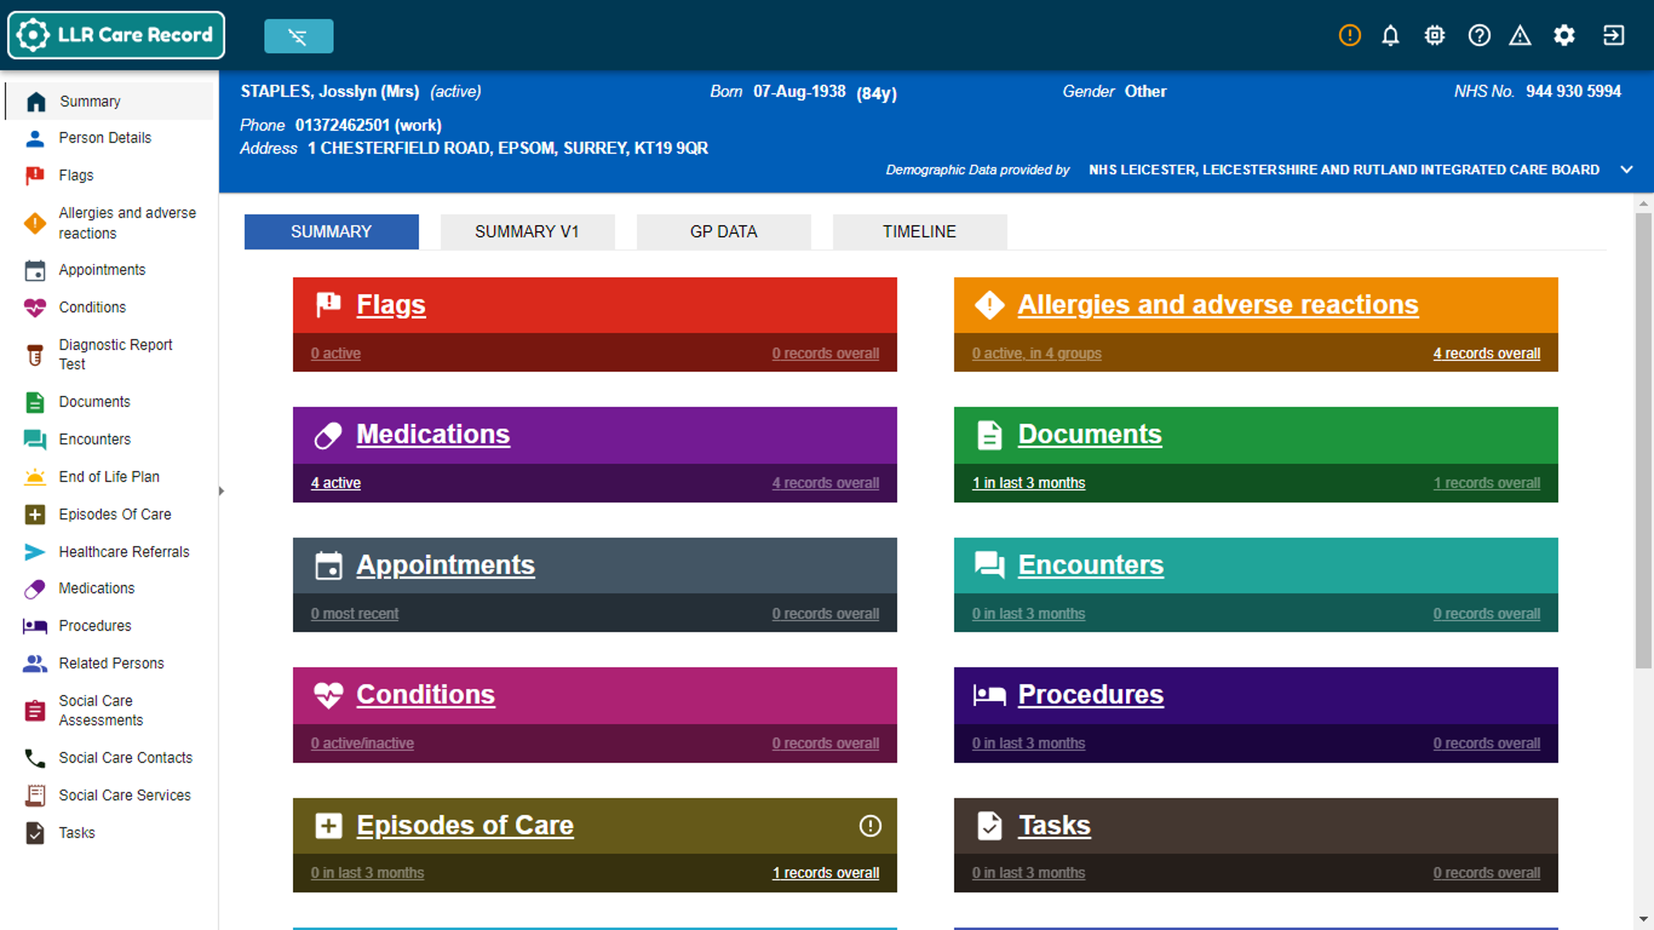
How does the LLR Care Record work?
It collates a person’s separate health and care records from services they’ve accessed and puts this into a secure, structured format in a digital area.
This read-only digital shared care record will be accessible to you via PharmOutcomes.
Notes:
How does the LLR Care Record work?
As and when new entries are made on a person’s record within individual systems, the CR will pull that information into it within a few moments.
[CLICK] You can see here, that we’re starting to integrate with all sorts of systems.
S1 - For S1 users, there’s a short user registration process and then you’ll see a new button within your unit called LLR Care Record. You simply click onto this button, and it will open the person’s CR onto a webpage.
LL - For LL users, on the left-side panel within a person’s health record, you’ll see a new option LLR CR. You simply click onto this button, and it will open the person’s CR within LL.
Standalone - You yourselves will be accessing a person’s CR through a website what we call a “Portal” which is a webpage that will take you directly to a person’s CR using their NHS number.

Slide 6
Connecting Community Pharmacy into the LLR CR
Project initiated by the LPC
Grant obtained to progress access by CPs
Collaboration with LLR CR Programme Team
Confirmed worthwhile – clear drivers for use, potential benefits
Piloting soon
Do you want to be an early adopter?
Looking for diverse CPs – size, range of services
Simple and secure system
Rolling out across many LLR organisations
For CPs - single method of access: via PharmOutcomes
Sensitive data - for qualified/clinical staff
Members of the public with an LLR GP included by default
Simple centralised public opt out process
Onboarding is quick and simple – 1 hour’s online training
No cost to CPs
Information Security Agreement (ISA) to sign
Enabling the link: PharmOutcomes to the LLR CR
Feed back to confirm and quantify the benefits

Slide 7
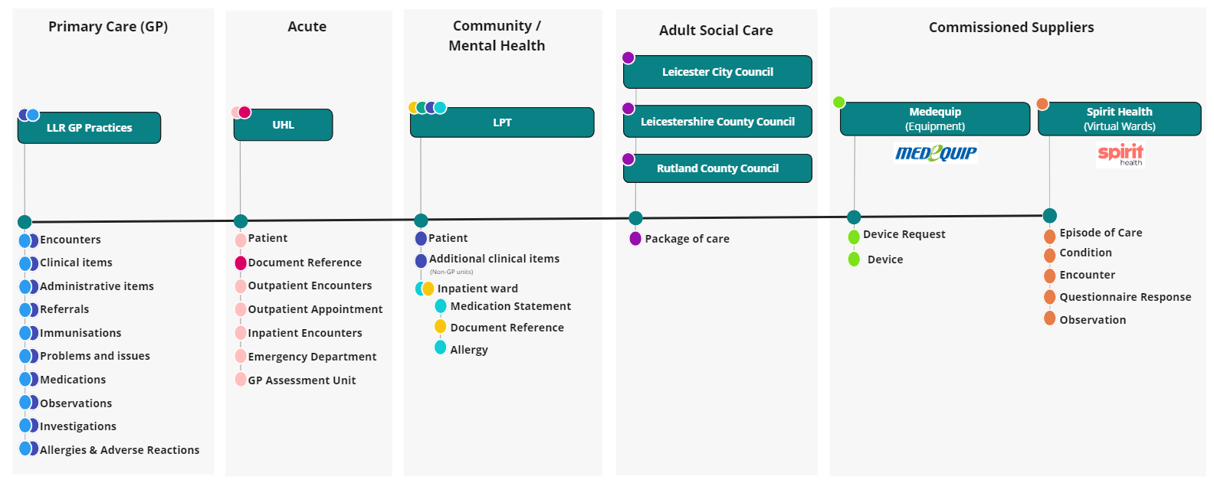
Who are the data providers?
Notes:
[Use laser pointer]
What information about a person will be available and where does this information come from.
For e.g., from GP practices (whether your person is with a S1 or an EMIS practice), you can see a large majority of the GP record, and this will be available in its own separate tab on the CR [covered later].
From UHL, you’ll also be seeing a person’s outpatient appts and inpatient/outpatient encounters.
From LPT, you’ll see a person’s documentation if they’ve had an inpatient stay, along with further mental health records from S1. [Currently the LPT providers that will come through to the CR are Discharge Hub, MHSOP Outpatient and Community, AMH Community and Adult LD Community and Inpatient services. Over time, all other units will follow. It will only show on the CR if the person has used that service.]
From Leicester City, Leicestershire County, and Rutland County Council Adult Social Care, you’ll see a person’s package of care.
In time, you’ll also see a person’s Mediquip record, if there are any pieces of equipment that have been delivered to a person’s home.
And finally, if a person has been on a Virtual Ward, you’ll also see information generated during that stay by the person at home taking their readings, such as their BP. If the person caring for them has also filled in questionnaires about the persons general state of wellbeing, this information will also be available to you on the CR.
[CLICK] What you’ll be able to see right now, is GP data, UHL encounters and appts, documents and allergies if a person has been an inpatient within LPT, and social care data from Rutland County Council. In time, you’ll start to see more data flowing into a person’s CR from all the different systems, and we’ll let you know as and when other sets of information is pulled into the CR.
Using the CR means you’ll start to see information from other services, and they will see information from your service.
As the CR will be relied on by everyone who can access it, it’s important to ensure the information you enter onto your own system is accurate and up to date.

Slide 8
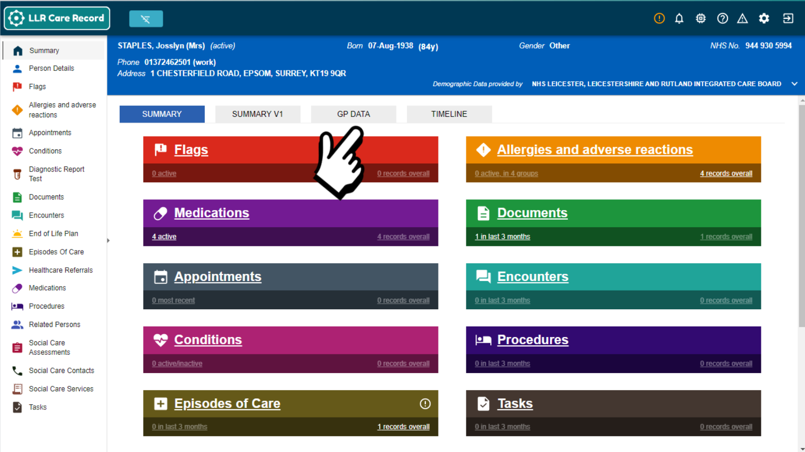
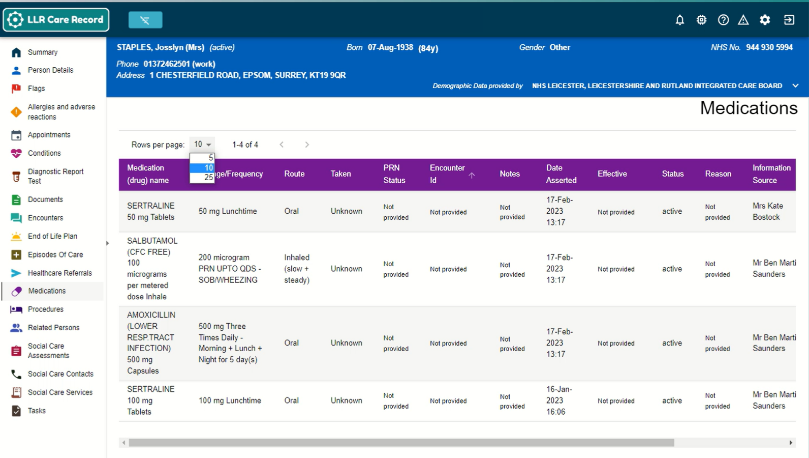

Slide 9
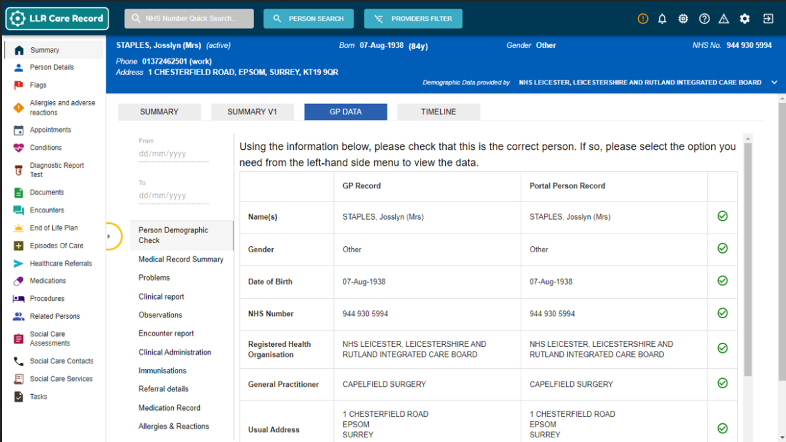
Notes:
And this will display in this format.
[CLICK] You can use these options here to view specific GP information within a given date range.
[CLICK] Just a reminder, we recommend you click on the arrow here to hide the Navigation Sidebar so you can view the GP information more clearly.
I just wanted to point out something important and that is the information within this “GP Connect” tab is currently not displayed within any panels on the “Summary” screen.
[CLICK] Therefore, we recommend for information such as allergies, to check both locations – from the Navigation Sidebar as well as from the “GP Connect” tab.

Slide 10
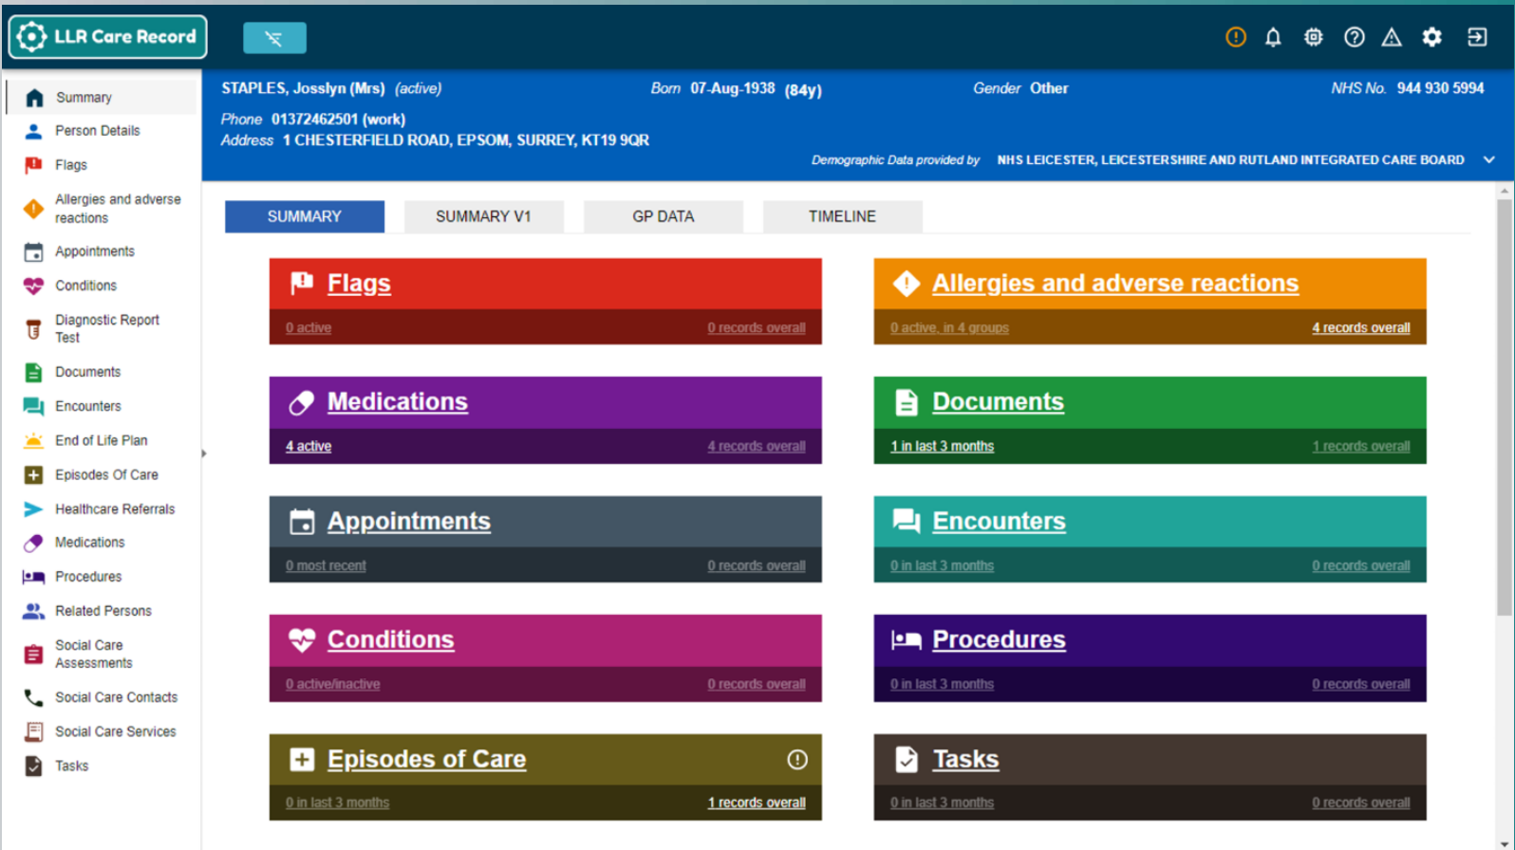
Notes:
And will return back to the “Summary” screen.
[CLICK] On this screen, you’ll see there are a number of tabs across the top.
[CLICK] Currently, we are in the “Summary” tab which is data organised into these panels from relevant providers. At the moment, this “Summary” screen does not include GP information.
[CLICK] However, you can click on the “GP Connect” tab here to access the person’s GP information.

Slide 11
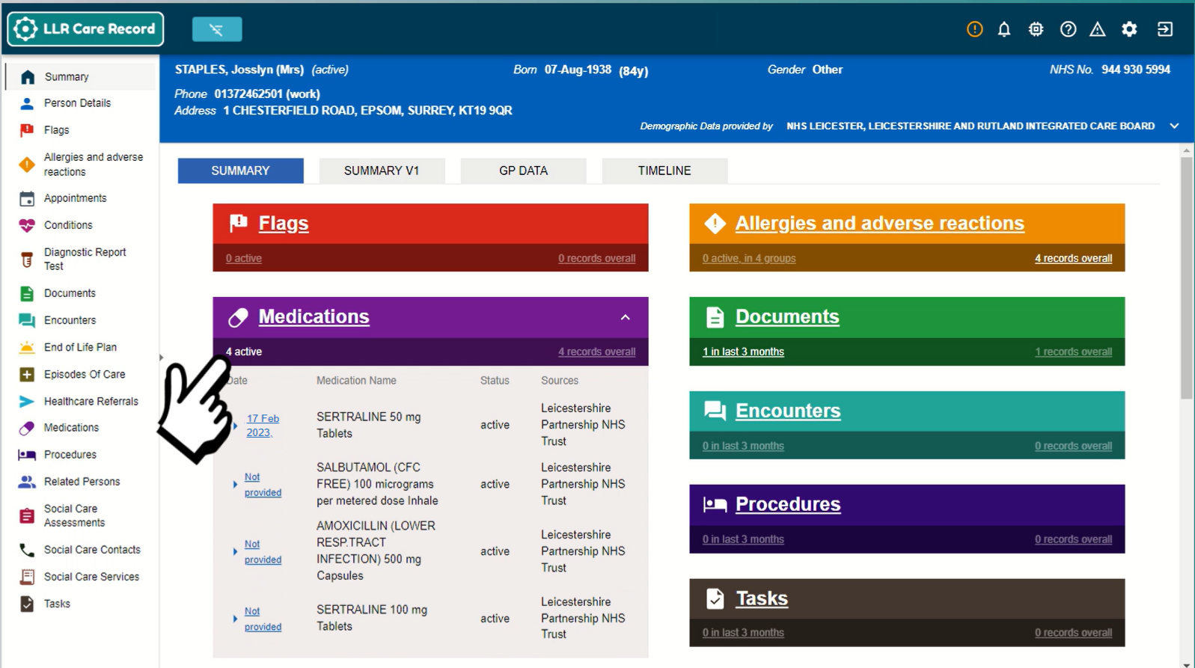

Slide 12
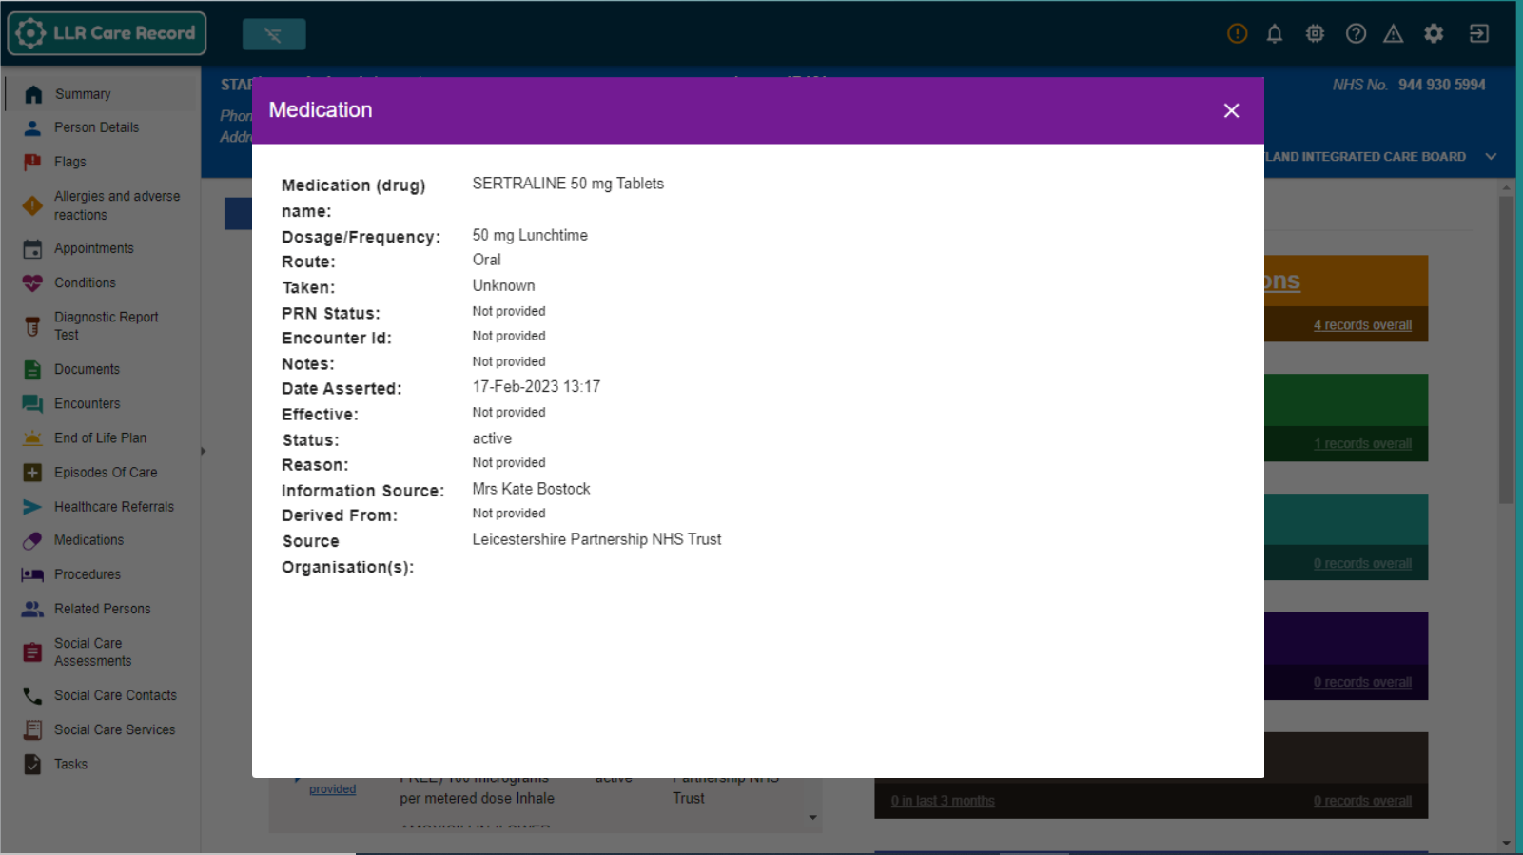

Slide 13
Why get involved?
Less time obtaining information from GP practices
Quicker, better service for customers
Medication safety
Better advice to patients helping them manage their conditions
Improved transfers of care out of hospital
Polypharmacy management and meds optimisation
Supporting antimicrobial resistance policy
Delivering extended care services relieving GP pressure

Slide 14
Time freed up for the important things
Making fewer and shorter calls
Example
Just 20 minutes per working day saved obtaining information equates to two working weeks, per person, per year available for more productive uses.
...while improving care for customers and reducing the GP burden
Notes:
So, we very much hope that we can improve that for you, by making the information you need available quicker.
We’ve heard that even just finding out a person’s GP details can take up to half a morning sometimes.
So, imagine if you were able to save around 20 min a day.
That equates to 2 working weeks, per person, per year, of breathing space that you can spend doing the work that you came in to do.
So hopefully you can see a little context here on how those 20 mins saved can make things easier overall in your working life.

Slide 15
Benefits to CP customers
Not having to remember and repeat complex medication-related details.
Better and potentially quicker care as the professionals caring for you will be able to see your records.
Pharmacist can see your medications, what you’ve taken in the past, and if you have allergies – making prescribing safer.
Less 'just in case' follow up and fewer duplicate tests.
Your communication needs are known.
Information sharing to support your care is more secure.
Professionals will be able to see your care preferences and personalise their response.

Slide 16
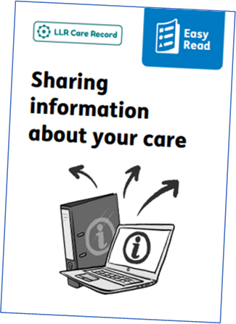
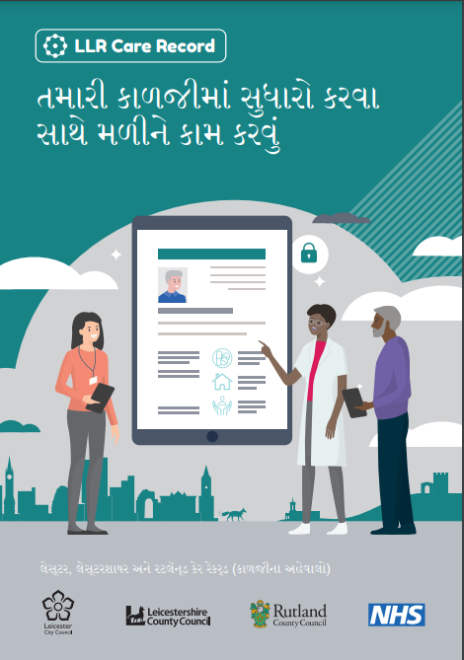
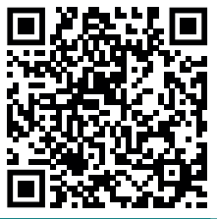
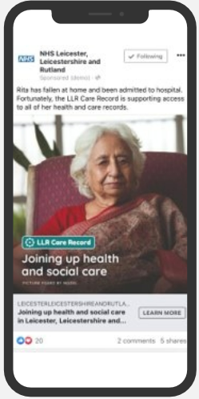
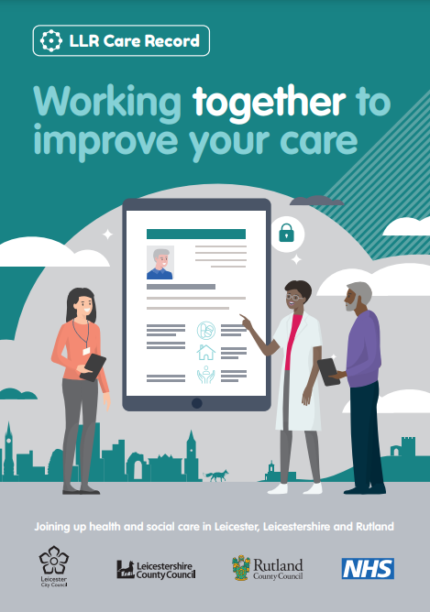
Informing the public
Active communications raising awareness – ongoing
Local radio advertisements
Facebook campaign: c500k+ views
LLR Care Record web page with links to
Video with subtitles
Easy Read leaflet
Leaflets in English, Arabic, Gujarati, Polish, Punjabi, Romanian, Somali and Urdu
Posters
Frequently Asked Questions
Contact the Programme Team lpt.llrcarerecord@nhs.net

Slide 17
Thank you
Find out more: LLR Care Record web page
Contact us or volunteer as early adopters:
Lpt.llrcarerecord@nhs.net
Notes:
Link to animation sent in invitation email which explains what the LLR CR is. Brief explanation of LLR CR (for the benefit of those who may have not seen the video):
A person’s treatment and care can be provided by several organisations.
These organisations have their own IT system to store that person’s information (e.g., one organisation may have S1, and other LL).
This means that a health and care professional may only be able to see a person’s record from within that same organisation, and it might not show a person’s full history.
The LLR CR joins up these separate records and brings it together into one structured format which you will have access to.
This means health and care professionals directly involved in that person’s care can see the bigger picture across the different services that person has accessed.
Today we’re going to be telling you a little more about this and showing you what the LLR CR system looks like.
A lot of the public think we already have this in place.
They’re also keen to have this in place because they also experience the consequences of when information isn’t flowing between the services who are supporting them.

Slide 18
Questions?

