Slide 1
Better Mental Health for All
Neighbourhood Leads
& Social Prescribing

Slide 2
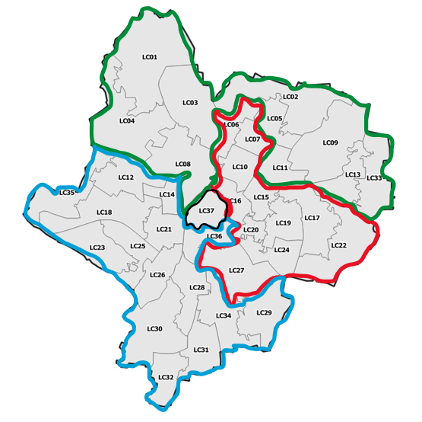
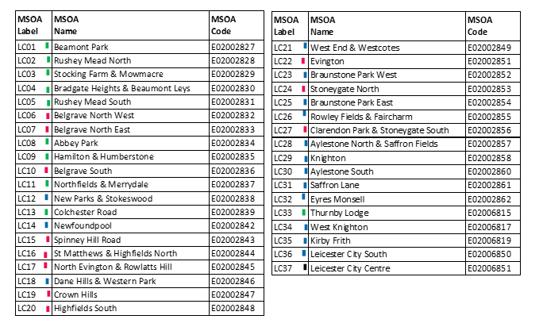
Leicester City Neighbourhood Leads
Rob Snow - City North
robert.snow1@nhs.net
City West
Rob Snow (New Parks)
Robert.snow1@nhs.net
Eliza Deakins (Saffron, Eyres Monsell)
Eliza.deakins1@nhs.net
Terry Rushin (Braunstone)
Terry.rushin@b-inspired.org.uk
Aisha Jagot- City East
Aisha.jagot@nhs.net

Slide 3
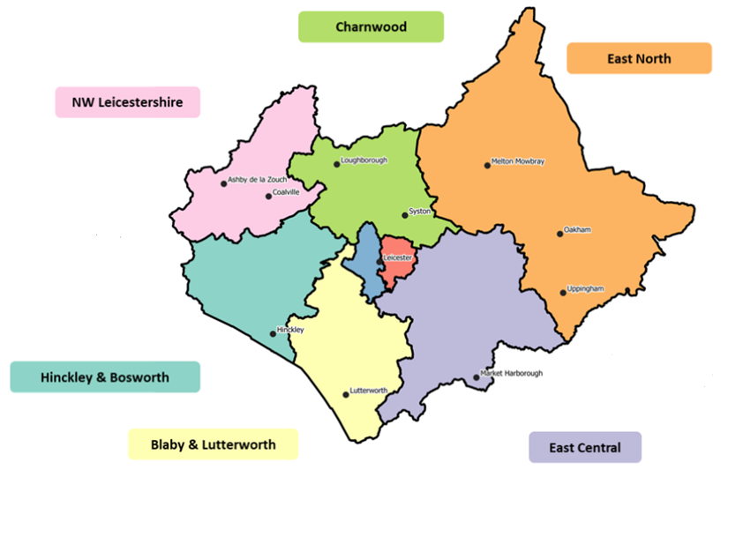
County Neighbourhood Leads
X8 roles employed by LPT
X3 roles employed via Districts*
Sarah Jones
Sarah.jones353@nhs.net
Morag Tyler
Melton
morag.tyler@nhs.net
Inbal Bland
NW Leicestershire
inbal.bland1@nhs.net
*Mark Young
Rutland
MYoung@rutland.gov.uk
Hinckley & Bosworth
*Jodine Legg
jodine.legg@hinckley-bosworth.gov.uk
&
Aime Carroll
Amie.Carroll@hinckley-bosworth.gov.uk
Blaby
Hannah Williams
hannah.williams@blaby.gov.uk
Teresa Spilsbury – Harborough
teresa.spilsbury@nhs.net
Eliza Deakins – Oadby & Wigston
Eliza.deakins1@nhs.net

Slide 4
Timeline overview for Joy Social Prescribing
April - September
End Oct
November - December
Jan – March 24
April 24 onwards
Prelaunch activity;
•DPIA and contract in place • LHIS on board to link to S1
• PCN and wider system engagement
• Testing in Charnwood
•Steering Group in place
• VCS Partners engaged
Roll-out starts Charnwood
Blaby & Lutterworth
NW Leicester
Consolidation Phase
• Roll out across all DMH teams
• Roll out across LPT
• Other system partners
Melton
City West
Hinckley & Bosworth
Harborough
City East
Oadby & Wigston
Population of the marketplace: Engaging with key partners to merge and upload ‘opportunities’ to the website (Active Together; City Council & County Council, VCS)

Slide 5
Why Joy has been commissioned across LLR
ICS partners in LLR have increased their focus on prevention and are adopting a ‘whole person approach’ to health and care provision
The current landscape is a myriad of different databases and social prescribing lists which do not offer professionals or citizens a clear and comprehensive view of the support that is available
All partners want a more joined-up and efficient approach to social prescribing across LLR
The system has been adopted and rolled out by Rutland County Council who undertook a thorough research exercise to find this solution which is seen as best in the market
We want to provide the evidence of the impact of social prescribing on people's health and wellbeing – proof of the shift in focus for the funders towards prevention
5

Slide 11
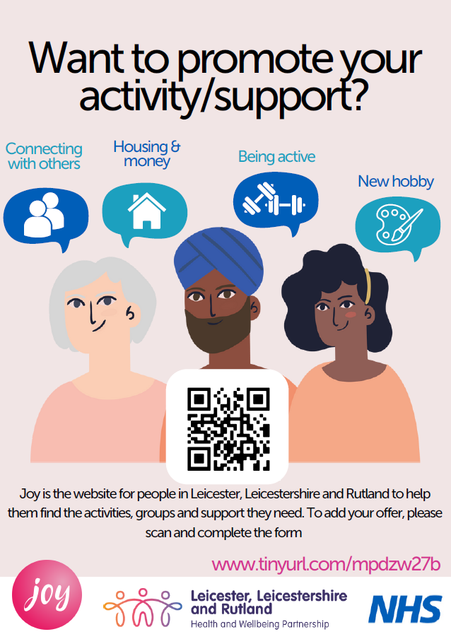
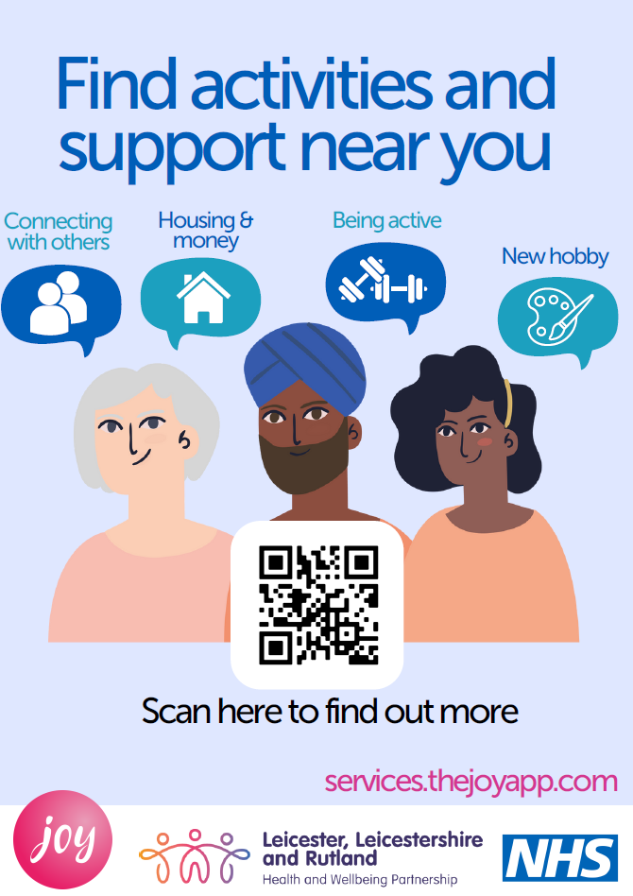
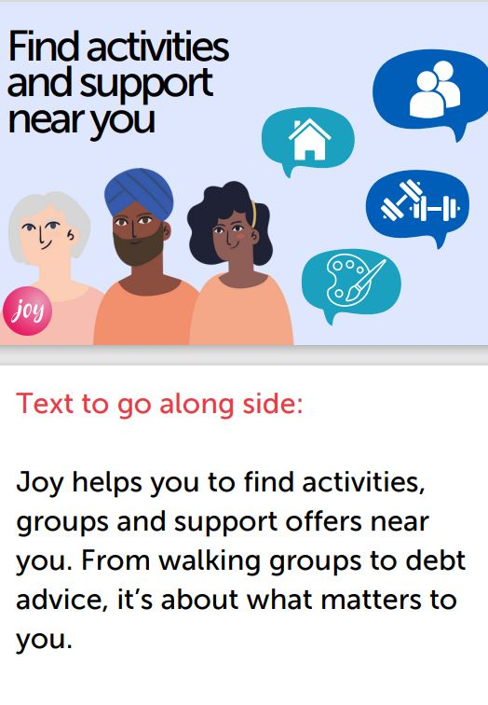
Promotional materials
Posters

Slide 12
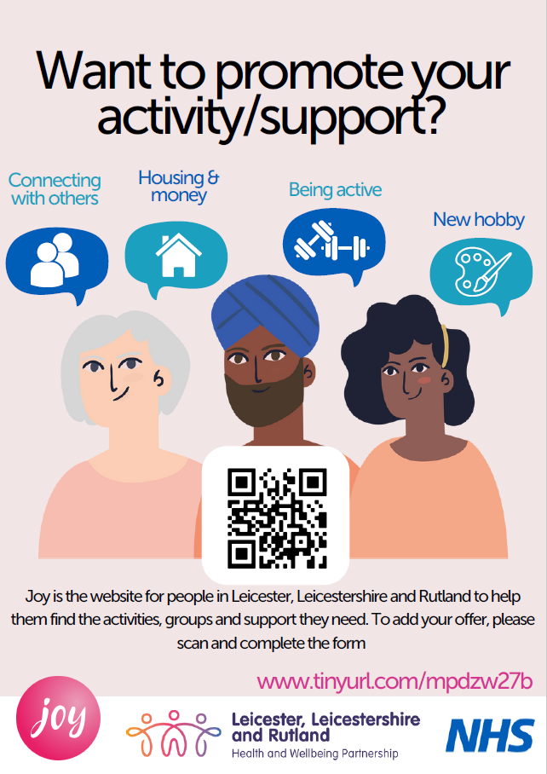
Next webinar:
Thursday 30 November
10.30am – 11.15
If you would like to come along email louise.oreilly6@nhs.net

