Slide 1
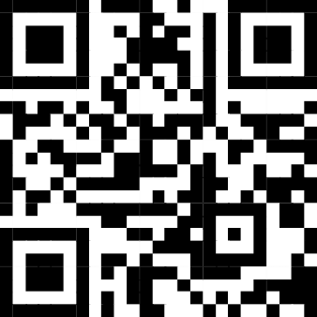
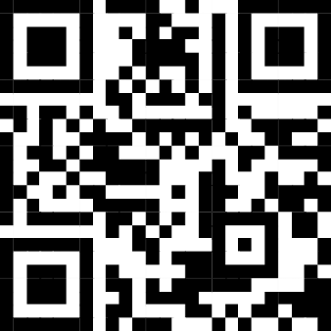
Guidance on Updating the Directory of Services (DoS) - East Midlands
The DoS is used by other services within the NHS (particularly NHS111) to identify which community pharmacies are open and which services they offer so they can ensure patients are referred to an appropriate pharmacy. Therefore, it is important that pharmacy teams keep their DoS profile accurate.
If the pharmacy cannot offer any services:
At any time:
If the pharmacy can open but cannot offer Pharmacy First:
Email the East Midlands DoS Team as soon as you become aware you cannot offer the service via:
england.eastmidlandsdos@nhs.net
Include
ODS code of the pharmacy
Address and postcode of the pharmacy
Reason Pharmacy First is unavailable
Planned date and time when it will be available
Name of person requesting the update
Don't forget to inform local GP Practices if you temporarily cannot offer Pharmacy First
Use Profile Manager https://organisation.nhswebsite.nhs.uk to close your profile for the duration of the time you are not open
For guidance on how to use Profile Manager there are a selection of videos here https://tinyurl.com/yfkfw7s3
Please ensure all member of the pharmacy team are aware when the DoS needs updating and how to do it

Slide 2
Guidance on Updating the Directory of Services (DoS) - East Midlands
Is the pharmacy open and offering Pharmacy First
No
Yes
If the pharmacy is open but not offering Pharmacy First
If the pharmacy is closed
No action required
Email the East Midlands DoS Team as soon as you become aware you cannot offer the service via:
england.eastmidlandsdos@nhs.net
Include
ODS code of the pharmacy
Address and postcode of the pharmacy
Reason Pharmacy First is unavailable
Planned date and time when it will be available
Name of person requesting the update
Use Profile Manager https://organisation.nhswebsite.nhs.uk to close your profile for the duration of the time you are not open
Please ensure all member of the pharmacy team are aware when the DoS needs updating and how to do it

