Slide 1
Pharmacy First Update
Paul Gilbert
Community Pharmacy Clinical Lead
Paul.gilbert7@nhs.net

Slide 2
Current Sign-ups
Total contractors | No of pharmacies opted in Pharmacy First | % of contractors opted in Pharm1st
224 | 216 | 96%
As of 30/01/24

Slide 3
Current Referrals
Total PharmRefer referrals 1842
93 referrals via PharmRefer 31/01
1749 referrals via PharmRefer 01/02 - 16/02
v 911 in first 16 days of January (+estimated 234 Extended Care service provisions v 1145)
77 GP Practices v 51 in first 16 days of January
132 Community Pharmacies v 83 in first 16 days of January

Slide 4
Why formal referrals are required
Ensures patient has a private discussion with the pharmacist
  If signposted, the patient may be seen by another member of the team in the pharmacy area and treated under the Self-care Essential service​
Reassures patients that their concern has been taken seriously and the pharmacist will be expecting the patient​
  If signposted, the patient may feel they are being fobbed off and be unsatisfied with the service provided by the GP practice ​and the pharmacy as they won’t be expecting the patient
Ensures the patient will be directed to a pharmacy of their choice providing the service​
  Improves the patient journey.

Slide 5
Why formal referrals are required
If the patient does not contact the pharmacy, the pharmacy team will follow up with the patient and the GP practice will be made aware of the outcome
  If signposted, this will not happen as the pharmacy won’t be aware that the patient was meant to visit the pharmacy
PharmRefer is the preferred platform for making referrals in LLR
  Improves data quality via an auditable trail of outcomes
  Allows identification of dropped referrals
  PRISM will be stood down for CPCS in the future – consider transitioning if still using PRISM / Ardens nhs.net referrals

Slide 6
Notifications
Minor illness and clinical pathway consultations
GP Connect Update Record will provide the functionality to automatically update a patient’s GP medical record
If a patient needs an in-hours appointment with their GP practice, after agreeing this course of action, the pharmacist should contact the patient’s GP practice to secure them an appointment
A patient’s general practice will be notified on the day of provision of the service or on the following working day
Where possible, sent as a structured message in real time via the NHS- assured IT system
NHSmail as a back-up

Slide 7
Guidance to Midlands Community Pharmacy Teams on managing NHS 111 Pharmacy First
A Minor Illness Referral Needs Urgent Escalation
If following an NHS 111 Pharmacy First consultation, a patient requires onward referral for an urgent appointment when their GP practice is closed, the pharmacist should call NHS 111 using the healthcare professional's line for access to a clinician to seek advice.
The healthcare professionals’ line can be accessed via ringing NHS111 and dialling *7 at the main menu.
Unable to Supply an Urgent Repeat Medicine
If the medicine is not in stock, pharmacists should check other local pharmacies for availability.
If the medicine is in stock elsewhere then forward the electronic referral to this pharmacy via NHSmail or PharmOutcomes (visit http://tinyurl.com/bdfz3mav for guidance).
In this instance, both pharmacies are eligible for the service completion. There is no need to call NHS 111 in this instance.
A Minor Illness Referral Needs Non-Urgent Escalation
If following an NHS 111 Pharmacy First consultation, a patient requires a non-urgent onward referral to their GP practice, the pharmacist should signpost the patient to make contact with their practice and close the referral on PharmOutcomes accordingly.
Do not ask the patient to contact NHS 111 back following a Pharmacy First referral from NHS 111
Pharmacists should make any contact necessary with NHS 111 via the healthcare professionals’ line

Slide 8
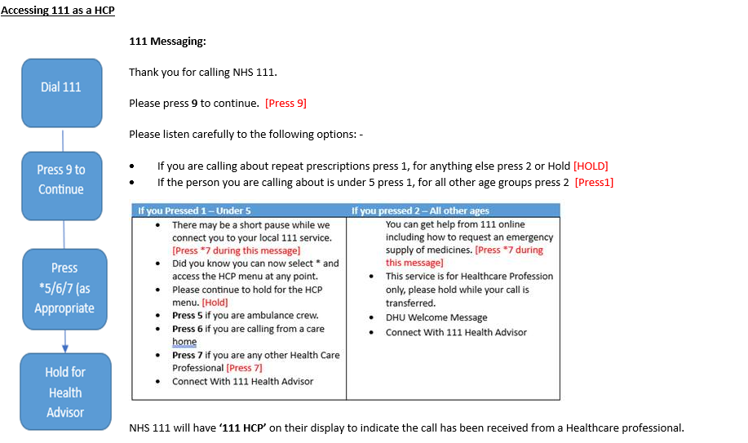
Guidance to Midlands Community Pharmacy Teams on managing NHS 111 Pharmacy First
Contacting NHS111 DHU as a healthcare professional
Please see this guidance if you need to contact NHS111 to bypass the queue.
Do not ask the patient to phone back NHS 111 following a Pharmacy First referral from NHS 111
Pharmacists should make any contact necessary with NHS 111 via the healthcare professionals’ line

Slide 9
What we have asked GP Practices to do
Activate PharmRefer license if not already done so
  If there is difficulty activating PharmRefer please contact melanie.burdett@nhs.net for support
Verify email address for receipt of outcome notifications from PharmOutcomes if not already done so.
  Contact melanie.burdett@nhs.net if unsure if this has been actioned
Attend Active Signposting training if not already done so,
  Contact hannah.bajwa@nhs.net to register
Speak to your local community pharmacists
  Understand their service model, so clear information to patient can be provided
  Agree how urgent actions are relayed to the practice
  How pharmacists can secure an in hours appointment
Brief reception teams on changes and new conditions
Notes:
Contact Hannah Govind for active signposting

Slide 10
What we want pharmacies to do
Perform the service to a high quality standard
  Consultation room fit for purpose
  Correct equipment
  Record keeping to a high standard
If all clinical pathways for Pharmacy First are not available 100% of the time reflect on why that is and what is the journey to 100% availability.
Engage your locums
Report IT teething issues
Flag practices signposting and not referring
Highlight inappropriate 111 referrals
Speak to local practices
Keep the DoS up to date
Notes:
Contact Hannah Govind for active signposting

Slide 11
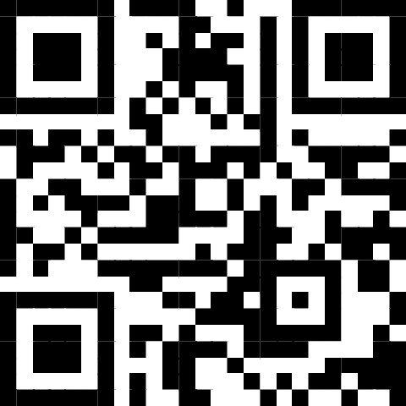
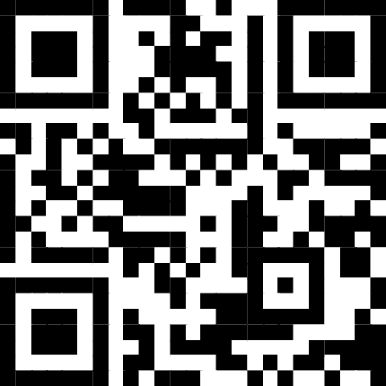
Guidance on Updating the Directory of Services (DoS) - East Midlands
The DoS is used by other services within the NHS (particularly NHS111) to identify which community pharmacies are open and which services they offer so they can ensure patients are referred to an appropriate pharmacy. Therefore, it is important that pharmacy teams keep their DoS profile accurate.
If the pharmacy cannot offer any services:
At any time:
If the pharmacy can open but cannot offer Pharmacy First:
Email the East Midlands DoS Team as soon as you become aware you cannot offer the service via:
england.eastmidlandsdos@nhs.net
Include
ODS code of the pharmacy
Address and postcode of the pharmacy
Reason Pharmacy First is unavailable
Planned date and time when it will be available
Name of person requesting the update
Don't forget to inform local GP Practices if you temporarily cannot offer Pharmacy First
Use Profile Manager https://organisation.nhswebsite.nhs.uk to close your profile for the duration of the time you are not open
For guidance on how to use Profile Manager there are a selection of videos here https://tinyurl.com/yfkfw7s3
Please ensure all member of the pharmacy team are aware when the DoS needs updating and how to do it

Slide 12
Guidance on Updating the Directory of Services (DoS) - East Midlands
Is the pharmacy open and offering Pharmacy First
No
Yes
If the pharmacy is open but not offering Pharmacy First
If the pharmacy is closed
No action required
Email the East Midlands DoS Team as soon as you become aware you cannot offer the service via:
england.eastmidlandsdos@nhs.net
Include
ODS code of the pharmacy
Address and postcode of the pharmacy
Reason Pharmacy First is unavailable
Planned date and time when it will be available
Name of person requesting the update
Use Profile Manager https://organisation.nhswebsite.nhs.uk to close your profile for the duration of the time you are not open
Please ensure all member of the pharmacy team are aware when the DoS needs updating and how to do it

Slide 13
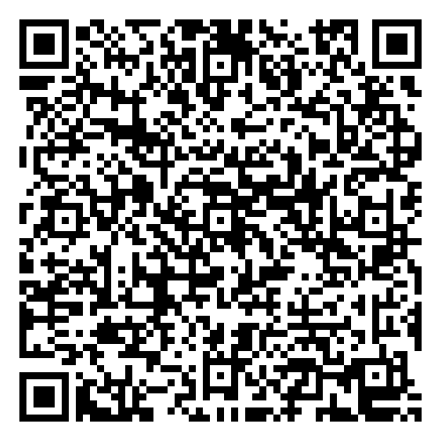
Locum Webinar
Date: Thursday 29th February 2024
Time: 19:00 – 20:15
Via MS Teams
Agenda
Overview of Pharmacy First
Pharmacy First digital developments
Training opportunities
Progress to date on Pharmacy First
Frequently asked questions
Contacts, resources and networks
MS Forms form to register:

Slide 14
For further information
Updates to practices will be communicated via the GP newsletter and primary care webinar, to community pharmacies via LPC and East Midlands Primary Care Team
Briefing from CPE
Community Pharmacy Leicester and Rutland website
Or contact
Paul Gilbert​ - Community Pharmacy Clinical Lead​
paul.gilbert7@nhs.net
07775028289
Mel Burdett​ - Integration and Transformation Manager​
melanie.burdett@nhs.net
07919188567

