Slide 1
NHS Pharmacy First
Learnings from the First Two Months
Gareth McCague
Service Support Pharmacist, CPL&R
Notes:
It has been a frenetic time since January, with lots going on.
The objective here is to pause tand reflect on what has been learned, so that the problems we have seen don’t have to be experienced by everybody.

Slide 2
Broad Issues Arising
Study Requirements (overwhelming)
Operational Time Pressures
Surgery Referrals (problematic)
Commercial Reports (Service Volumes, Claims, & Thresholds)
MultiFactorAuthentication
Notes:
These are the headings we will be reflecting on:
Study volumes are quite overwhelming, causing some professional anxiety
Operational Service delivery is an issue, & fitting it all into your day.
Inappropriate Surgery Referrals are causing problems
And Reporting Volumes, Claims for Services, and achieving volume thresholds to qualify for the incentive payments.
And we must mention the blessed Multifactorial Authentication so lots to look forward to!

Slide 3
Study Requirements (overwhelming?)
Traditional Approach to Study
Study the CPPE material (& URLs)
Study the PGDs (& URLs)
Study the SLA (Service Level Agreement)
lastly… …we look at the Service Delivery forms (paper or electronic)
Notes:
Lots of pharmacists are feeling rather snowed under with all the study….
The traditional approach pharmacists follow to getting service ready follows a path something like this…

Slide 4
Study Requirements (overwhelming?)
Traditional Approach to Study
Study the CPPE material (& URLs)
Study the PGDs (& URLs)
Study the SLA (Service Level Agreement)
lastly… …we look at the Service Delivery forms (paper or electronic)
- Volume of reading is overwhelming…
- dozens of URL references to click on…
- “a clinical rabbit hole” …
- professional anxiety …
- “I’ll never remember all of the…?
Notes:
The reading volume is enormous…
You are presented with dozens of URL links which divert you, all very interesting, but still diverting you.
It has been described to me as a “clinical rabbit hole” with numerous tunnels that you can go down.
Some pharmacists are worrying themselves to bits, and thinking every other pharmacist will probably know all this stuff..
“How will I remember all of those exclusions” is a common sentiment!

Slide 5
Study Requirements (overwhelming?)
Traditional Approach to Study
Study the CPPE material (& URLs)
Study the PGDs (& URLs)
Study the SLA (Service Level Agreement)
lastly… …we look at the Service Delivery forms (paper or electronic)
Learning & Advice
flip it & explore the Service Delivery forms FIRST!
look at the actual boxes to be ticked & the issues to be considered
see extent of clinical support in the Delivery Form (PharmOutcomes)
…and enjoy a sense of decompression!
- reading volume is overwhelming…
- dozens of URL references to click on…
- “a clinical rabbit hole” …
- professional anxiety …
- “I’ll never remember all of the…?
Notes:
Whereas my advice is to radically rethink your approach to getting Service Ready.
Start by looking at the ELECTRONIC SERVICE DELIVERY Paperwork (the PharmOutcomes pages) and note the issues that need to be considered and the boxes to be ticked.
Crucially, look and appreciate the extent…
…before you start into your studying, and feel a sense of decompression rather than added pressure.

Slide 6
Notes:
First check out our CP L&R website.
The screenshots are on there for you to look at before you start your reading
We have included user guides and the FAQs.
This is also good resource for locums who can look at these screens at home, without being logged into a pharmacy system.

Slide 7
Notes:
Especially, watch the Pharmacy First Video, even if you are already a confident service provider, as it demonstrates click thro’s that you might not yet have used.

Slide 8
Notes:
The PharmOutcomes screens shows the gateway criteria, so you don’t need your study file on your knee when providing Pharmacy First services.

Slide 9
Notes:
And all of those exclusions you were worrying bout are helpfully listed, so that you won’t forget any.

Slide 10
Flipping allows pharmacists to focus their Study
It’s like previewing a practical exam question before doing your revision
Identifies the clinical issues arising in Service Delivery
Allows pharmacists to focus their study on what matters
Helps discernment when faced with suggested URL links
Allows confidence to build before an actual service provision

Slide 11
Operational Time Pressures
Pharmacists not using their staff effectively
delegate checking for new referrals, set computer reminders
Notes:
Moving on, Time pressure is another problem for many pharmacists, who are trying to do everything themselves.
And I am observing that many pharmacists are not using their teams, even for the simplest of support tasks,
Pharmacists could delegate….

Slide 12
Operational Time Pressures
Pharmacists not using their staff effectively
delegate checking for new referrals, set computer reminders
colleague prints off the referral cover sheet & pop it under your nose
you say, looks OK, & suggest time for appointment, avoid lunchtime, etc
Notes:
A dispensary colleague could print off…

Slide 13
Operational Time Pressures
Pharmacists not using their staff effectively
delegate checking for new referrals, set computer reminders
colleague prints off the referral cover sheet & pops it under your nose
you say, looks fine, suggest time for appointment, avoid lunchtime, etc
your colleague phones the patient, & says, “we have received a referral from the surgery, can you pop in to see the pharmacist between 3 & 4pm”
[colleague says, “I am not a pharmacist” if patient starts talking symptoms]

Slide 14
Operational Time Pressures
Pharmacists not using their staff effectively
delegate checking for new referrals, set computer reminders
colleague prints off the referral cover sheet & pops it under your nose
you say, looks fine, suggest time for appointment, avoid lunchtime, etc
your colleague phones the patient, “we have received a referral from the surgery, can you pop in to see the pharmacist between 3 & 4pm”
[colleague says, “I am not a pharmacist” if patient starts talking symptoms]
your colleague notes it in the diary, and sets a reminder on computer
your colleague “registers” the patient on PharmOutcomes, all ready…

Slide 15
Surgery Referrals (problematic)
Practices received negligible guidance on PF from central NHS
Promised “Pharmacy First – Toolkit for Practices & PCNs” didn’t happen!
They got a Referral Guide with inadequate Inclusions&Exclusions criteria
Practices were confused by media coverage
We are seeing practices…
referring patients who are out of PGD age range
referring patients with ‘obvious’ red flag symptoms
sending patients to pharmacy without an electronic referral
Notes:
Problems with Surgery Referrals take a few forms, but first note that …

Slide 16
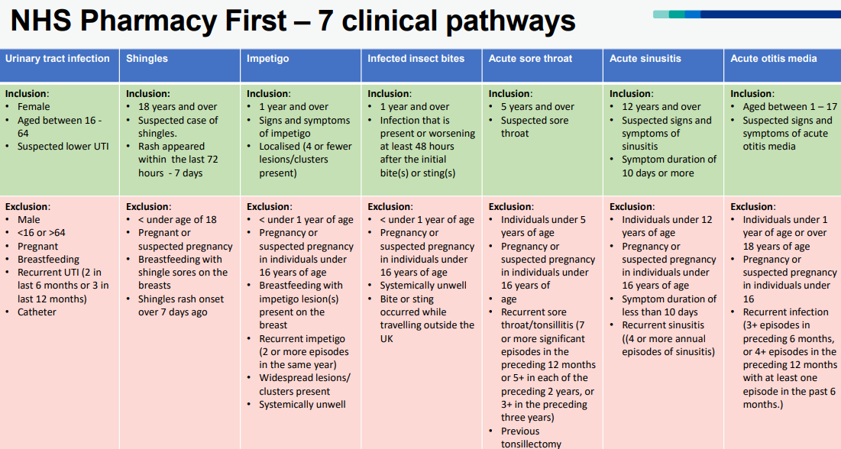
NHS England
Original Version
Check with Reception Team – some are still using this!
Notes:
This was the original Referral Guide provided to Practices by NHS England, to support Surgery Reception teams when making referrals.
The inclusions were not inadequate, and the lack of excludiuon symptoms has led to numerous patients being inappropriately referred.
Thankfully we spotted the issues within the first week, and drafted a more helpful and accessible Guidance Tool.
So, the FIRST THING is to CHECK if your local Practice is still using this?
Have a quick look at the UTI Inclusions & Exclusions, which might explain why referrals have been problematic!

Slide 17
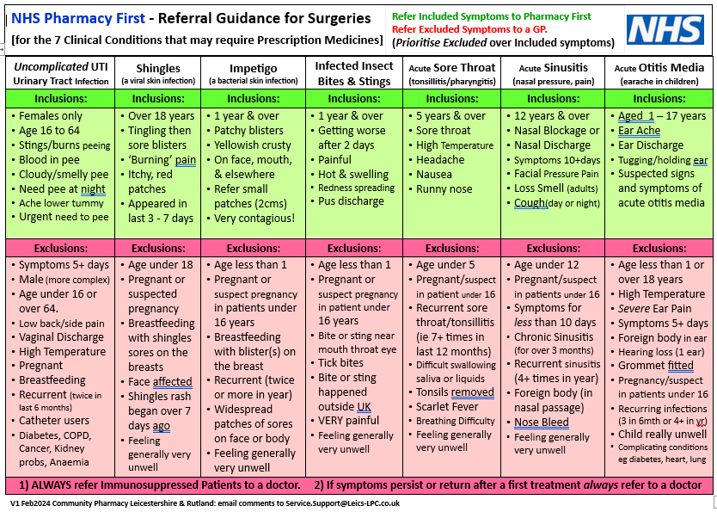
Notes:
Now look at this LLR version which is much more helpful. For example look at the UTI inclusions and exclusions
We advise Receptionists to try and avoid mentioning to patients the actual diagnostic terms, in the white boxes, because it increases their expectations for antibiotics.
And it resonates with reception teams when we say how unhelpful it is when patients arrive demanding a prescription for antibiotics regardless of what the clinician says!

Slide 18
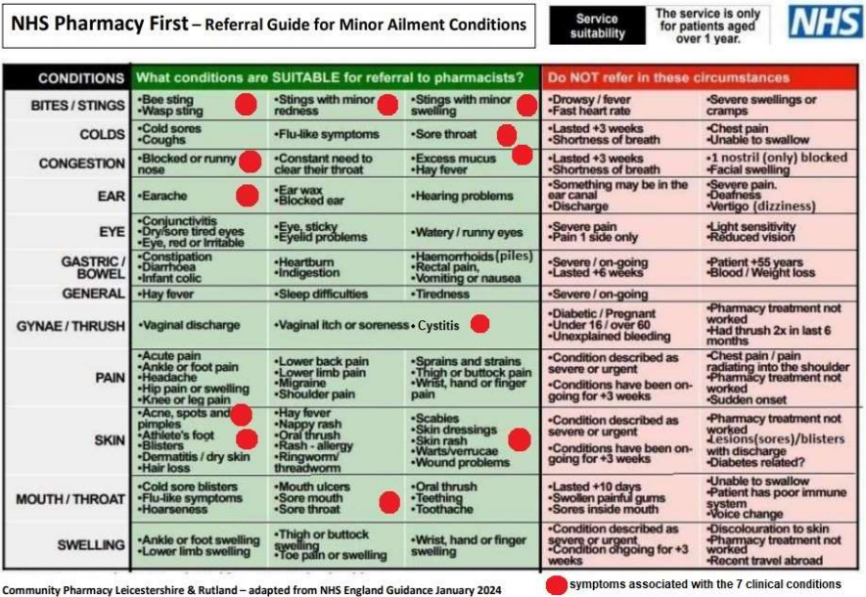
Notes:
Unfortunately, it seems that the high-profile promotion of Pharmacy First, and the focus on the seven conditions, has given some surgeries the impression that Pharmacy First as replaced CPCS. So, be alert to this and be sure to equally promote Pharmacy First Minor Ailments in conversations with surgery teams. Reception teams will already be familiar with this older Referral Guide, originally for CPCS which lists around 72 Green symptoms all of which are treatable with over-the-counter medicines.
And mention that with Pharmacy First pharmacists can now go a stage further with some of these symptoms, where highlighted in red, and offer prescription medicine treatments if any of the seven conditions are diagnosed.
Indeed it may actually be easier for surgery reception teams to just continue using this highlighted Referral Guide with its easy symptom terminology, and just leave it to the pharmacist to consider whether it might be appropriate to escalate matters and treat the issue with a prescription product!

Slide 19
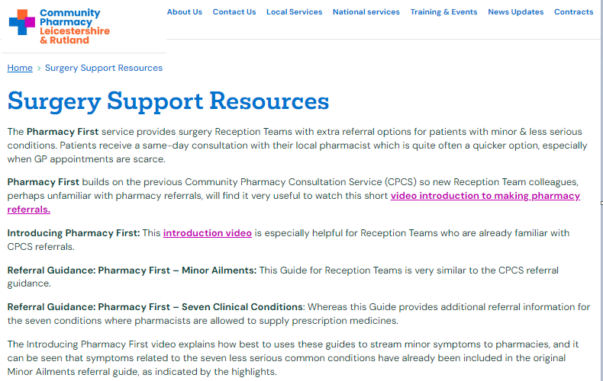
Notes:
This is the Surgery Support Resources page on our CPL&R website. It is a good idea to follow up a surgery visit with an email sharing the link to this page.
It is totally geared to encouraging surgery compliance, and gives your contact an opportunity to share your key messages with others in the Practice.
Aim to encourage Practice Managers and Practice Pharmacists to watch the short “Introducing Pharmacy First” video, which it gets everything across very succinctly.

Slide 20
Red Flags ?
Pharmacy First consult protocol designed to identify ‘Red Flags’
“Red Flag” issues usually referred back (RB) to surgery
Occasional “referral backs” should reassure. (clinical vigilance)
Assure patients: RBs are good indicators of clinical team-working
RBs fast-tracked for a clinical app at surgery (good for patients)
Notes:
Moving on, it is good to reassure Reception Teams that the consultation protocols pharmacists follow are designed to identify Red Flag issues because we know that Patients don’t always mention everything they should to receptionists who are trying their best to assist. So surgery teams should BE REASSURRED THAT Referrals Back are A GOOD SIGN OF THE PROTOCOLS WORKING, and definitely not an indicator of a poor service. Even encourage receptionists to make a positive thing out of a Referral Back, maybe saying to patients they are glad the pharmacist spotted whatever it was, and that they might try and get an appointment squeezed in a bit sooner now rather than later.

Slide 21
Notes:
Having spoken about Referral Backs, it is important to put their frequency in perspective. This impressive data set of CPCS Outcomes shows 80% of referrals for cough, cold & sore throat symptoms were resolved by the pharmacist. 75% of skin rash problems were sorted, 81% of diarrhoea & Constipation problems, 80% of minor eye problems. So encourage Receptionists to assure patients that a pharmacy consultation for these conditions is most likely to resolve the problem.

Slide 22
Can’t I just ask patients to ‘go to the pharmacy?’
GP practices should continue to digitally refer patients to Pharmacy First
(like previous GPCPCS as opposed to signposting.
Pharmacy First patients receive confidential consultation.
(Signposted will be seen by a pharmacy counter assistant)
Courteous: Patient will be expected
Did Not Attend? Patient will receive a contact from the pharmacy
Planning: Referrals enable pharmacy to plan & manage workload,
Data: Referral data provides evidence patients are accessing clinical care within 24/48 hours showing GP practices are supporting the PCARP.
Profession Transfer of Care Clinical responsibility passes to pharmacist..
Evidence: an audit trail of the referral from receptionist.
Notes:
Verbal referrals are a common problem, and this slide provides a summary of good reasons why Receptionists should send Electronic Referrals
1)The key reason is, an electronic referral confirms the Transfer of Care from the Surgery to the Pharmacy: This is important because the patient came expecting to see an NHS Doctor in the first instance, creating a duty of care for the surgery. An electronic referral will therefore record that the care has been transferred over to the pharmacy.
2)Another important reason is referred patients will be seen by a Pharmacist in their private consultation room, whereas walk-in patients are likely to be seen by a Chemist Counter assistant at the chemist counter. Don’t add that you will intervene. Just leave the point hanging. An electronic referral will guarantee an NHS Pharmacy First Service, but a pop over to the pharmacy will not..
3)Consider also DNAs or Did Not Attends, which can be problematic if the patient says yes to verbal advice to go to the pharmacy, and then they decide not to go. What if the patient ignores the advice & went home & sepsis set in? What if they end up in hospital having spoken to the Receptionist earlier in the day? Whereas the pharmacist will contact any electronically referred patients to arrange a consultation, which helpfully serves to chase them up and so reduce the risk. And the electronic record will be proof that the receptionist had done their job properly, which is a point that receptionists will take on board.
4) Electronic referrals also helps collect Audit Evidence and Data: Electronic referrals can be reported on to illustrate compliance, especially to show that patients are accessing care within the Recovery Plan’s target of 24 or 48 hours. Whereas verbally referred patients cannot be counted towards the performance of the practice.
5) Another quite important point is that Pharmacists like the professional courtesy of receiving a referral because they will be anticipating or will phone the patient, rather than them just turning up. Because otherwise sods law dictates they will arrive during a frantically busy time, or when staff are at lunch, and so the patient may have to wait longer than they might expect to. So the consultation gets off to an unsatisfactory start for all involved.

Slide 23
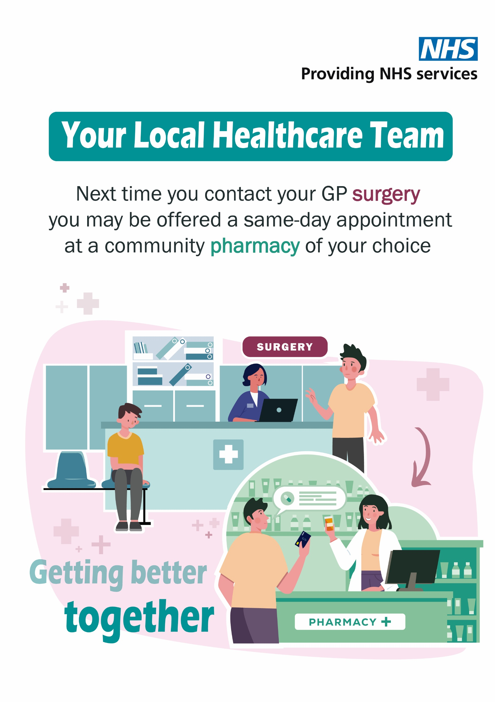
Notes:
Unfortunately, we have learned that some patients have reported feeling “fobbed off to the pharmacy”.
These pharmacy teamworking Poster resources are still available to encourage patient acceptance of pharmacy referrals from surgeries.
That said, the terminology, PHARMACY FIRST is unhelpful in Surgeries, because we want receptionists to refer suitable patients who are waiting.
But we don’t want waiting patients to look at a Pharmacy First poster, and decide “I’ve waited long enough”, and just leave and go to the pharmacy first.
These Posters have been designed to inform patients that the NHS Pharmacy First service is a high quality, planned and considered NHS treatment pathway.
So these poster resources will counterbalance negative feelings about pharmacy referrals, by portraying the service as a valuable option for patients.,

Slide 24
Commercial Reports
(Service Volumes, Claims, & Thresholds)
Reporting Pharmacy First Service
[an Open House meeting on its own?]
Contractors not being paid what they anticipated.
Misunderstanding Pharmacy First Claims
MYS Service Reports
PharmOutcomes Service Reports

Slide 25
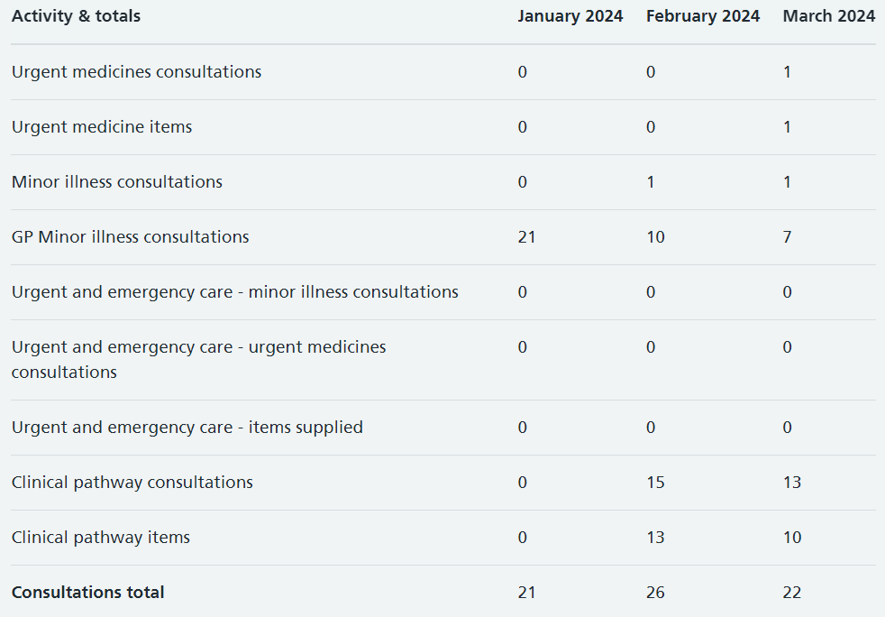
MYS – Pharmacy First Report

Slide 27
Pinnacle Message: 10th April 2024

Slide 28
Multi Factor Authentication (in Surgeries)
Practices using PharmRefer need MFA
Some Practices do not permit staff mobile phones at work
So MFA caused an immediate end of Pharmacy First referrals
PharmRefer is inoperable without MFA
NHS Leics ICB is advising using a DeskTop authenticator [2Fast]
If your local surgery has stopped PharmaRefer?
If they have reverted back to emails and PRISM forms?
Surgeries should Contact: Melanie.Burdett@nhs.net

Slide 29
Multi Factor Authentication (Locums)
Locums who work in one pharmacy (only)
No problems
2) Locums who work around various pharmacies?
Need a recommended solution.
Please share if you have a recommendation

Slide 30
For further support with Pharmacy Support
contact: service.support@leics-lpc.co.uk
Or visit our website:
https://leicestershire-rutland.communitypharmacy.org.uk
MFA: Melanie.Burdett@nhs.net
Notes:
I trust that this was helpful.
Please email service support for further information.
Or visit our website if you wish to review this presentation again, or for downloadable pdf copies of the Referral Guides.
Good luck with your pharmacy first services.!

