Slide 1
Community Pharmacy Open House Surgery Apr 2024 Rajshri Owen Chief Officer

Slide 2
Follow us on social media Facebook Leicestershire & Rutland Community Pharmacy | Leicester | Facebook Instagram Community Pharmacy Leicestershire & Rutland (@communitypharmaciyllr) | Instagram LinkedIn https://www.linkedin.com/in/community-pharmacy-leicestershire-and-rutland-577723276 (*If you are not on the WhatsApp group, get in touch chiefofficer@leics-lpc.co.uk |07984 465 387)

Slide 3
Agenda 1. Updates from Community Pharmacy Leicestershire and Rutland including ICB update 2. Accurrx – Catherine Webb Operations Manager 3. Pharmacy First –Gareth, Service Delivery Facilitator

Slide 4
Updates

Slide 5
MFA: Issues with MYS and PharmOutcomes syncing
Spoken to a lot of you when this first arose back in March
Clearly still some issues
Added a help page on the website
Issues with MYS and PharmOutcomes syncing – Community Pharmacy Leicestershire and Rutland
What should I do if I have submitted my claim with incorrect information? Pharmacy owners should email the MYS team (mys@nhsbsa.nhs.uk) for further guidance on how their claim will be reviewed.

Slide 6
MFA: Issues with MYS and PharmOutcomes syncing
We have made clear to CPE the unacceptable effect this has had on pharmacies’ workload and stress and we are extremely concerned about the impact on both providers and patients.
CPE in response “We are pressing Government and the NHS for urgent action to resolve the problems and restore faith in the data and payment mechanism so that pharmacies are fairly recompensed for their hard work in delivering a vital new service.”

Slide 7
Pharmacy First

Slide 8
Pharmacy First
Gareth continues to be available to support on Friday to conduct contractor visits, including surgery visits & referrals.
Lots of resources available via our website to support practice and pharmacies
They are approved by Community Pharmacy Clinical Lead for the ICB Paul Gilbert and Mel Burdett (LLR ICB) Surgery Support Resources – Community Pharmacy Leicestershire and Rutland
There are also some national resources which were launched last week by Community Pharmacy England. These materials, which sit on a new Pharmacy First: Information for GPs webpage, are intended to offer an introduction to the service, explaining the logistics behind it and addressing any potential concerns. Lots of further re. sources can be found here New Pharmacy First materials aimed at GPs - Community Pharmacy England (cpe.org.uk).

Slide 9
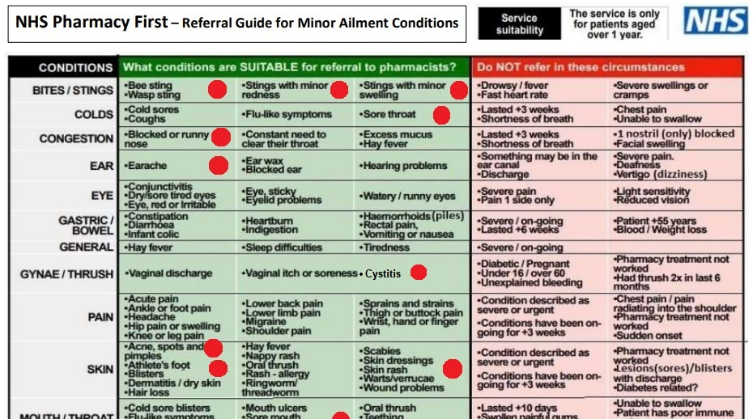
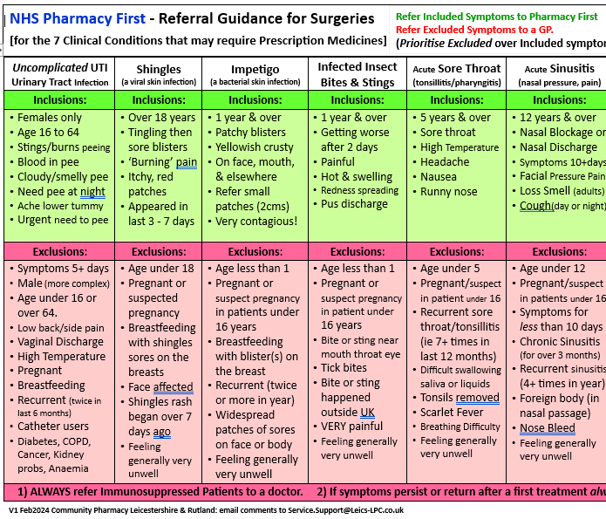
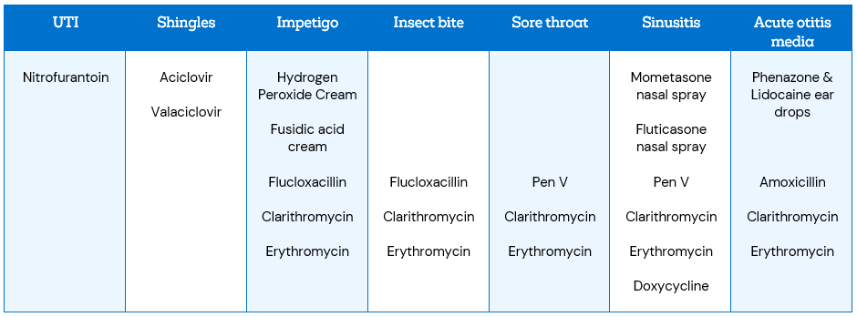
Resources

Slide 10
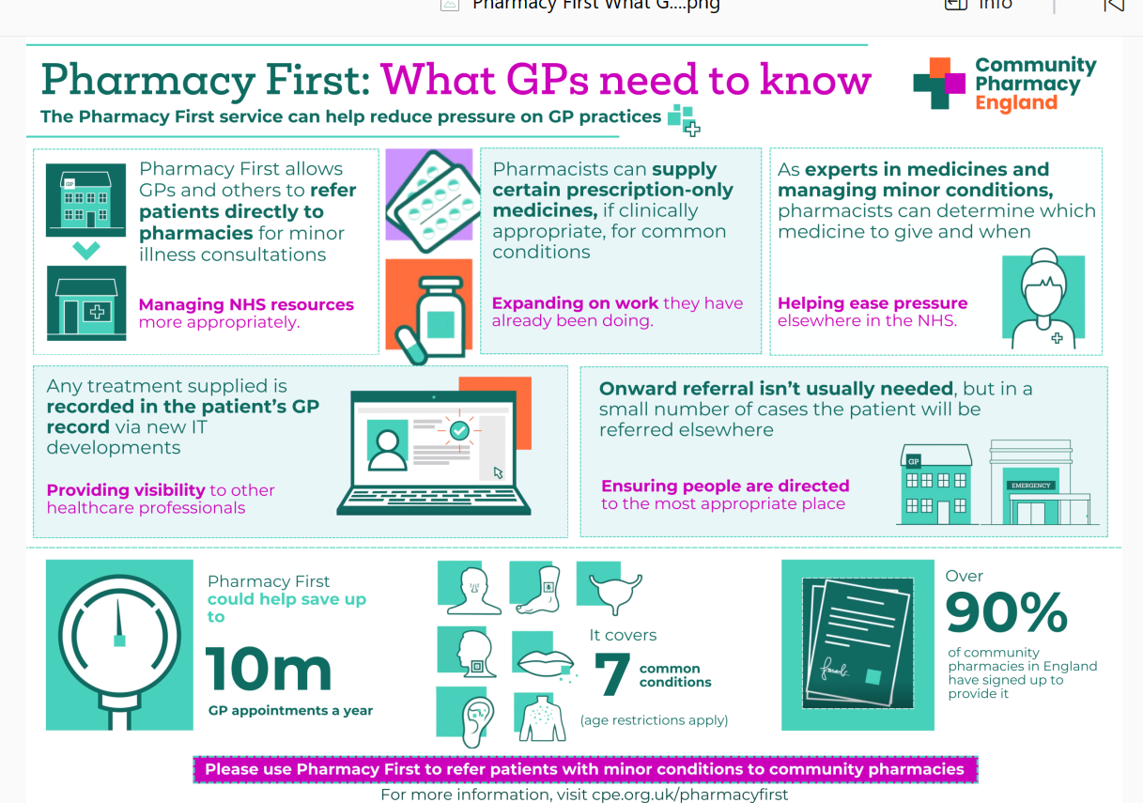
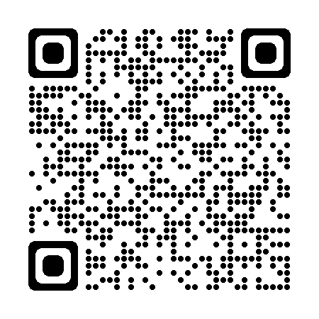
Pharmacy First
Pharmacy First GP resources - OneDrive (sharepoint.com)

Slide 11
Animation – GPs
New Pharmacy First materials aimed at GPs - Community Pharmacy England (cpe.org.uk)

Slide 12
Accurx

Slide 13
Service Delivery Facilitator

Slide 14
Questions
If you require additional support from the administrative team, please contact any member of the team
Rajshri Owen- Chief Officer | chiefofficer@leics-lpc.co.uk
Kate – Administrator | admin@leics-lpc.co.uk
Gareth McCague – Service Delivery Facilitator | service.support@leics- lpc.co.uk
Vinay Mistry-Service Development Lead | servicedevelopmentlead@leics-lpc.co.uk

