Slide 1
Measles and the MMR
Dr Virginia Ashman, Clinical Lead, LLR Vaccination Programme
Notes:
KAY Welcome & purpose

Slide 2
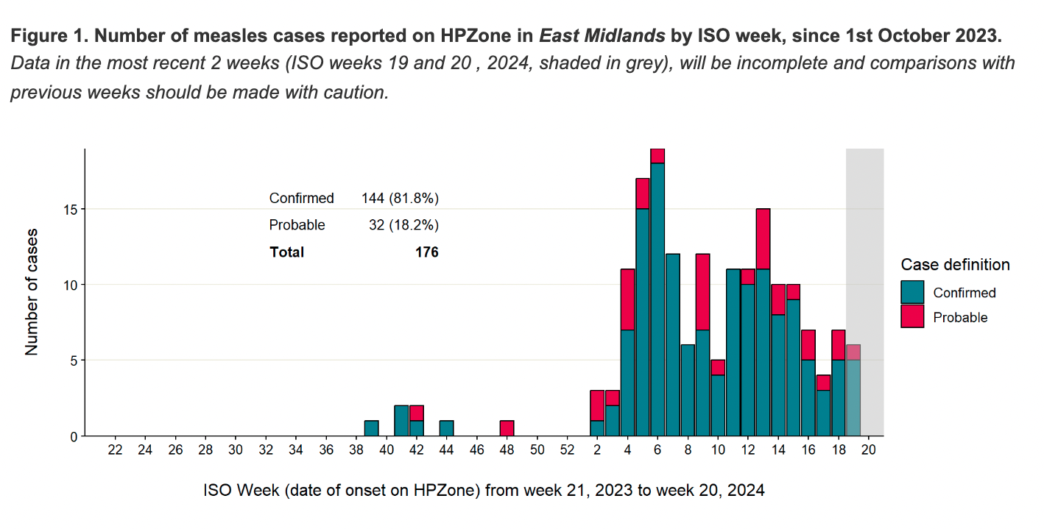

Slide 3
Overview
What is Measles?
Symptoms/signs
Complications
Infection timeline
Herd Immunity
Vaccination
Exposure to Measles
Self-Isolation

Slide 4
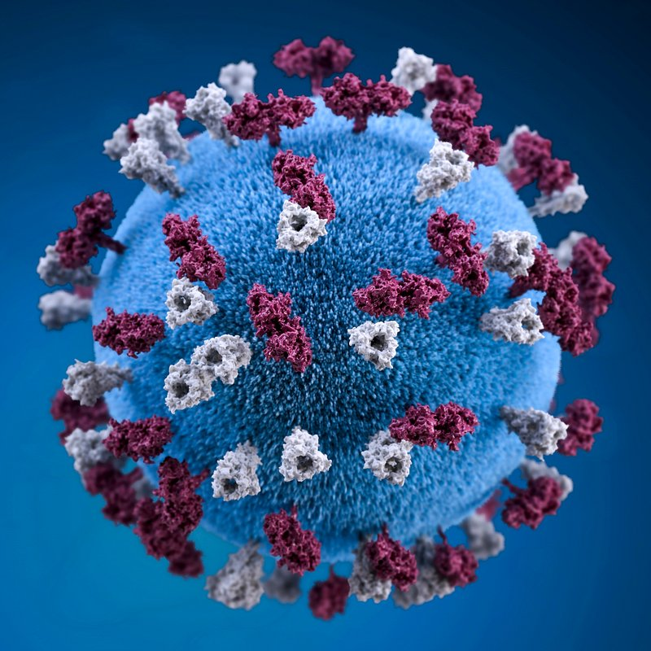
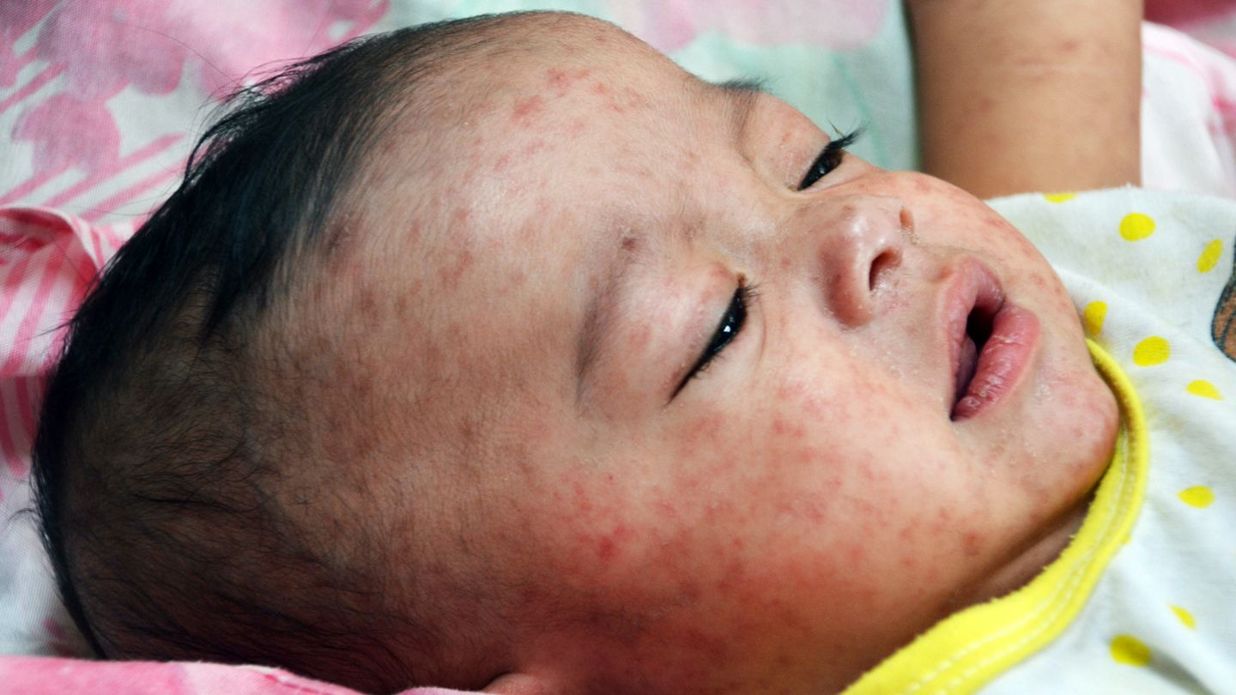
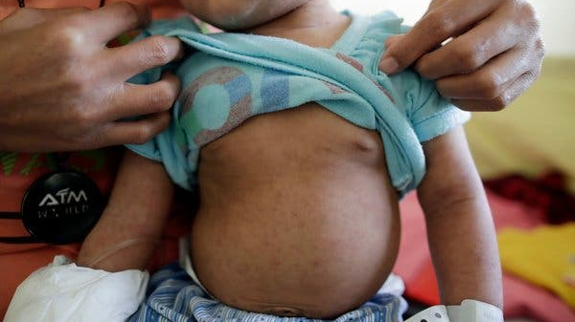
Measles (Rubeola virus) very infectious
IMMUNE: Fully vaccinated (or part vaccinated) or had measles previously
NOT IMMUNE: Not vaccinated (or only part vaccinated), and not had measles previously

Slide 5
How many people could one person infect?
Measles
COVID
R_{0 (Reproductive number)}

Slide 6
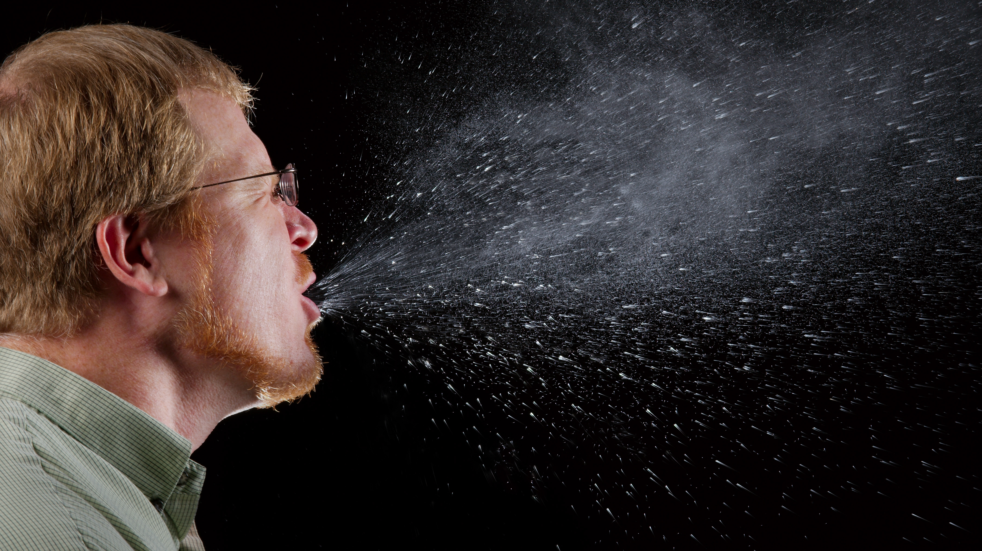
10 Non-immune contacts
Infectious
Transmitted by cough and sneeze droplets via eyes, nose & mouth

Slide 7
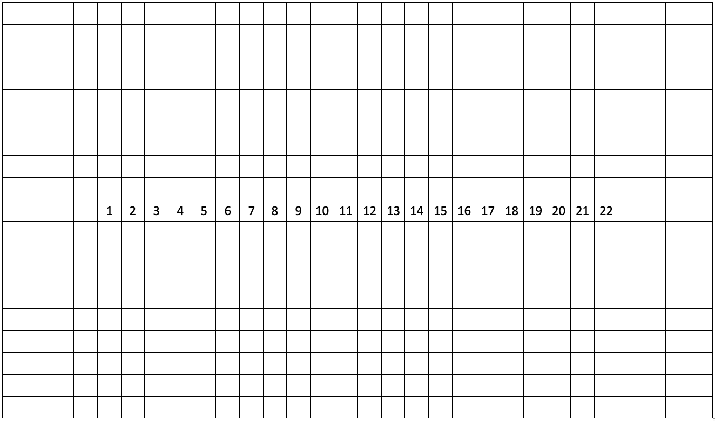
Lara
HIGH FEVER
COUGH/COLD & CONJUNCTIVITIS
INFECTIOUS
10-12 day incubation period
Paul

Slide 8
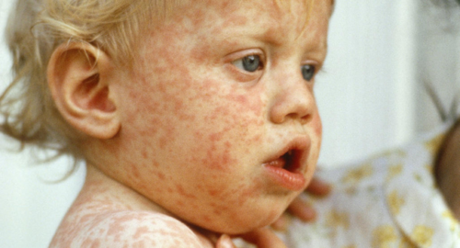
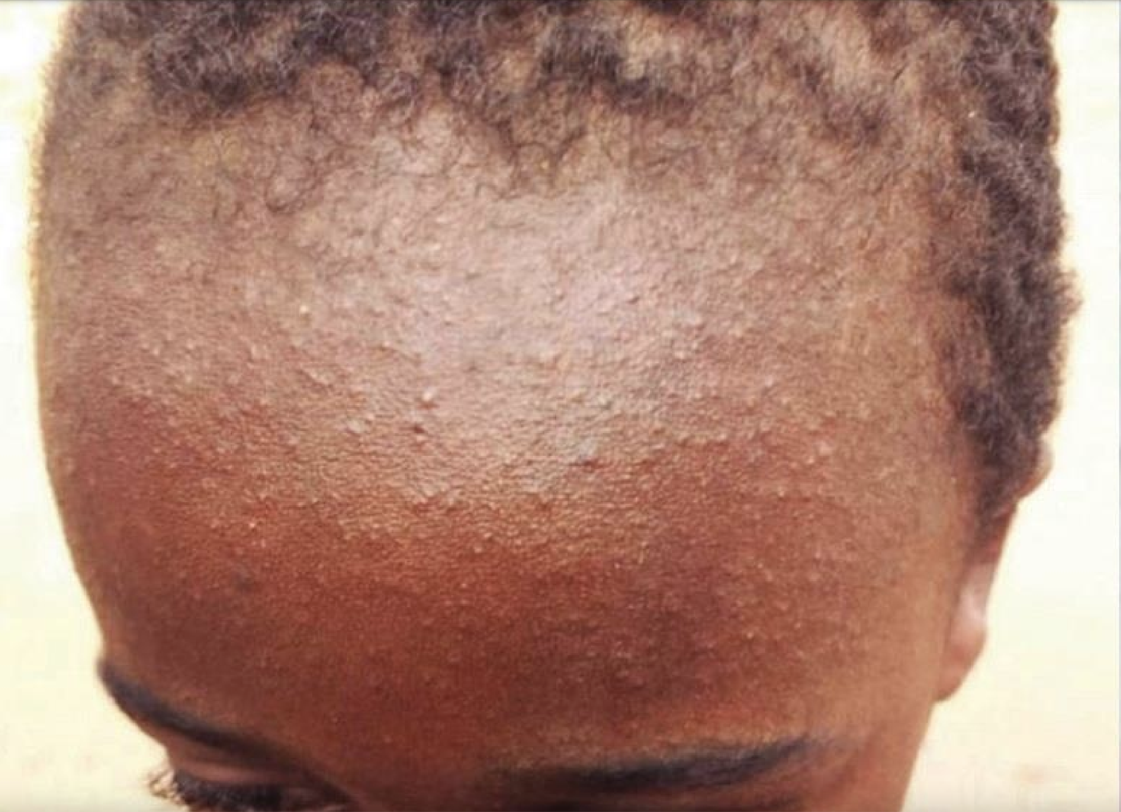
Infectious for 4 more days after rash develops…

Slide 9
Lara
HIGH FEVER
COUGH/COLD & CONJUNCTIVITIS
INFECTIOUS
KOPLIK SPOTS
Paul

Slide 10
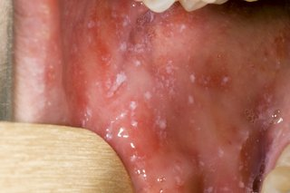
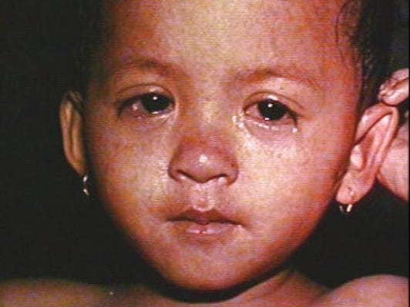
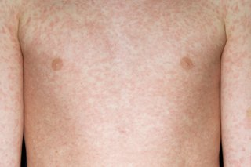
Measles symptoms/signs:
High temperature
Runny nose / sneezing
Cough
Red, sore, watery eyes
Koplik spots
Rash

Slide 11
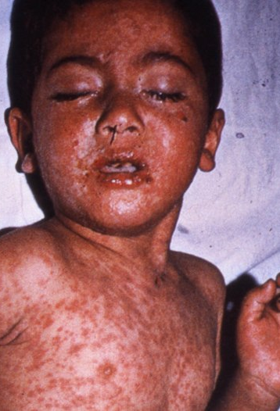
20-40% require hospitalization 10-20% develop complications:
Ear infection
Pneumonias
Fits, encephalitis, brain injury
Diarrhoea
Blindness, deafness
Miscarriage, premature birth, stillbirth
Death
More dangerous for babies under 12 months and adults over 25

Slide 12
What can we do?
Herd immunity in our community!

Slide 16
Herd
Immunity
95%

Slide 17
Herd
Immunity
95%
Leicester
80.7%

Slide 21
Vaccination
MMR₁ results in 95% protection (usually age 12 months)
MMR₂ results in 99% protection (usually age 3 years & 4 months)
Live vaccine (unsuitable for pregnant or immunocompromised)
Porcine-free Priorix available
Protection is longstanding
Measles vaccine introduced in 1968. Any older adults likely to have natural immunity but this varies according to where they were born

Slide 22
Eligibility for MMR:
Everyone of any age in the UK is entitled to 2 doses of MMR vaccine for free on the NHS
But:
Young babies cannot be vaccinated
Some allergy sufferers cannot be vaccinated
Vaccination is not usually offered in pregnancy
Those with poorly functioning immune systems, either due to an illness affecting the immune system or a treatment which suppresses their immune system are unable to be vaccinated

Slide 23
MMR Vaccines:
Catch-up regime is 2 doses, 4 weeks apart
Porcine free

Slide 24
MMR side effects:
Most people do not get any serious side-effects; however, some people will experience:
Sore arm
Tiredness
A fever
A rash
Swollen neck glands
These are significantly less serious than the symptoms of measles.

Slide 25
What if I’ve been in contact with Measles?
All: Complete any swabs/testing requested to help us monitor the disease and understand who is at risk
Immunised individuals: Please spread the word and encourage others to protect the community
Non-immune:
Vaccination ASAP wherever appropriate
Immunocompromised individuals need to telephone their GP for advice
Self-isolation whilst potentially incubating/infectious with virus.

Slide 26
Lara
HIGH FEVER
COUGH/COLD & CONJUNCTIVITIS
INFECTIOUS
Average 10-12 day incubation period
Paul

Slide 27
Lara
HIGH FEVER
COUGH/COLD & CONJUNCTIVITIS
INFECTIOUS
Average 10-12 day incubation period
Incubation period can be 7-18 days
Paul

Slide 28
Lara
HIGH FEVER
COUGH/COLD & CONJUNCTIVITIS
INFECTIOUS
Average 10-12 day incubation period
Incubation period can be 7-18 days
Non-immune contacts: isolation period to avoid infecting others
Paul

Slide 29
Summary of key points
Measles is very infectious & spreads very easily
Anyone can catch it at any age
Vaccination gives lifelong protection
You can be routinely vaccinated at any age after your first birthday
Vaccination involves two doses off MMR vaccine – free of charge
If you think you have measles, call NHS 111 or your GP for advice – do not go to your surgery or A&E and stay away from other people.

Slide 30
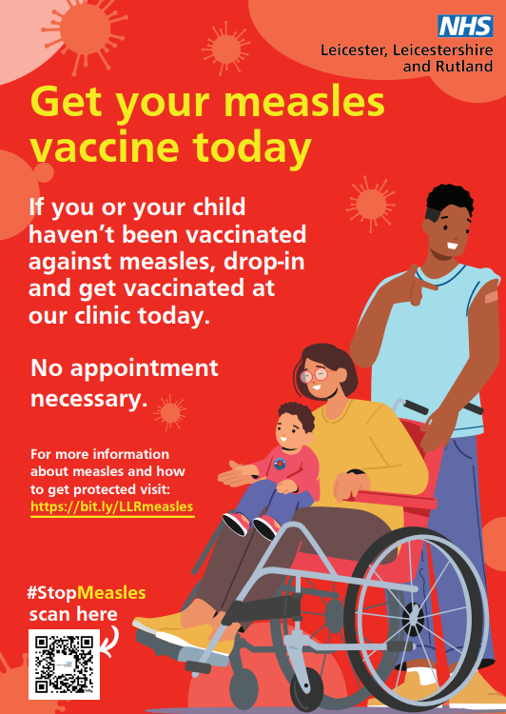
To get a Measles Vaccination
If you don’t know if you are fully immunised against measles - speak to your GP
GPs provide MMR vaccinations
If you are struggling to get an MMR vaccination from your GP, call our helpline, you may be able to get an MMR vaccination from one of our mobile vaccination units operating across LLR - for details, tel: 0116 497 5700 & select ‘option 1’.

Slide 31
Mobile MMR Vaccination: City Locations
Date | Location | Availability
19/05/2024 | Peepul Arts Wellbeing Mela, LE4 | 11am to 5pm
23/05/2024 | Tudor Centre, Steady Steps, LE4 | 9am to 11am
23/05/2024 | King Richard III School, LE3 | 12pm to 4pm
24/05/2024 | Heron GP Practice, LE5 | 10am to 4pm
25/05/2024 | Town Hall Square, LE1 | 10am to 4pm
28/05/2024 | Primark, LE1 | 10am to 4pm
29/05/2024 | Primark, LE1 | 10am to 4pm
04/06/2024 | Leicester Adult Education, LE1 | 11am to 2pm
07/06/2024 | Horizon Healthcare, LE5 | 10am to 2pm
07/06/2024 | Al-Islamia School | 2.30pm to 4pm
08/06/2024 | Leicester Market | 10am to 4pm
10/06/2024 | Evington Leisure Centre, Steady Steps, LE5 | 10am to 4pm
11/06/2024 | Aylestone Library, LE2 | 10am to 2pm
12/06/2024 | Primark, LE1 | 10am to 4pm
20/06/2024 | Community Health Centre, LE2 0GU | 10am to 2pm

Slide 32
Mobile MMR Vaccination: County Locations
Date | Location | Availability
20/05/2024 | Barrow Health Centre, Barrow Upon Soar, LE12 | 10am to 4pm
21/05/2024 | Salvation Army Community Café, LE11 | 10am to 2pm
30/05/2024 | Quorn Medical Practice, LE12 | 10am to 4pm
31/05/2024 | Alpine Surgery, Loughborough LE12 | 10am to 4pm
31/05/2024 | Measham Library, Swadlincote, DE12 | 10am to 4pm
04/06/2024 | Anstey Surgery, LE7 | 10am to 4pm
13/06/2024 | Barrow Health Centre, Barrow Upon Soar, LE12 | 10am to 4pm
15/06/2024 | Peepul Centre supporting Vita Minds with diabetes awareness | 10am to 4pm
29/06/2024 | Place to Grow, Enderby LE19 | 10am to 4pm

Slide 33
Pertussis

Slide 34
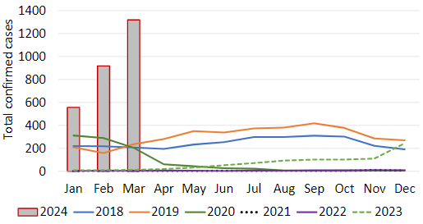
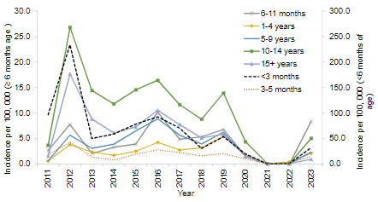
Confirmed Cases of Pertussis in England
858 Confirmed cases reported to UKHSA in 2023. So far this year: 556 cases confirmed in Jan, 918 cases in Feb, and 1,319 cases in March 2024 – these latest figures include 5 infant deaths. 50.8% of the 2024 cases are in children aged 15 years or older and 28.6% in children aged between 10 and 14 years. Confirmed cases of pertussis in England by month - GOV.UK (www.gov.uk)
Annual incidence by age of confirmed cases of pertussis by month in England: 2011 to 2023
Confirmed cases of pertussis by month in England: 2018 to 2024

Slide 35
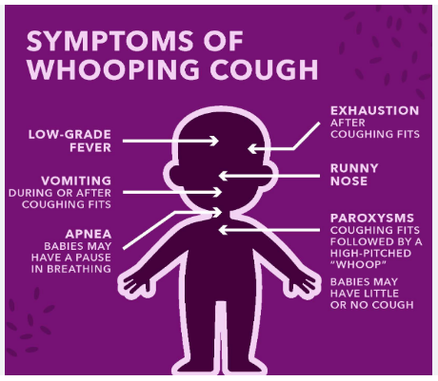
Pertussis is a notifiable disease
NHSE & UKHSA urge pregnant women to have whooping cough vaccination as cases surge in Midlands
Bacterial infection of the lungs and breathing tubes, that spreads very easily and can be very serious for unvaccinated babies and small children.
First signs are similar to a cold – a runny nose and sore throat.
After a week, the patient will get coughing bouts that last for a few minutes and get worse at night and may develop into the ‘whoop’ sounds – a gasp for breath between coughs.
Three time periods to vaccinate:
During pregnancy between 16 & 32 weeks, to protect mum and baby (can be given up to 8/52 postnatal)
As part of newborn vaccinations at 8, 12 & 16 weeks
Pre-school as booster vaccination at age 3 years & 4 months
Whooping cough - NHS (www.nhs.uk)
Notes:
Ginny

