Slide 1
Pharmacy Technician Update
Rose Balment
Senior Pharmacy Technician, NWL PCN
NHSE Midlands Pharmacy Technician Leadership Group (PTLG)

Slide 2
Introduction
16 years experience working in pharmacy
Background in community, hospital and general practice settings
Registered pharmacy technician since 2016

Slide 4
Regional Pharmacy Leadership Team Monthly Briefing
Usually on the last Thursday of the month, the NHSE Regional Pharmacy Leadership Team hold a drop-in briefing over Teams.
Updates on everything that is going on pharmacy-wise across the Midlands. They cover community, primary, and secondary care and is a great one-stop shop for information.
To be added to the invite list please contact midlands.regionalpharmacyteam@nhs.net or sign up here for the monthly newsletter "Script" https://forms.office.com/e/

Slide 5
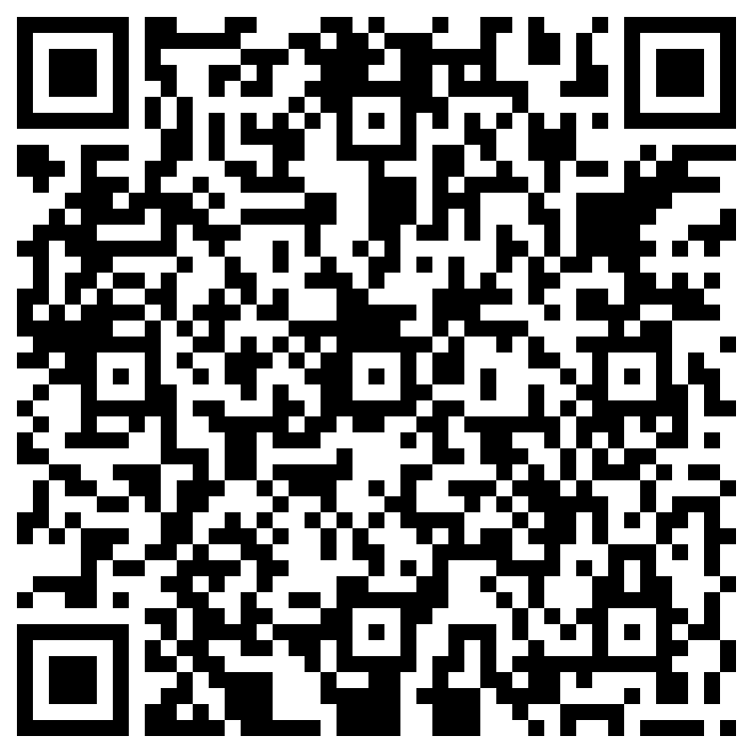
LLR Pharmacy Technician Newsletter
Collated by pharmacy technicians working across different sectors in LLR
1st edition of the newsletter distributed in September 2024
Currently sent to 225 pharmacy technicians across LLR
QR code below to join the mailing list

Slide 6
LLR Teaching Forum
Every fortnight alternate Tuesdays & Thursdays
Wide range of topics with guest speakers
Next teaching forum is Tuesday 29th October 11am-12
To be added to the mailing list, email:
llrpharmacyteachingforum@uhl-tr.nhs.uk

Slide 7
Pharmacy Clinical Services Evaluation
NHS England have RAND Europe (not-for-profit) organisation to conduct an independent evaluation of clinical services under the Community Pharmacy Contractual Framework (CPCF) as known as the ‘pharmacy contract’
Evaluation aims to gather input from pharmacists, pharmacy technicians and other pharmacy staff, and contractors regarding the successes and challenges they have faced in providing CPCF services
https://www.smartsurvey.co.uk/s/CPPSQ1/

Slide 8
PGD legislation
From 26th June 2024, registered pharmacy technicians in England are able to supply and administer medicines under patient group directions (PGDs)
The NHS Specialist Pharmacy Service has resources available to support registered pharmacy technicians in the use of PGDs: Patient Group Directions – SPS - Specialist Pharmacy Service – The first stop for professional medicines advice.
A new CPPE e- learning PGD preparedness programme aimed at registered pharmacy technicians is in development.
https://www.cppe.ac.uk/programmes/l/ptgpdir-e-02

Slide 9
Training Opportunities
CPPE
Community Pharmacy Technician - advancing your role training
Community pharmacy technician: advancing your role : CPPE
CPPE accuracy checking pharmacy technician programme
Accuracy checking pharmacy technician programme : CPPE
Propharmace
Training for Educational Supervisors including Designated Supervisors (DS)
Training for Designated Prescribing Practitioners (DPP)
Educational Supervisor Training for the Community Pharmacy Workforce – ProPharmace

Slide 10
Eezycd

Slide 11
Are pharmacy technicians technical or clinical?

Slide 12
Questions
Rose.balment@nhs.net

