Slide 1

Contract Variations &
Impact on Pharmacy Services
Webinar 20/05/25

Slide 2
Agenda:
1. Pharmacy Services Performance to date and Contractual Changes Gareth McCague CPL&R & Paul Gilbert LLR ICB
Blood Pressure Checks
Pharmacy First Service
Contraception Service
NMS
PQS
Use ‘chat’ for questions
“bundling”
2. Further details of Funding Settlement 2025/26- Rajshri Owen
3. Offer to Community Pharmacy: Technician Apprenticeship Funding - Ms Suki Tagger NHS England

Slide 3

First - PCARP & Bundling
GP Access – an issue for NHS & Patients
Primary Care Access Recovery Plan [PCARP] – includes roles for pharmacy
  Pharmacy First (with targets for the £1k fee)
  Hypertension Case Finding
  Pharmacy Contraception Service
Were introduced separately
NOW being ‘bundled’ (to qualify for the £1k fee)

Slide 4
Blood Pressure Checks in CPL&R
How are we doing?
LLR is delivering the highest service volumes in East Midlands
LLR is 3rd place overall in the wider Midlands Region
But:
Service quality is not good – indicated by poor readiness to offer ABPM services.

Slide 5
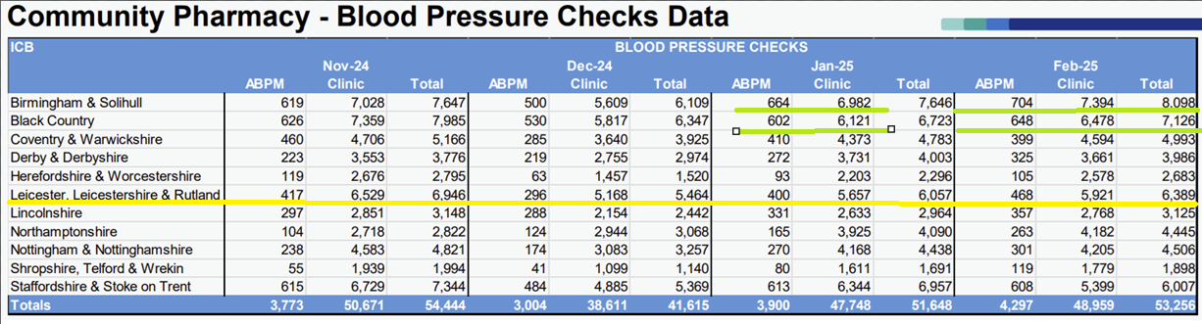
CPL&R – Leading in East Midlands
3rd in Midlands overall (East+West)
Leicestershire & Rutland ICB Yellow Line ABPM approx: 6.3 % of total over the 4 months
Birmingham & Solihull ICB + Black Country ICB Lime Lines ABPM approx: 10% of the total 41% more than LLR

Slide 6
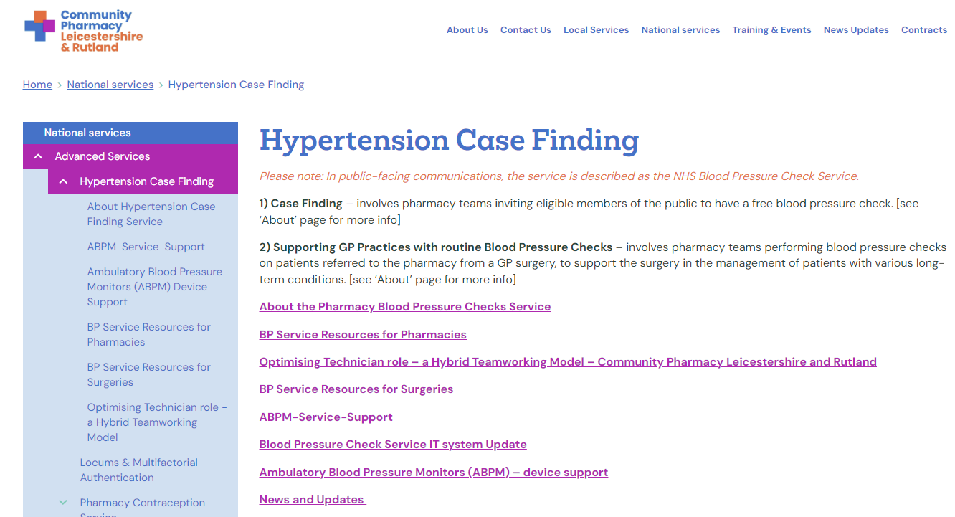

Slide 7
BP Case Finding - Contractual Changes
Bundling Impact – must be registered to provide BP Checks from June
- MUST deliver ONE ABPM per month, from October
ABPM Fee – increased to £50.85
Service Fee – clinic check fee reduced to £10 to reflect skill mix [& VAT exemption]
Service Spec – changes anticipated - clarifying eligibility for repeat clinic checks and clarification of criteria for Practice-to-Pharmacy referrals. [tbc?]
Discussion: How can we increase ABPM service provision?

Slide 8
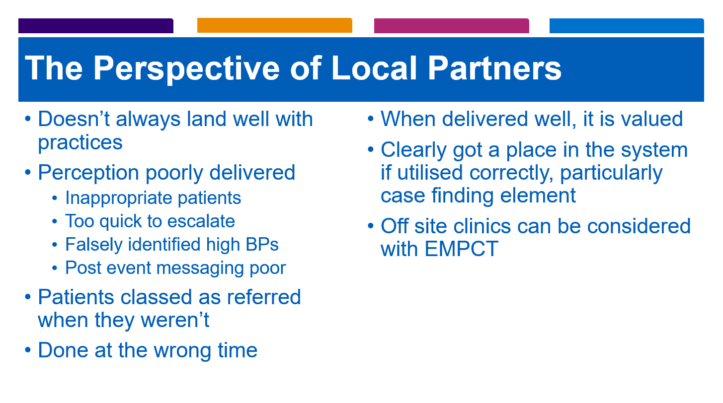

Slide 9
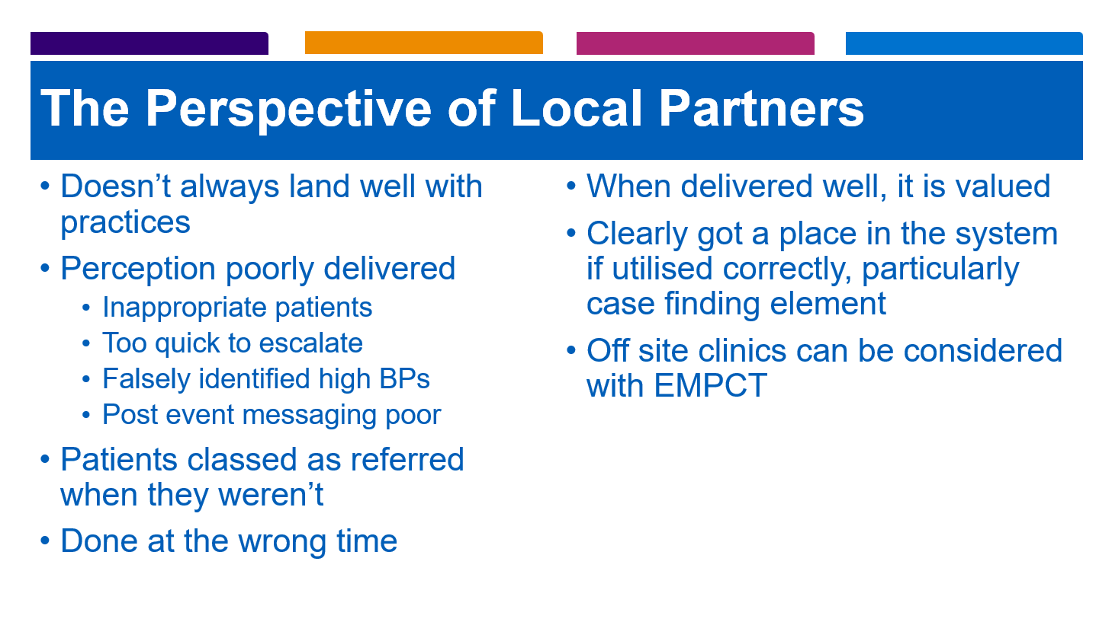

Slide 10
Contraception Services in CPL&R
How are we doing?
In East Mids: 2nd ex 5 in 2024 [4th ex 11 LPC areas in Midlands East+West ]
Good ratio of Initiation vs Ongoing Supply [LLR= 10.4%] [Staffs=10.6%]
But:
Contractor Registration: 198/225 = 90% (25 contractors still to register)
Contractor Engagement is c. 67% (perhaps a training refresh required for some?)

Slide 11
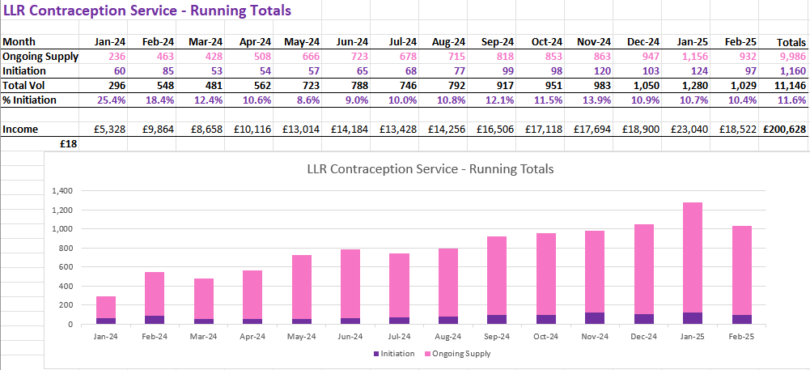
Contraception Services

Slide 12
Contraception - Contractual Changes
Bundling – contractors must be registered to provide PCS from June 2025
Service Fees – increased to £25 (up from £18 for both Initiation and Ongoing supply)
NHS EHC Service – being added to Contraception service menu, October 2025 (subject to IT)
NHS EHC Provision – will be more ‘open access’ (less restrictive age limits )
NHS EHC Service Fee – will be £20 + cost of EHC [LA EHC = £12.50]
NHS EHC Training Options – PQS corresponds. More useful & supportive
Provision - MUST deliver (n?) per month from March 2026. (NB: in the ‘bundling’)
n is likely to be the total of PCS and EHC services? [NB: tbc]

Slide 13
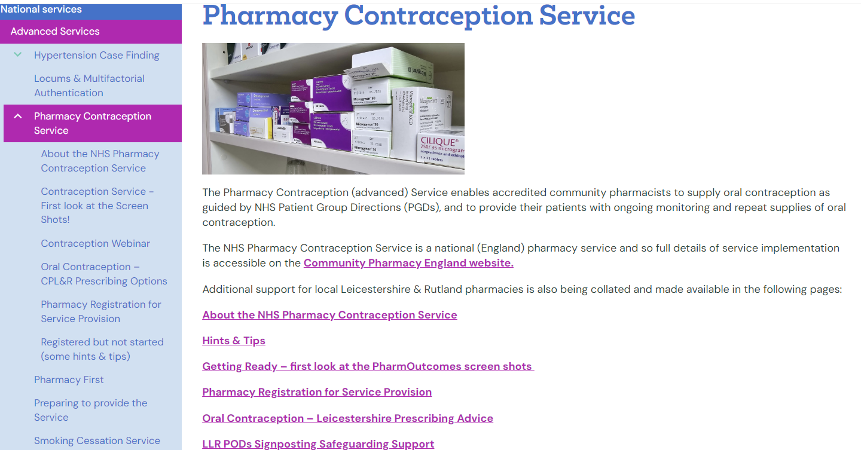
Contraception - Contractual Changes
Bundling Impact – must be registered to provide PCS from June
Service Fee – Initiation increased to £25 (up from £18)
EHC Service – being added to Contraception service menu, in October
EHC Provision – will be more ‘open access’ (less restrictive age limits )
EHC Service Fee – will be £20 + cost of EHC
EHC Training Options – in PQS (ie supporting provision, PQS being more directly useful)
Provision - MUST deliver (n?) per month, ‘bundling’ from March 2026 - Likely to be a total of PCS and EHC services? [tbc]
NB: Actively seek an ‘ongoing supply’ intervention, before receiving a referral for ‘initiation’

Slide 14
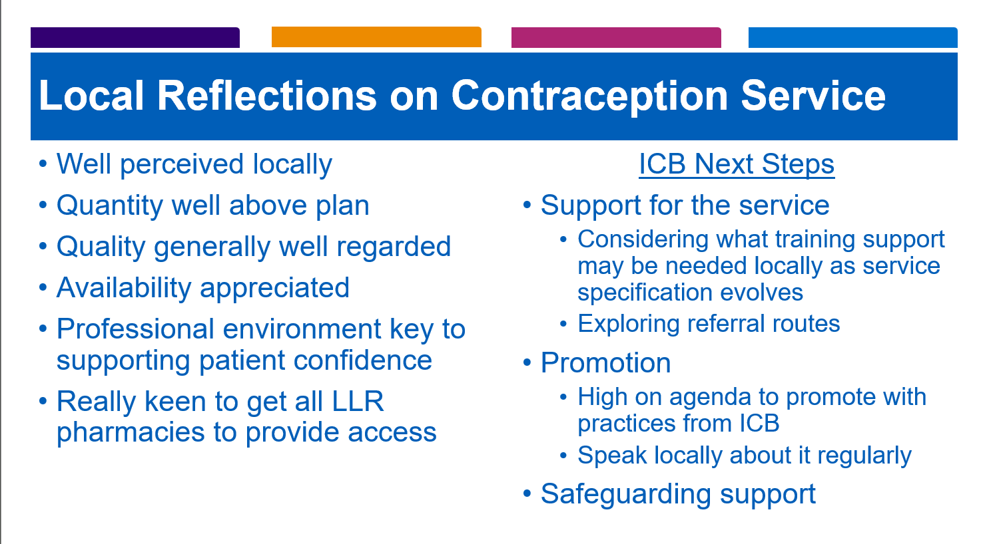

Slide 15
Pharmacy First in CPL&R
How are we doing?
In East Mids: 1st out of 5 LPC areas in 2024 [4th ex 11 in Midlands E+W ]
LLR Contractor Income: growing, now c. £150,000 per month
[£1.8m since start, highest PF contractor income in East Midlands]
But:
Referrals from surgeries are poor [85% of referrals from just 25% of Practices] [20% sent 0 ]

Slide 16
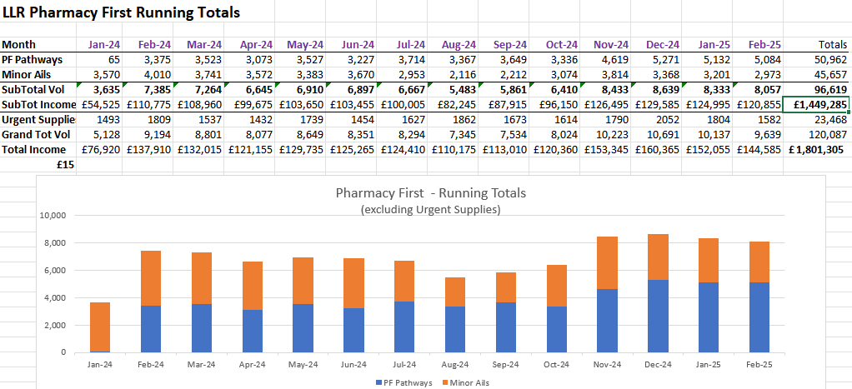
Pharmacy First Performance
How are we doing?
In East Mids: 1st ex 5 in 2024 - [4th ex 11 areas in Midlands ]
LLR Contractor Income: growing, now c. £150,000 per month!
[£1,800,000 since start, highest contractor income in East Midlands]]
But:
Referrals from surgeries are poor [85% of referrals from just 25% of Practices] [20% sent 0 ]

Slide 17
Pharmacy First – Contractual Changes
Service Fee – increases to £17
Gateway Banding: 20-29 +£500 >30 +£1,000
NB: Consider: 19@ £17 each, 20 @ £42 each 30 @ £50 each
(£17+£25) (£17+£33)
Bundling Impact – threshold fee NOT paid unless all 3 services bundled, from June 2025
Discussion: Be ready to Encourage Practices to make electronic referrals?
Be familiar with arguments for electronic Referrals over verbal Signposting
SystmOne introducing an inbuilt referral module [PharmRefer & MFA will be less of a barrier]
                Eg

Slide 18
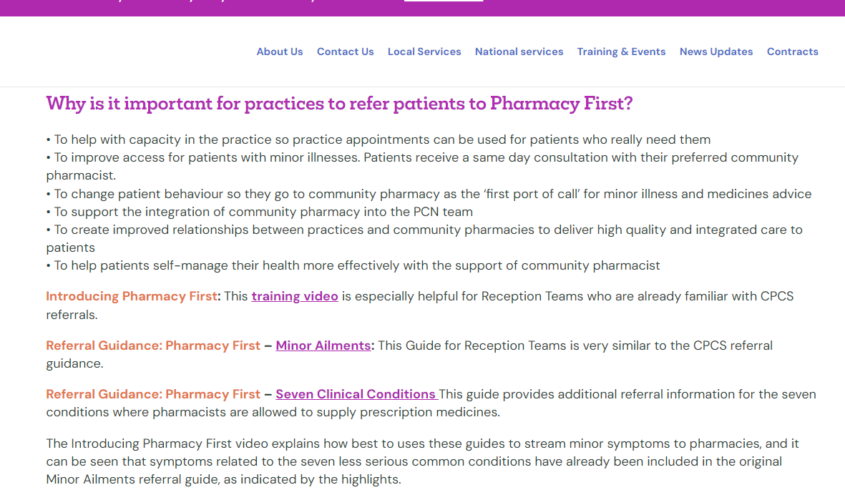
Pharmacy First – Contractual Changes
Bundling Impact – threshold fee NOT paid unless bundled, from June
Service Fee – increases to £17
Gateway Banding: 20-29 +£500 >30 +£1,000
Consider: 19@ £17 each, 20 @ £42 each 30 @ £50 each
(£17+£25) (£17+£33)
Discussion: Encouraging Practices to make electronic referrals?
SystmOne introducing an inbuilt referral module [PharmRefer & MFA less of a barrier]
Learn the case for electronic Referrals over verbal Signposting
Makes case for e.referrals over verbal signposting

Slide 19
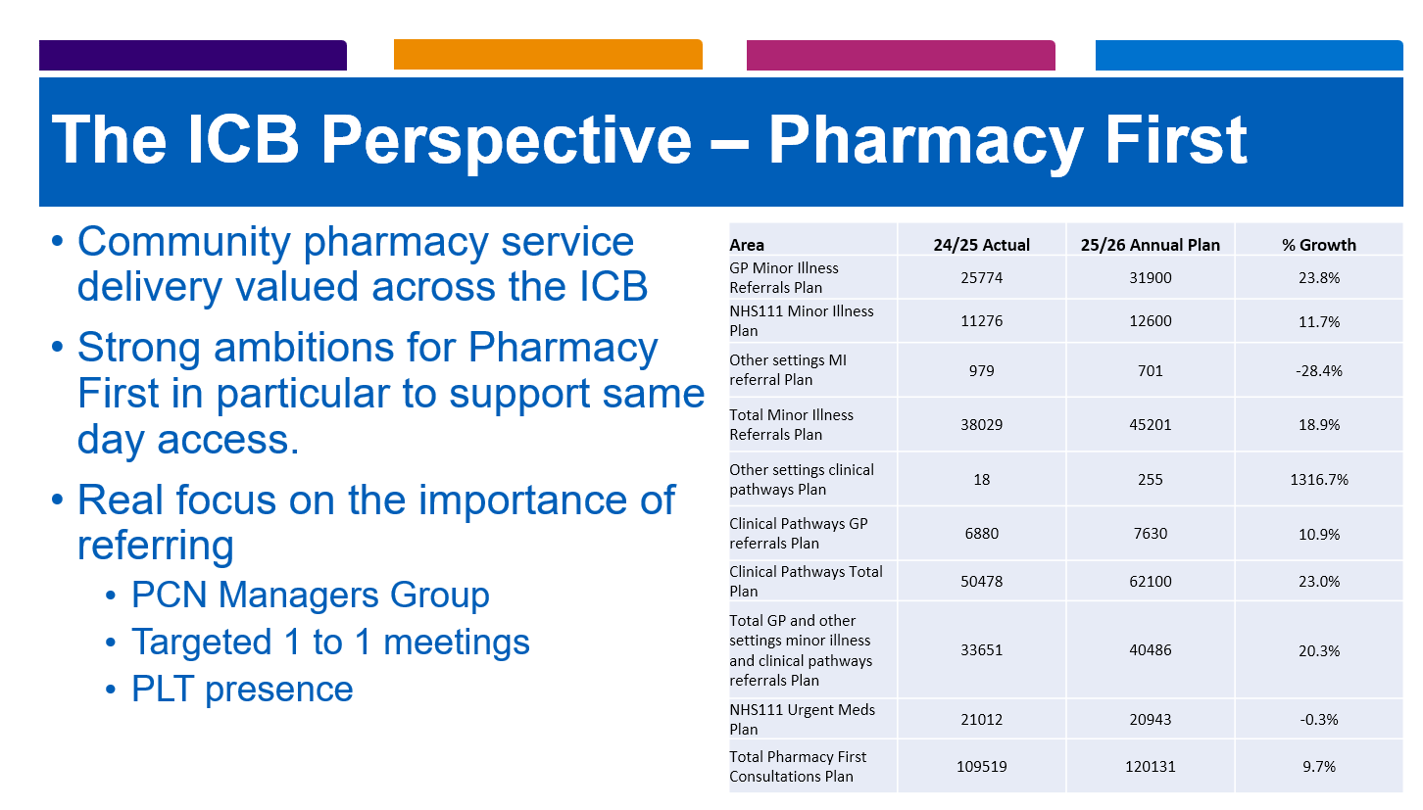

Slide 20
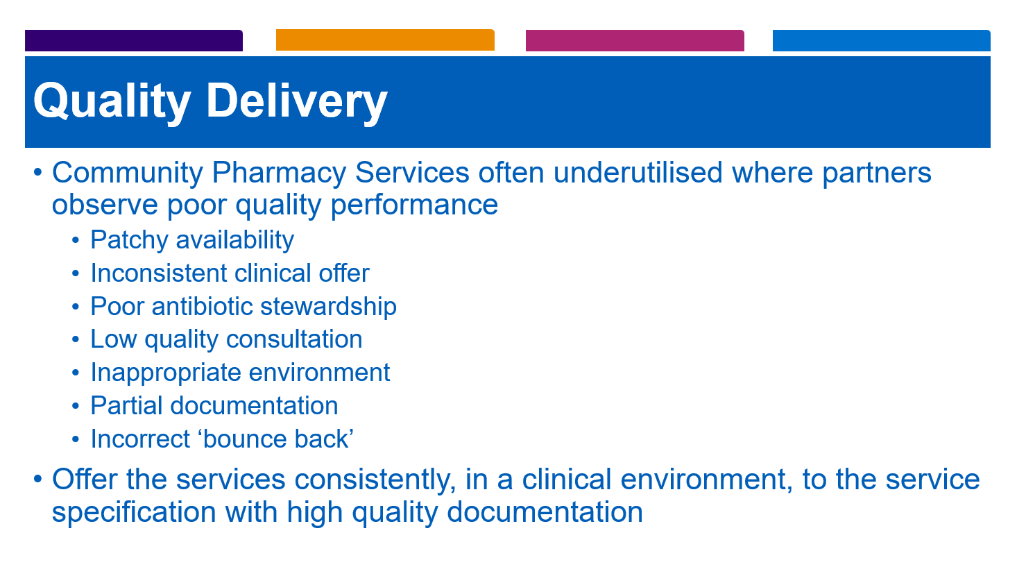

Slide 21
New Meds Service - Contractual Changes
Bundling Impact – not applicable
Split Service Fee – intervention part £14, follow up £14
Patient Contact – claims only if patient consultation taken place
Service Caps – appears to have doubled, but it computes the separate parts
Off-site subContracting - not allowed, except by employees
MYS Changes – until MYS IT is updated, claim sum of interventions & follow ups
    - Eg 20 completed Interventions + 11 completed Follow ups = MYS Claim for 31 NMS fees
Expansion – from October, meds for depression will be eligible for NMS
Training – voluntary, & encouraged via PQS

Slide 22
PQS Pharmacy Quality Scheme 2025-2026
Scheme - worth £2,875 per pharmacy. (approximates to dispensing fees for 2,000 items)
Patient Safety Domain (20 points) - Fewer and some refresher activities inc… Antimicrobial stewardship, Sepsis Training, Enhanced DBS
Meds Optimisation Domain (30) – Update DOS confirming Palliative Care items in stock
CPPE – Mental Health Consultations (soft skills)
Respiratory audit (pMDI) + Overuse of SABAs without steroid
CPPE Emergency Contraception + Assessment
Aspiration Payment (can claim £2,156 (75%) in advance, this month for 1st July receipt.
(balance to be claimed or reconciled Feb 2026) [deadline 16th May - passed]
PQS Time demands? – significant. But consider PQS payment = 12x days locum fees
PQS Support? – a separate session for LLR contractors is being considered, tbc.

Slide 23
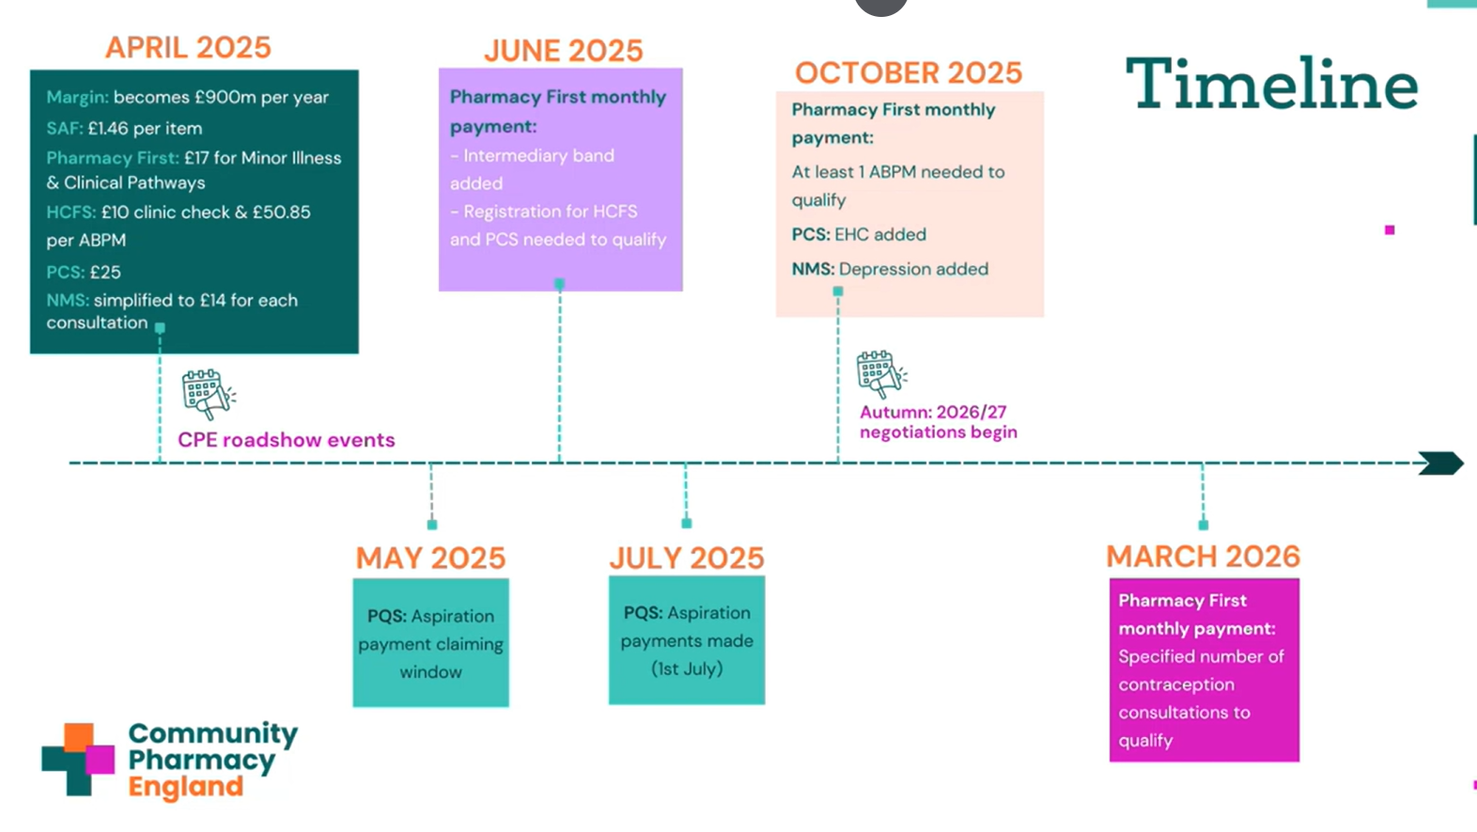

Slide 24
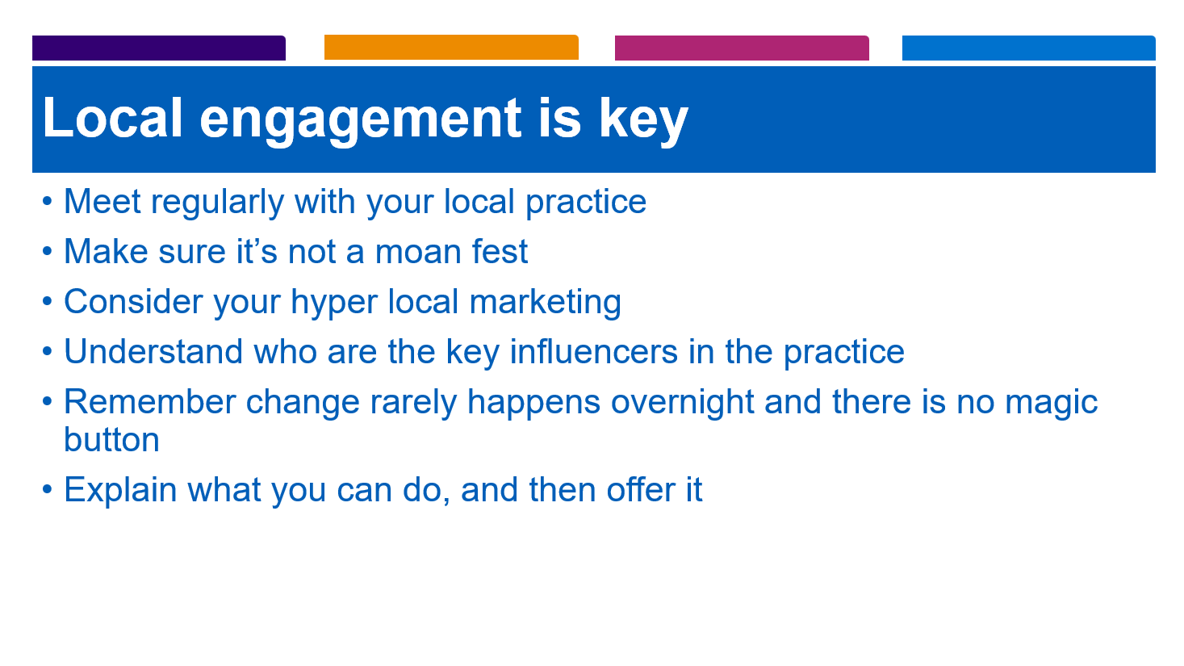

Slide 25
Other Regulatory Changes
Clinical audits
During 2025/26, there will be no requirement to complete a nationally chosen or pharmacy owner selected clinical audit.
Health campaigns
During 2025/26, pharmacies will only have to take part in a maximum of two national health campaigns and two campaigns selected by their Integrated Care Board (ICB).
Practice leaflets
The requirement to produce a practice leaflet will be removed.
Patients signing prescription declarations
The requirement for patients that pay an NHS prescription charge to complete and sign the declaration on the rear of the prescription form or EPS token will be removed.

Slide 26
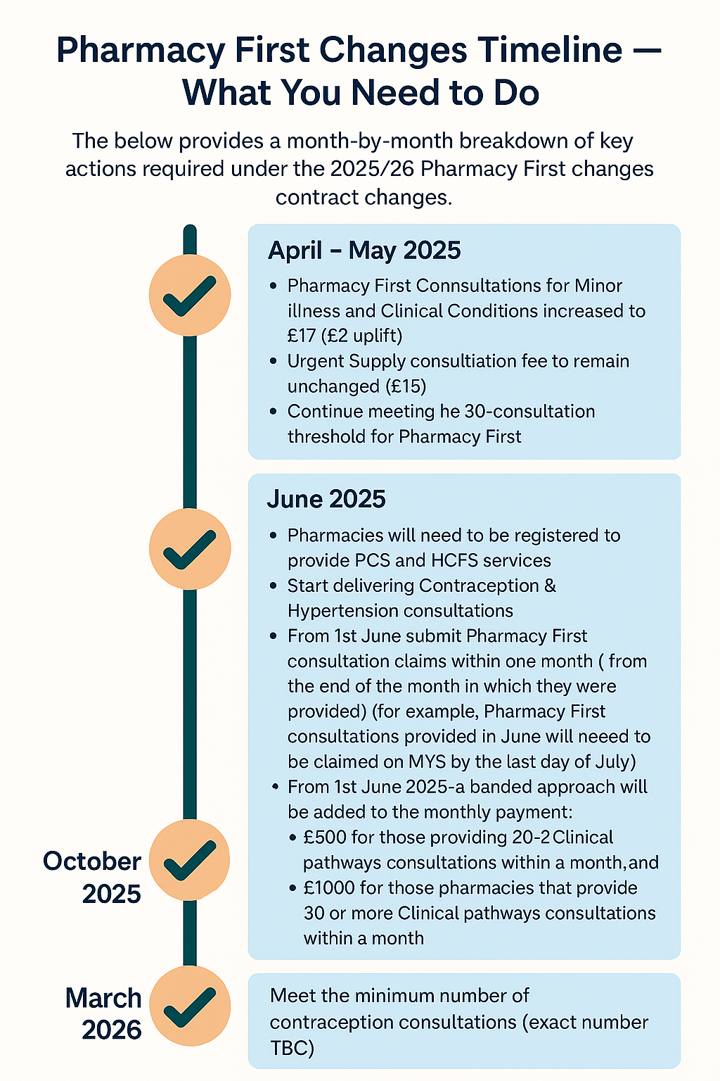
What you need to know
Amendment of regs’ test for changing the days and times of core opening hours
These regulatory amendments should enable pharmacy owners to change their opening hours to days and times that better serve their patients and likely users of the pharmacy, and in some cases, close at quiet times or out-of-hours.
Key points are:
▪ Changing core opening hours remains an application process – the ICB must approve any proposed change. Community Pharmacy England cpe.org.uk
▪ The total number of core opening hours must remain the same (another provision applies for applications to reduce the number of core opening hours).
▪ The new/proposed core opening hours must better meet the needs of patients and likely users of the pharmacy.
▪ A pharmacy owner’s evidence of the economic viability of their current opening hours may be considered by the ICB.
▪ The PLPS Regulations (Terms of Service) must be amended first – only then will this change be effective/apply.
▪ The Pharmacy Manual will be revised accordingly.

