Slide 1

Medicines Waste
‘Only Order What You Need’
Rajshri Owen
Chief Officer

Slide 2
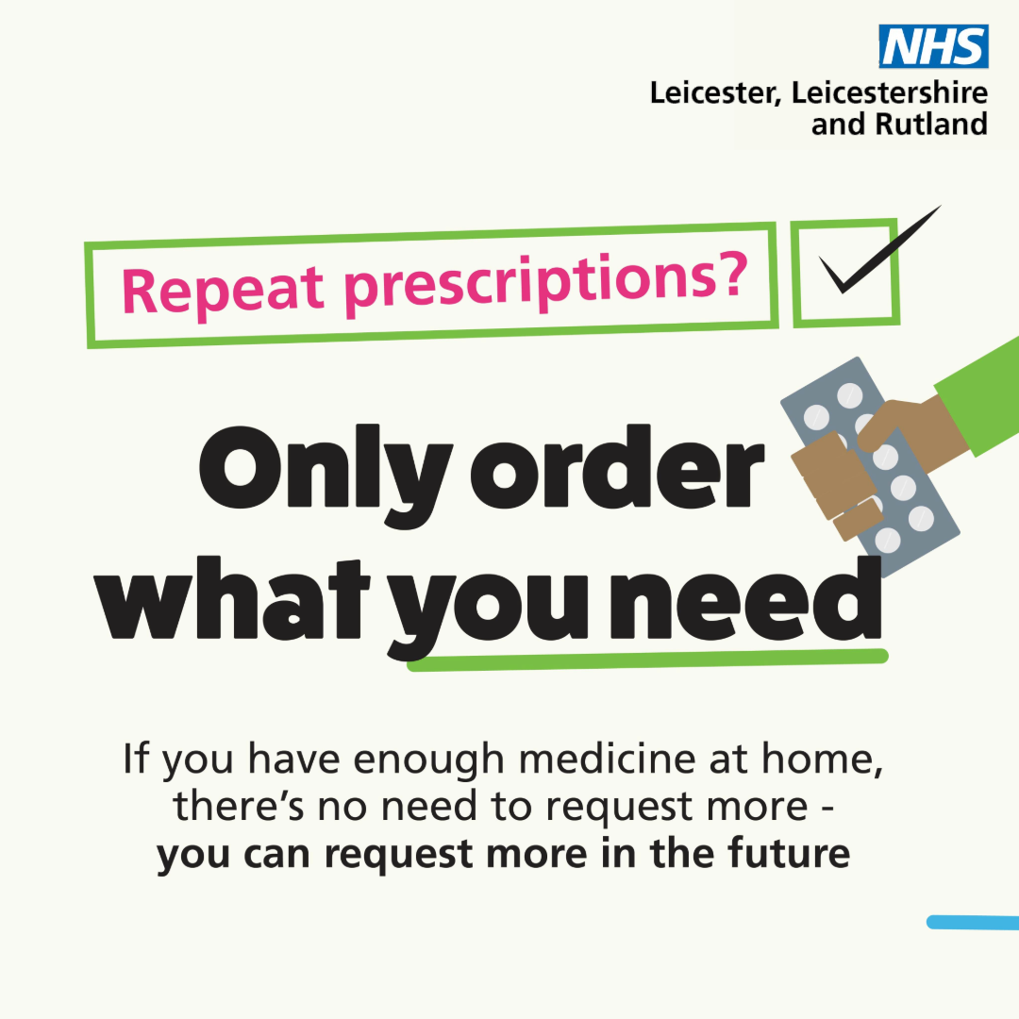
Medicines waste campaign
New medicines waste campaign launching 16 June - Only Order What You Need!
Coordinated campaign 16th June -4th August (CP)
Estimated £3 million medicines over ordered each year in LLR – could be used to fund additional staff and provide direct care
Based on a campaign run by NHS Dorset
The campaign raises awareness and encourages two key behaviours:
  Only ordering the items they need when they request their prescription – via NHS App
  Checking the prescription bag, before they leave the pharmacy, and returning anything they don’t need.
Raising awareness of the benefits of only ordering what they need and how easy it is to do.

Slide 3
Communications strategy
In the first instance maximise ICB owned channels and stakeholder relationships to launch the campaign (phase 1)
Alignment with launch of complementary campaign in GP Practices, community pharmacies and care homes
Cross marketing alongside other relevant campaigns, e.g. bank holiday repeat prescription ordering, NHS App promotion, inhaler technique, long term conditions management, pharmacy and general practice use, green messaging
Review after 2 months to determine next steps
Notes:
Patient empowerment campaign
Multi-modal communications campaign to reach patients on repeat medications and educate them on their ability to step back from requesting every item available to them, every month

Slide 4
Audiences
People in receipt of repeat medication
  People with long-term conditions, including higher prevalence such as diabetes and asthma
  Older people
  40+ estimate
Carers
Parents of children receiving regular medication
Seldom heard groups, diverse communities and deprived areas
Pharmacy staff
Prescribers: GPs, ANPs other general practice prescribers
Patient Group Forums

Slide 5
Key messages
When ordering your repeat prescription, only ordering the items you need - it is easy to do in the NHS App
When you pick up your medicines from a pharmacy – check in the bag to see if there are items you don’t need, before you leave the pharmacy.
If you need to go into hospital, take your medication with you so additional medication doesn’t need to be ordered. Ask a relative or carer to bring your medication in for you if you haven’t got it with you.
Reasons to only order what you need:
  Stay Well
    Unused medicines expire and might not work as we want them to
    Keeping big stocks of medicines at home can make drug shortages worse
  Stay Safe
    Big stocks of medicines at home can be a danger to children and pets
    Medicines are only prescribed for you and to be safe, should not be shared
  Stay Green
    The best way to manage waste medicines, is to give them to your pharmacy. This helps stop medicines polluting our beautiful rivers and sea
    By only ordering what you need, you help the environment, because once medicines have left the pharmacy, they cannot be recycled or use by anyone else

Slide 6
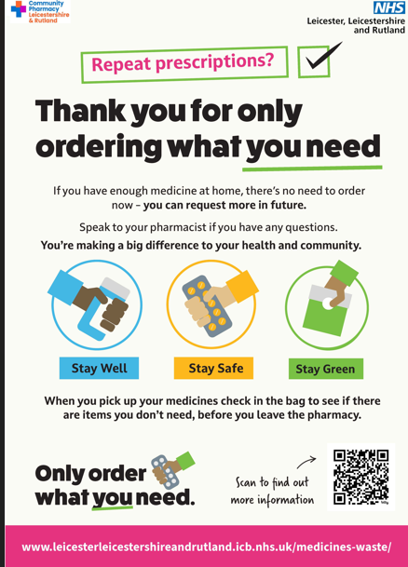
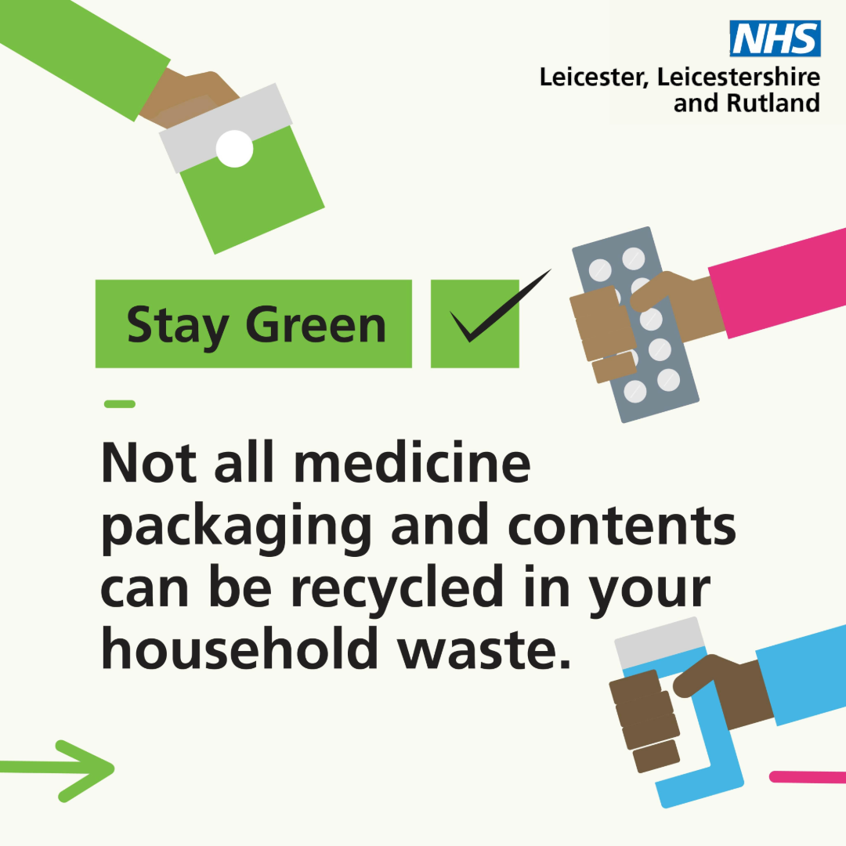
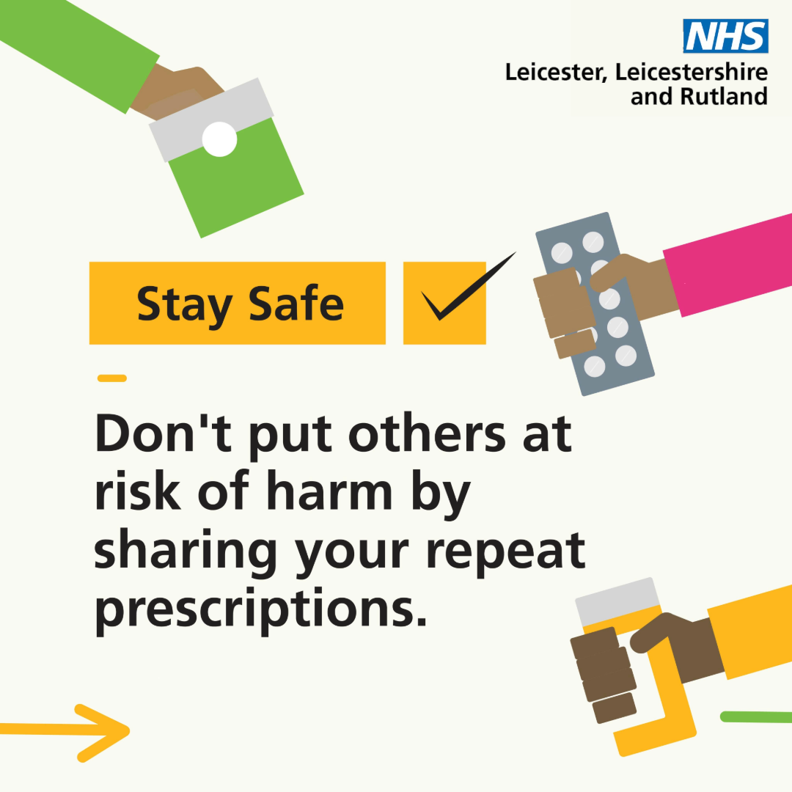
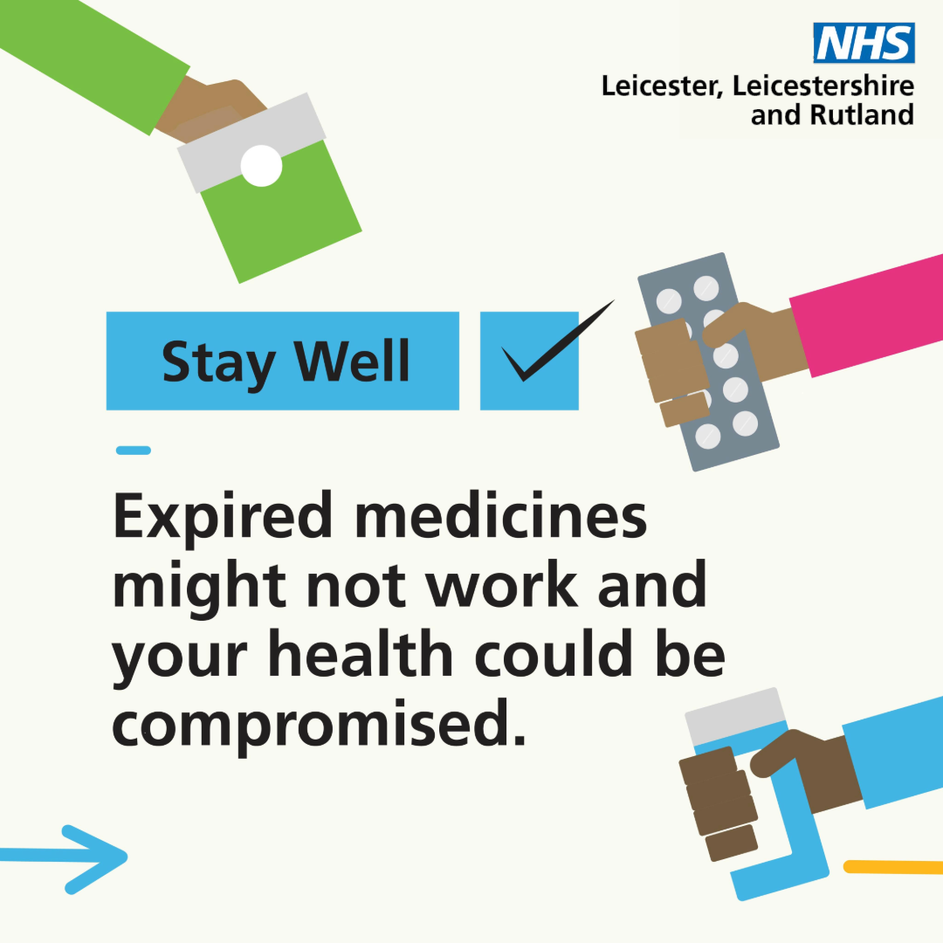
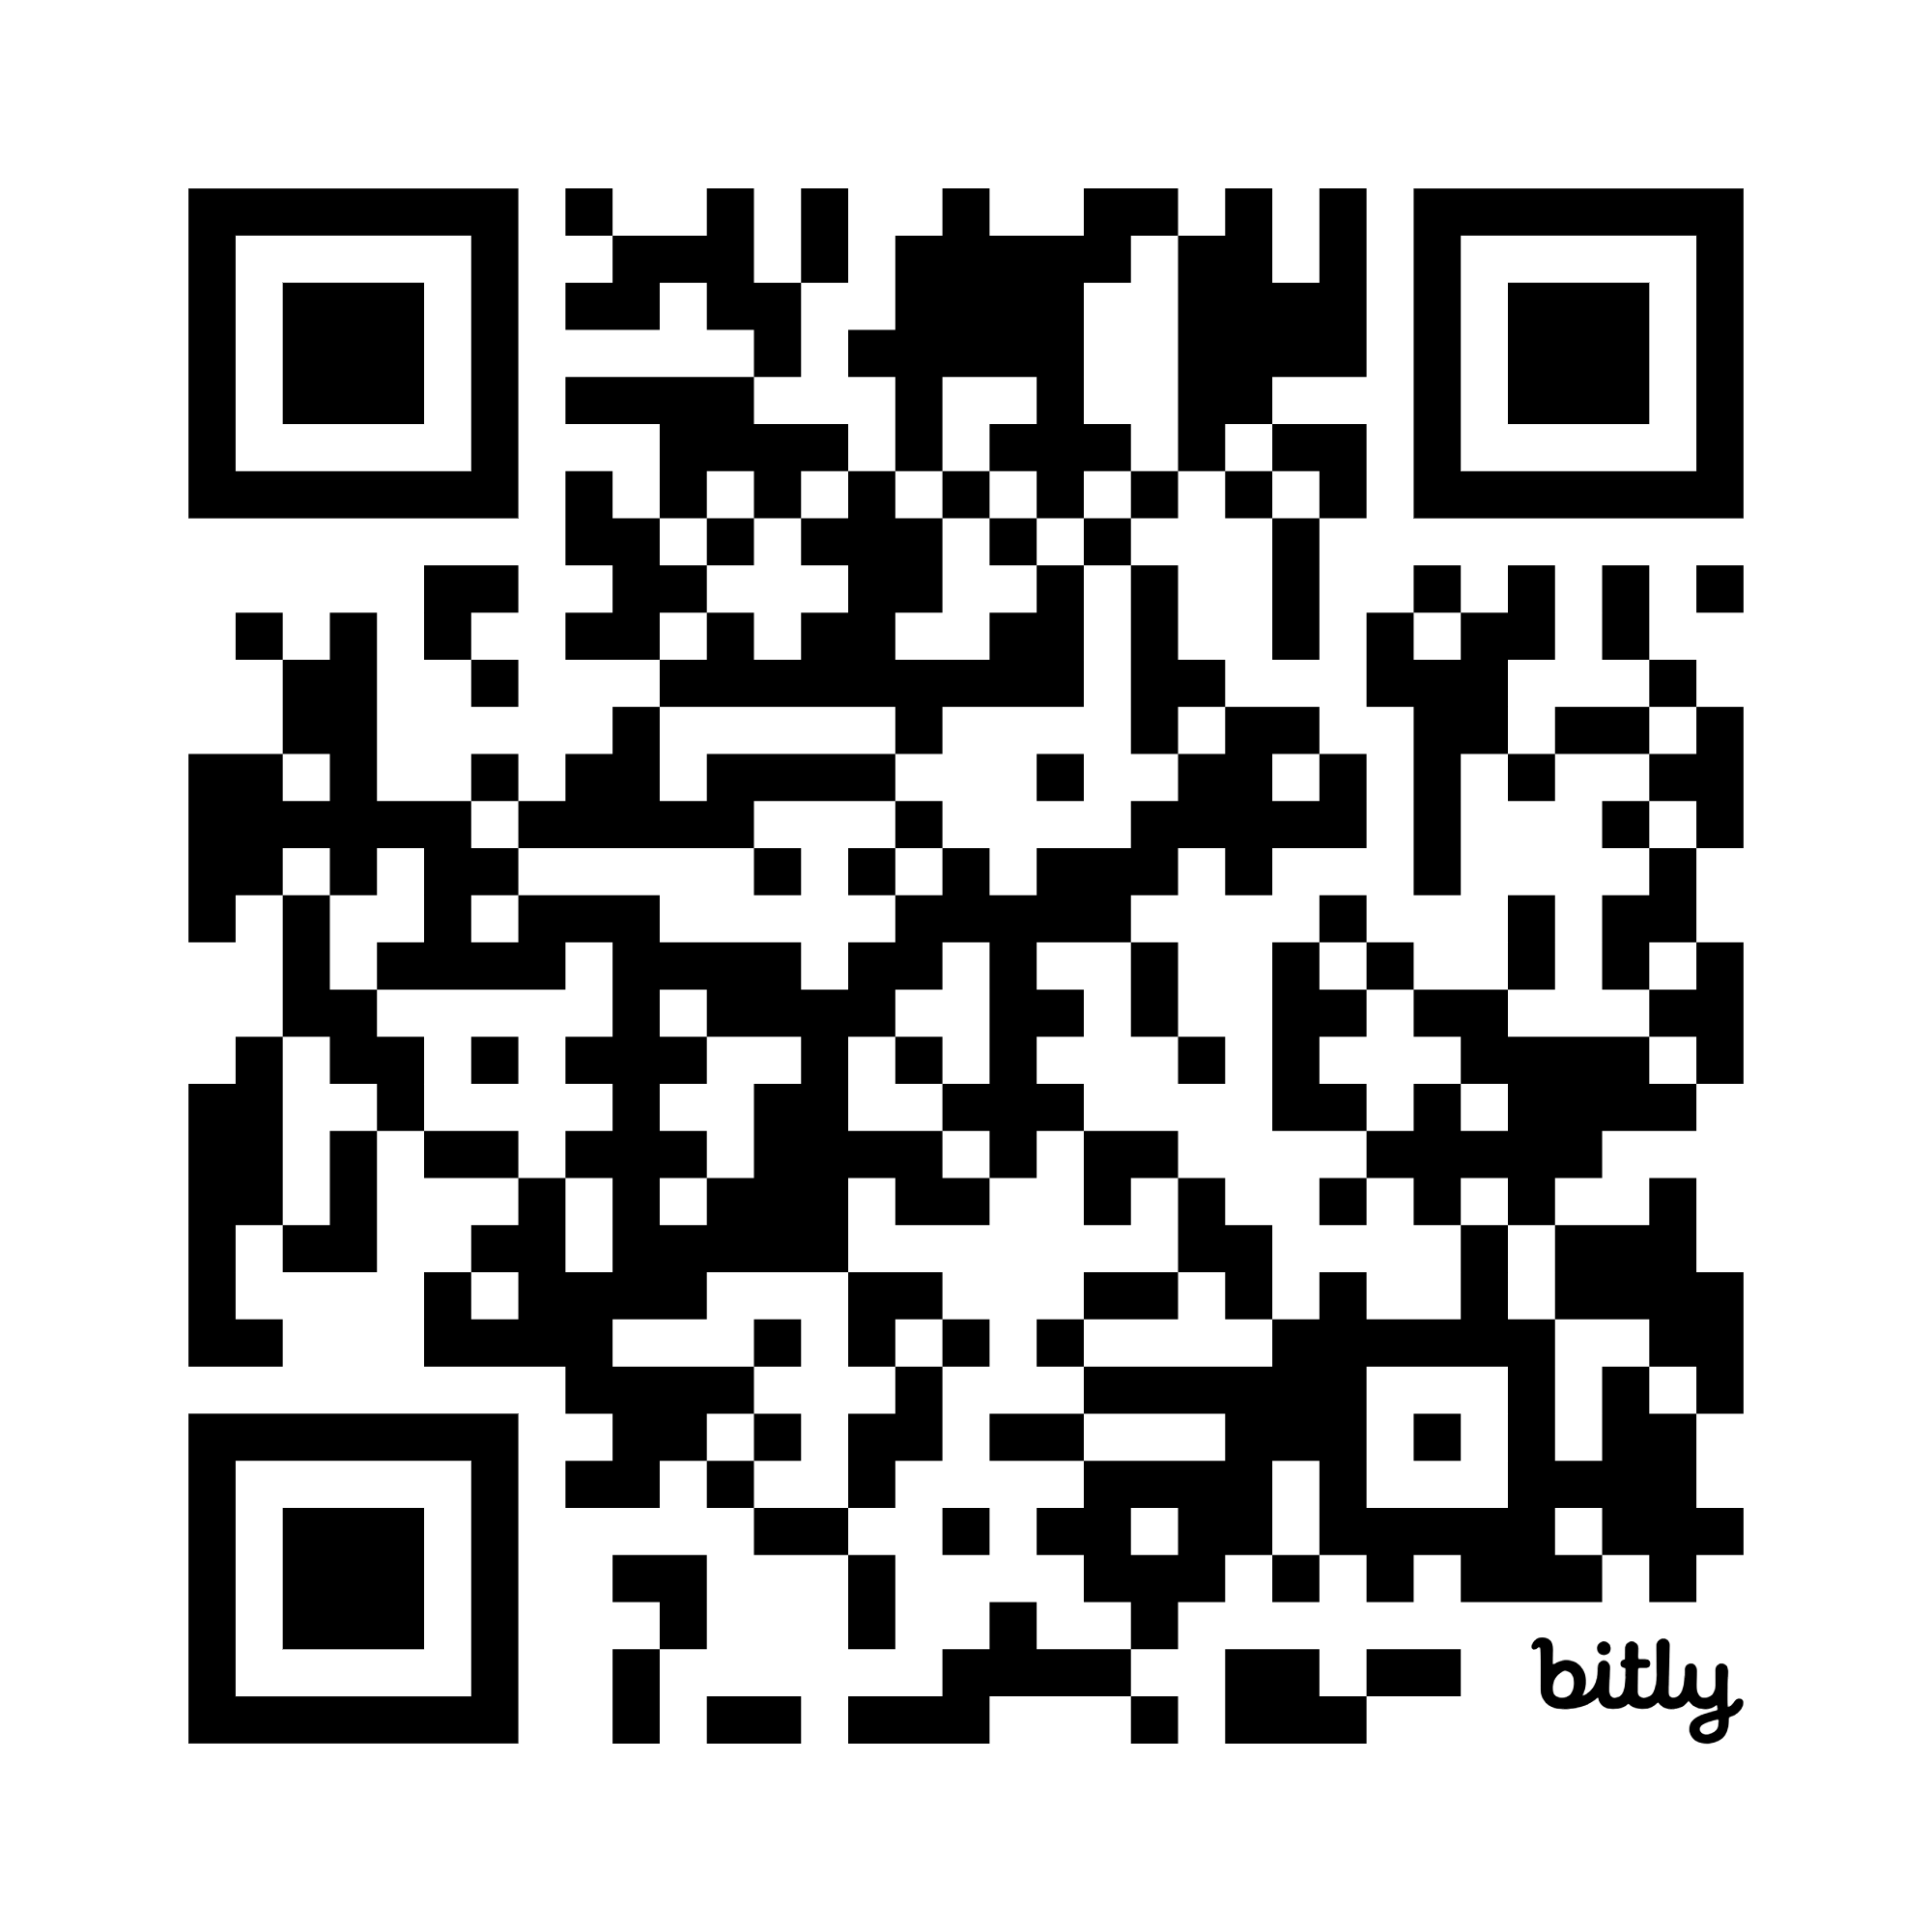
Resources Order Only What You Need – Community Pharmacy Leicestershire and Rutland
https://leicesterleicestershireandrutland.icb.nhs.uk/medicines-waste/

Slide 7
Campaign Promotion
Web page on CPL&R ICB website for pharmacies, general practice and partners to link to:
  Cross marketing on other relevant ICB web pages
  Promotion on home page
  SEO and AEO
Promote on CPL&R / ICB social media accounts
  Facebook
  X
  Instagram
  LinkedIn
  Whatsapp
Youtube video
Practice toolkit – website copy, text messages, social media, NHS App, waiting room screens
Pharmacies
  Posters

Slide 8
What do CPs need to do
Each CP must complete 4 actions in order to qualify and be eligible for £100 voucher over the 8 week period (16th June -4th Aug 2025)
Display poster (and other resources e.g. leaflets in the Pharmacy) with a QR code that allows patients to access further info
Third party ordering -The Community Pharmacy Team to stop ordering repeat prescriptions on behalf of patients (with exception for patients who have a genuine need for orders to be made on their behalf).
3. NHS App –confidently signpost patients to use the NHS App for ordering repeat medicines.
4. Community Pharmacy staff automatically advise patients how many items are in the bag and check to see if that was what the patient was expecting. This may prompt patients to check their medication before they leave the pharmacy “Open the Bag” or at least reduce the need for patients to contact the pharmacy again about missing or not having enough medication

Slide 9

Declaration of Completion
After the 4th August each CP will need to submit their declaration via the CPL& R website
Order Only What You Need – Community Pharmacy Leicestershire and Rutland
This has to be completed before 31st August
Voucher Express
Enter email address
This email address will be the email address that your voucher will be emailed to.

Slide 10
What do you need to do
Please promote to your patients 16th June -4th August
Toolkit will be available to download here by 12 June:
Order Only What You Need – Community Pharmacy Leicestershire and Rutland
There are 3 steps
Display poster in your pharmacy for the entire campaign duration
Support NHS App usage
Check your bag
Post campaign complete your declaration of completion before 31st August 2025.

Slide 11
Questions

