Slide 1

Pharmacy Contraception Service Workshop
WIFI: Hilton Honors WIFI
Password: Welcome25
Notes:
Register your cars

Slide 2
Agenda
Overview of the Pharmacy Contraception Service
Understanding the Upcoming Service Changes
Guest Speaker: Anthony Singh (Lead Clinical Pharmacist) – Delivering High-Quality Contraception Consultations
Guest Speaker: Nadya Jethwa (Lead Clinical Pharmacist and Pharmacy Contractor): Creating a Service-Driven Pharmacy: Culture, Systems and Success
Supporting Implementation and Ongoing Professional Development
Q&A and feedback
This event is sponsored by Exeltis.
The agenda has been developed independently.
Notes:
Show of hands for who has attended any webinars?
Show of hands of any technicians

Slide 3

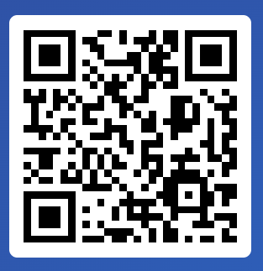
Slido
WIFI: Hilton Honors WIFI
Password: Welcome25
www.slido.com
Code: #1246421

Slide 4
Overview of the Pharmacy Contraception Service

Slide 5

Background and Service Objectives
Following negotiations for the CPCF, an expansion of the Pharmacy Contraception Service (PCS) was agreed to include oral emergency contraception (EC)
Provisional date: Wednesday 29th October 2025
  Delivery plan for recovering access to primary care (May 2023)
    The service improves access, making it more convenient for patients and reduces demand on other healthcare settings.
  The Women’s Health Strategy for England (Aug 2022)
    The governments 10-year strategy to improve health outcomes, tackle health inequalities and enhance overall wellbeing.
  Community Pharmacy has been providing EC for around 25 years
Notes:
The PCS expansion is a result of the CPCF negotiations. We’ve been advised that from Wednesday 29th October (subject to changes to the clinical IT systems being on schedule) the expanded service will go live. I will give you an insight into what the changes are a little later but first let's get a better understanding on why we deliver PCS and reasons for expansion.
The Community Pharmacy Contraception Service and its expansion aligns with the Delivery Plan for recovering access to primary care which aims to increase access and convenience to contraception through pharmacies for millions of patients, whilst reducing pressure on other healthcare settings.
As well as the women’s strategy for England which is the first of its kind. A 10yr strategy to improve health outcomes, tackle health inequalities and enhance overall wellbeing.
And may I use this opportunity to remind you all that you have all at some point in your career if not on a weekly basis have delivered an emergency contraceptive pill service as it has been a locally commissioned service for around 25 years nationwide. This national model allows community pharmacy to be at the front and centre in providing individuals with greater choice and access

Slide 6
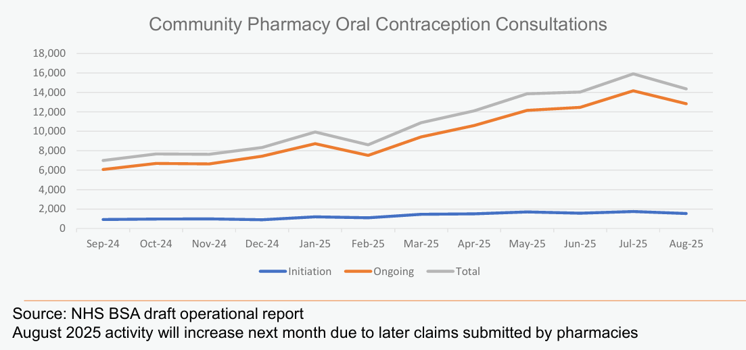
Service Delivery Data
LLR is ranking 4th place within Midlands

Slide 7
Understanding the Upcoming Changes

Slide 8
Key Changes
Service changes apply from 29th October 2025
Service will be expanded to include EC
Addition of drospirenone to the Progesterone Only Pill PGD to enable the supply of this medicine
Can be provided by trained and competent pharmacy technicians
All consultations must be verbal and provided from the pharmacy premises, directly with the person accessing the service, and for whom the medication is for
The need to provide additional support and advice, including advice on the avoidance of pregnancy and sexually transmitted infections (STIs)
Greater emphasis on recording information, particularly related to any safeguarding actions and any chaperone details
A requirement to check the individual’s GP record during all consultations
Change in minimum quantity of OC for ongoing supplies
Increased item of service fees
Notes:
Service will be expanded to include EC and is covered by two new PGDS – Ulipristal and Levonorgestrel. Please read these PGDs as it also includes off-label use
Addition of drosperienone to the POP PGD which is licensed from menarche upto and including 49yrs. All other POPs can continue to be provided upto and including 54 yrs.
Going forward pharmacy technicians can deliver the service, which supports greater use of skill mix
Minimum of 6 months supply for ongoing supply. If a lesser amount is supplied you are expected to document your clinical reason.
Service fees – Supply of OC is £25 which was increased in April and oral EC will be £20 per consultation

Slide 9
EHC
LNG
Presentation between 0 and 96 hours of UPSI or compromised OC
UPA
Presentation between 0 and 120 hours of UPSI or compromised OC
Must provide same medication for all repeat doses
If the individual has not reached menarche consider onward referral for further assessment
If a Cu-IUD is appropriate and acceptable, supply oral EC and refer to appropriate health service provider
Leicester City decommissioning EHC on 29th October with a 3-month grace period.
Notes:
EHC – some key points but for more details refer to the CPE website which I have linked at the end of this presentation and the respective PGDs
Repeat doses: within 7 days for LNG and 5 days for UPA

Slide 10
Supporting Implementation and Ongoing Professional Development

Slide 11
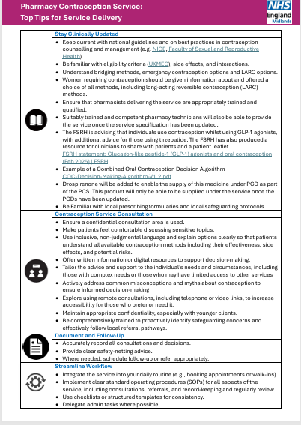
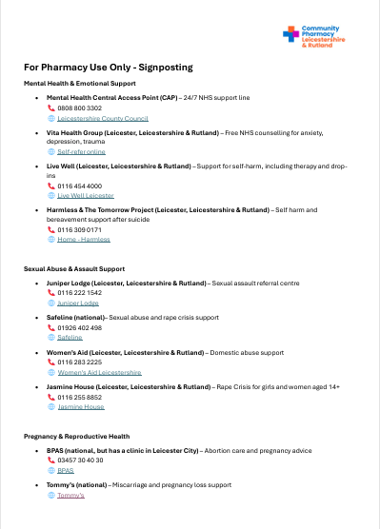

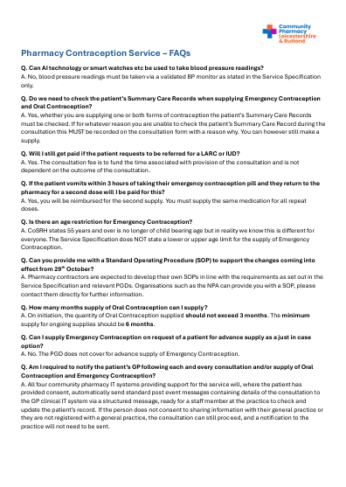
Competency & Training
Read all the information provided in the Resource Pack:
  Service Spec, PGDs, Summary of Changes, Top Tips, Signposting, FAQs, Formulary and Appointment Cards - Pharmacy Contraception Service-Overview & Local Support
CPE website: Pharmacy Contraception Service (PCS) - Community Pharmacy England

Slide 12
Next Steps
Currently registered and wish to continue (including EC)? NO action required
Currently registered but do not wish to deliver EC? De-register via the NHSBSA’s MYS portal before 29th October
  De-registering from the service after 31st August 2025 will make you unable to fulfil the gateway criteria for the Pharmacy Quality Scheme 2025/26, and consequently any Aspiration payments you have already received will be re-claimed at a future date. In addition, to receive the Pharmacy First Clinical Pathways monthly payment from June 2025, pharmacies need to be signed up to provide both the Hypertension Case-Finding Service and PCS.
Take aways
  Read Service Spec and PGDs
  Maximising service delivery – time allocation and engaging the whole pharmacy team
  The role of pharmacy technicians
  Initial conversation with your surgery
Notes:
Ask your surgery to refer patients to pharmacy for ongoing supplies, remove OC from repeat prescription, in return support GPs with QOF by sharing BP and weight measurements via notes section.

Slide 13
Q&A

