Slide 1
Train the Trainer - Community Pharmacists Information Webinar
Tuesday 10th March 2026

Slide 2

Breast Cancer Now
We're here to make sure that by 2050, everyone diagnosed with breast cancer lives and is supported to live well.
Fund world-class research
Provide life-changing support
Lead dedicated campaigns
Our Train the Trainer pilot is delivered by the Public Health, Inclusion and Awareness team
Improve awareness and promote early detection of breast cancer
A woman is diagnosed with breast cancer every 9 minutes and a man every day. That's around 55,000 women and 400 men each year

Slide 3


Aims of the pilot
Train healthcare and allied healthcare professionals to promote breast awareness, breast screening and risk reduction messages
Trainees will then have the confidence, knowledge and resources to share these key messages with their community

Slide 4
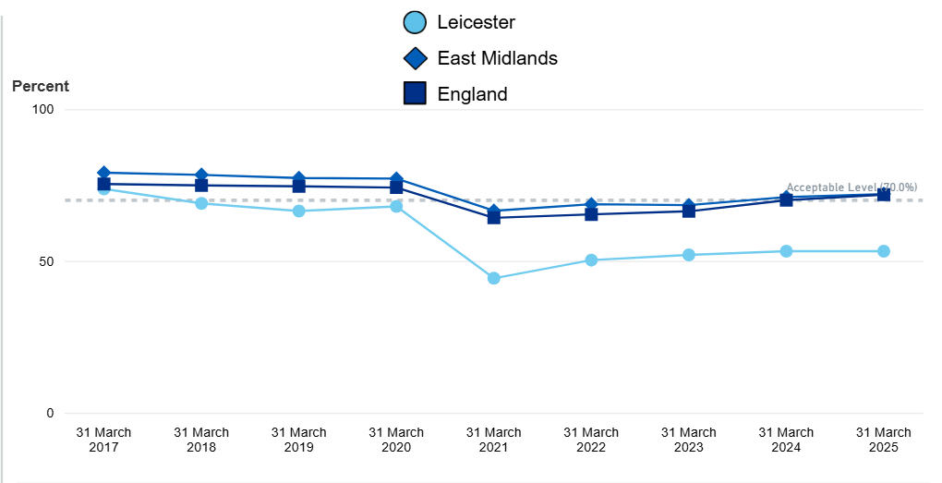
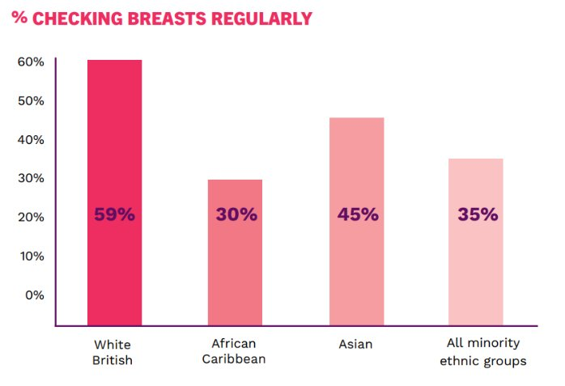
Why Leicester?
Breast Screening Coverage
Diverse Ethnic Communities
In 2024/25, breast cancer screening coverage in Leicester was 53.2%
Less likely to check their breasts, less aware of signs and symptoms and less likely to attend screening = more likely to be diagnosed at a later stage

Slide 5
How is training delivered?
Self-directed eLearning
Online Workshop
Both delivery methods are interactive and engaging and cover…
What is breast cancer?
Breast awareness, early detection and signs and symptoms
Risk factors and myths
The NHS breast screening programme
Developing an action plan

Slide 6

Learning outcomes of training
Trainees will...
Have increased understanding and knowledge on breast awareness, early detection and risk reduction messages
Be equipped with the knowledge, skills and resources to deliver crucial health messages in their communities
To encourage...
Breast awareness
Confidence to check and report new and unusual changes to GPs
Attendance to routine NHS breast screening services

Slide 7

What are the benefits?
Access to an online learning hub and educational webinars
Physical and digital resources to support community engagement
Ongoing support from the Breast Cancer Now team
Access to a small grant fund to support local activity
Opportunities to attend further events to develop knowledge, skills, engage with other trainees and share best practice
Breast Cancer Now certificate of completion

Slide 8


Why Community Pharmacists?
Trusted
In the heart of neighbourhoods and communities
Accessible
Growing role to play in prevention (and NHS 10-year plans)
High levels of trust

Slide 9

Other details
Training is being offered until July 2026
Ongoing follow up support available until July 2027
After training, we ask that:
Trainees aim to engage with people in their communities regularly in a way that suits them
Support the evaluation of the pilot by completing short surveys

Slide 10
Any Questions?
You can also email the team at: trainthetrainer@breastcancernow.org

