Slide 1
Maximising Service Delivery Income
Paul Gilbert – Community Pharmacy Clinical Lead
LLR ICB

Slide 2
The Importance or Service Delivery
The ICB want community pharmacy to maximise their service income through providing high quality, consistent services in line with the service specifications.
We want you to claim for what you have done
I NEED you to claim for what you do
Service Specification
Service Specification
Service Specification

Slide 3
Overclaiming Myth
Perception
‘Pharmacies claim for everything they do’
‘Pharmacies won’t do anything without funding’
‘Pharmacies sometimes don’t provide the service at the required standard’
‘Pharmacies claim for services they haven’t done’
Reality
Many pharmacies are terrible at claiming for the service work they do and often do significant unfunded work
It is rare that pharmacies claim for services they haven’t done
Pharmacies sometimes don’t provide the service at the required standard
Pharmacies often miss opportunities to delivery services
Service Specification
Service Specification
Service Specification

Slide 4
Operationalising in the pharmacy
Myth
Everyone knows the service specifications inside out
I wish! Rajshri and I don’t know them inside out, they’re lengthy and complex at times
But…….
Service Specification
Service Specification
Service Specification
Do your best to know them

Slide 5
The IT issue
Make sure you are using properly
Check your inbox regularly
Enter records contemporaneously, can you use ambient voice technology?
Understand what goes through MYS automatically and what doesn’t
The whole team

Slide 6
Pharmacy First
R + P = C
Referral + patient = claim

Slide 7
Myths
Myths I have come across
You have to supply to claim X
Know your gateway points
They’re better now X
R + P = C
…a referral is completed when… the patient is contacted and the patient refuses to undergo a full consultation but receives safety-netting advice.
R + P = C

Slide 8
Myths Continued
The patient is so ill I sent them to the emergency department so I can’t claim X
Know your service specification
…a referral is completed when…the pharmacist makes the decision that the presenting condition is not minor in nature and the patient is referred onwards
Some patients do not attend
Follow them up
Service Specification
Service Specification
Service Specification

Slide 9
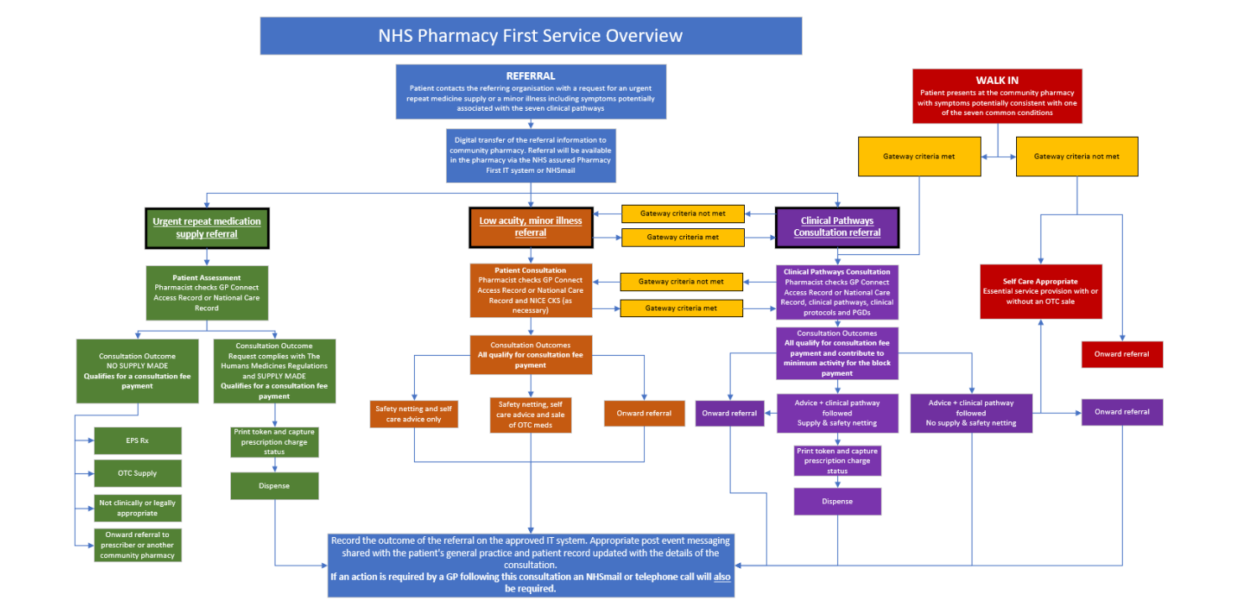

Slide 10
Hypertension Case Finding
Everyone that delivers it need to know exactly how to ‘sell’ and arrange eligible patients for ABPM
Follow-up your DNAs
What are your local opportunities for off-site clinics
  Events with high footfall of 40 – 65 years olds

Slide 11
Discharge Medicines Service
Accept them
Rejections should be rare
If you don’t know the patient, contact them to check they are happy for you to perform the service, and if they are progress to stage 1. They may not have had medicines before, or decided to change pharmacy while in hospital.
Residents in care homes benefit from DMS and should be routinely accepted. If the patient is new to the home and your pharmacy, they can still receive DMS. In line with the service specification, contact can be had with a carer rather than the patient where appropriate.

Slide 12
DMS Continued
Step 1 valid to complete and claim at step 1 even if it is identified they are deceased at step 1
Make sure you claim on MYS (no integrated link with PharmOutcomes)

Slide 13
General Points
Hyper local marketing – does everyone local to you know what you offer
Curate that relationship with local GPs, but there is no magic button and actions are better than words
Work together locally, a rising tide raises all boats
If you can’t deliver it find them another pharmacy that can, keep them in community pharmacy

